Slide 1
Antibiotic Use in Animal Health
Understanding FDA final VFD ruling

Slide 2
Consumer Attitudes
Antibiotic use is a public health issue
Important for animal agriculture to:
  Be proactive & take a leading role
  Maintain confidence in food supply
  Build consumer trust
Consumer attitudes*
48%
71%
53%
Feel uncomfortable
about antibiotic use in animal production
Have “serious or
some concerns” about conventional methods
Frequently wonder
if the food they buy
is safe
* Source: ml&p research for USFRA, 10/11, n=1,400.

Slide 3
Consumer Attitudes
You say
They hear
We use antibiotics to be more efficient
Because you only care about making money
We use antibiotics to keep animals healthy
You HAVE to use antibiotics because animals are kept in poor conditions
Regulatory agency reviews have approved antibiotics as safe after rigorous review process
We don’t know if it’s safe for the long term. They’ve been wrong before.
There are rules that dictate maximum residue limits allowed in animals
How can we be sure ANY residue is safe?
There is no evidence that use of antibiotics in animals causes resistance in humans
Yeah, right. We’re using so many, that has to be part of the reason.

Slide 4

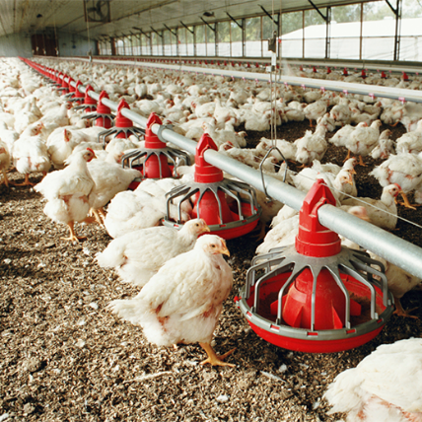
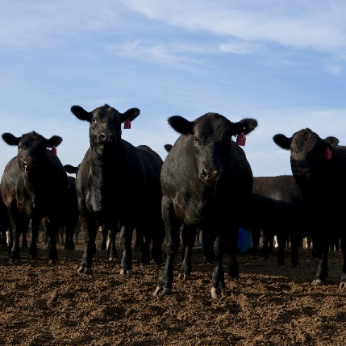
Access to Antibiotics
A public health issue
Antibiotic resistance vs. antibiotic residues
Access to effective antibiotics:
Critical for public health
Vital for livestock & poultry production
Essential for animal well-being

Slide 5

Access to Antibiotics
U.S. Food and Drug Administration:
  Concerned overuse in animals may reduce effectiveness in humans
  Is making important changes to antibiotic use in animals
  Goal is to promote judicious use of antibiotics, protect public health, and help curb the development of antimicrobial resistance

Slide 6
Antimicrobial Use in CA Livestock
August 2017
Antimicrobial Use and Stewardship
California Department of Food and Agriculture
Notes:
This slide set was last Updated August 2017

Slide 7
Relevant Terms
Antimicrobial Resistance
  When the drug used to kill the bacteria causing infection no longer works
Medically Important Antimicrobial Drug (MIAD)
  Those identified by the FDA as significant to human health
Guidance For Industry (GFI)
  Federal Documents published by the FDA Center for Veterinary Medicine (GFI 209, 213, 152 specifically address antibiotic use in livestock feed and water)
SB 27
  Senate Bill 27(Hill) was signed into California law in 2015,
  effective Jan 1st, 2018
Livestock
  “All animals and poultry, including aquatic and amphibian species, that are raised, kept, or used for profit. Livestock does not include bees or those species that are usually kept as pets, such as dogs, cats, and pet birds.” –as defined directly from Food and Agriculture Code
Notes:
SB 27 = (Hill) author Senator Hill
Livestock = if there are questions on this, you can direct them to the website. We should have some clarity on this in a few weeks.
For the purposes of the PowerPoint, antimicrobial = antibiotic

Slide 8
Review of National Regulations
Veterinary Feed Directive (VFD) for MIADs in Livestock Feed
  A written statement issued by a licensed veterinarian (in the State where it is used) for the use of VFD drugs or combination VFD drugs in or on feed.
Limitations on Use
  Must be used according to the label (no extra-label use)
  Only for treatment, control or prevention of disease
  (not for growth promotion)
Requirements
  Valid Veterinarian-Client-Patient Relationship (VCPR)
  New VFD if feeding continues beyond expiration of VFD document
  All parties, including the client and the veterinarian, must maintain a copy of
  the VFD for a minimum of 2 years
Medications in Water → Require Prescription (not a VFD)
Notes:
Went into effect Jan 2017.
A combination VFD drug is a VFD with an approved combination of drugs where at least one is a MIAD.
Off-label is the colloquial term, but extra-label is the technical term.
VCPR will be reference on a later slide.
Water drugs require a prescription, but is still a Federal law.

Slide 9
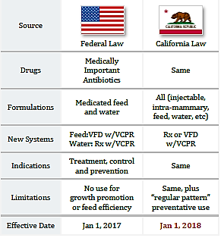
How Is CA Different?
Notes:
This table is comparative between the two laws, with both columns are referencing medically important drug laws.

Slide 10

Livestock: Use of Antimicrobial Drugs
CA Law for all MIADs in Livestock
  Effective Jan. 1st, 2018, over-the-counter injectable and all other forms of MIADs must be given with a prescription or VFD ordered by a California licensed veterinarian.
Limitations of Use
  Permitted when deemed necessary by a CA-licensed veterinarian
  Only for treatment, control or, in some cases, prevention of disease
  (not for growth promotion)
  “Regular Pattern” Preventative Use
    MIADs may not be administered solely based on age, weight, season,
    or life stage event without further justification by a licensed
    veterinarian within a valid veterinarian-client-patient relationship
Requirements
  Valid VCPR
  Prescription or VFD
Notes:
Regular pattern use → cannot use MIADs just because “it’s the way things have been working for the past 50 years.” A veterinarian needs to justify that the treatment is medically indicated.

Slide 11


Veterinary Oversight
Veterinarian-Client-Patient Relationship (VCPR)
  Veterinarian assumed responsibility
    Communicated with client
  Client authorized
  Knowledge of animal(s)
    Examination of patient OR
    Medically appropriate and timely visits
As defined by the California
Notes:
16 CCR § 2032.1 Veterinarian-Client-Patient Relationship.
(a) It is unprofessional conduct for a veterinarian to administer, prescribe, dispense or furnish a drug, medicine, appliance, or treatment of whatever nature for the prevention, cure, or relief of a wound, fracture or bodily injury or disease of an animal without having first established a veterinarian-client-patient relationship with the animal patient or patients and the client, except where the patient is a wild animal or the owner is unknown.
(b) A veterinarian-client-patient relationship shall be established by the following:
(1) The client has authorized the veterinarian to assume responsibility for making medical judgments regarding the health of the animal, including the need for medical treatment,
(2) The veterinarian has sufficient knowledge of the animal(s) to initiate at least a general or preliminary diagnosis of the medical condition of the animal(s). This means that the veterinarian is personally acquainted with the care of the animal(s) by virtue of an examination of the animal or by medically appropriate and timely visits to the premises where the animals are kept, and
(3) The veterinarian has assumed responsibility for making medical judgments regarding the health of the animal and has communicated with the client a course of treatment appropriate to the circumstance.
(c) A drug shall not be prescribed for a duration inconsistent with the medical condition of the animal(s) or type of drug prescribed. The veterinarian shall not prescribe a drug for a duration longer than one year from the date the veterinarian examined the animal(s) and prescribed the drug.
(d) As used herein, “drug” shall mean any controlled substance, as defined by Section 4021 of Business and Professions code, and any dangerous drug, as defined by Section 4022 of Business and Professions code.

Slide 12
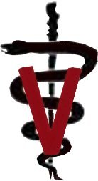
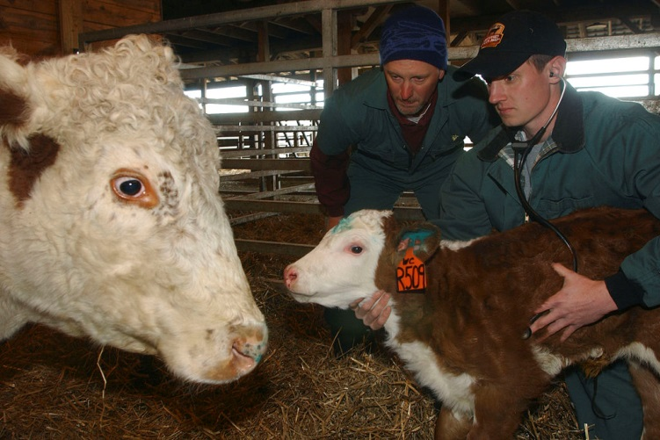
Veterinary Shortage
Timely Access to Veterinary Care
  Identify ‘rural’ areas with a deficit of livestock veterinarians
Proposed solutions
  Feed Stores can continue to sell antibiotics
  Treatment protocols
    Reviewed as needed or annually within a valid VCPR
    Standing prescriptions
  Provide supplemental education for veterinarians
    Livestock handling
    Herd Health (Preventative Medicine)
    Common diseases
Notes:
The law requires that the CDFA address the veterinary shortage and ensure that livestock producers have timely access to veterinary care.
Feed stores will continue to sell antibiotics if they are already doing so and those antibiotics remain OTC under federal legend. A producer will need to present a prescription in order to purchase the drug from the feed store.

Slide 13
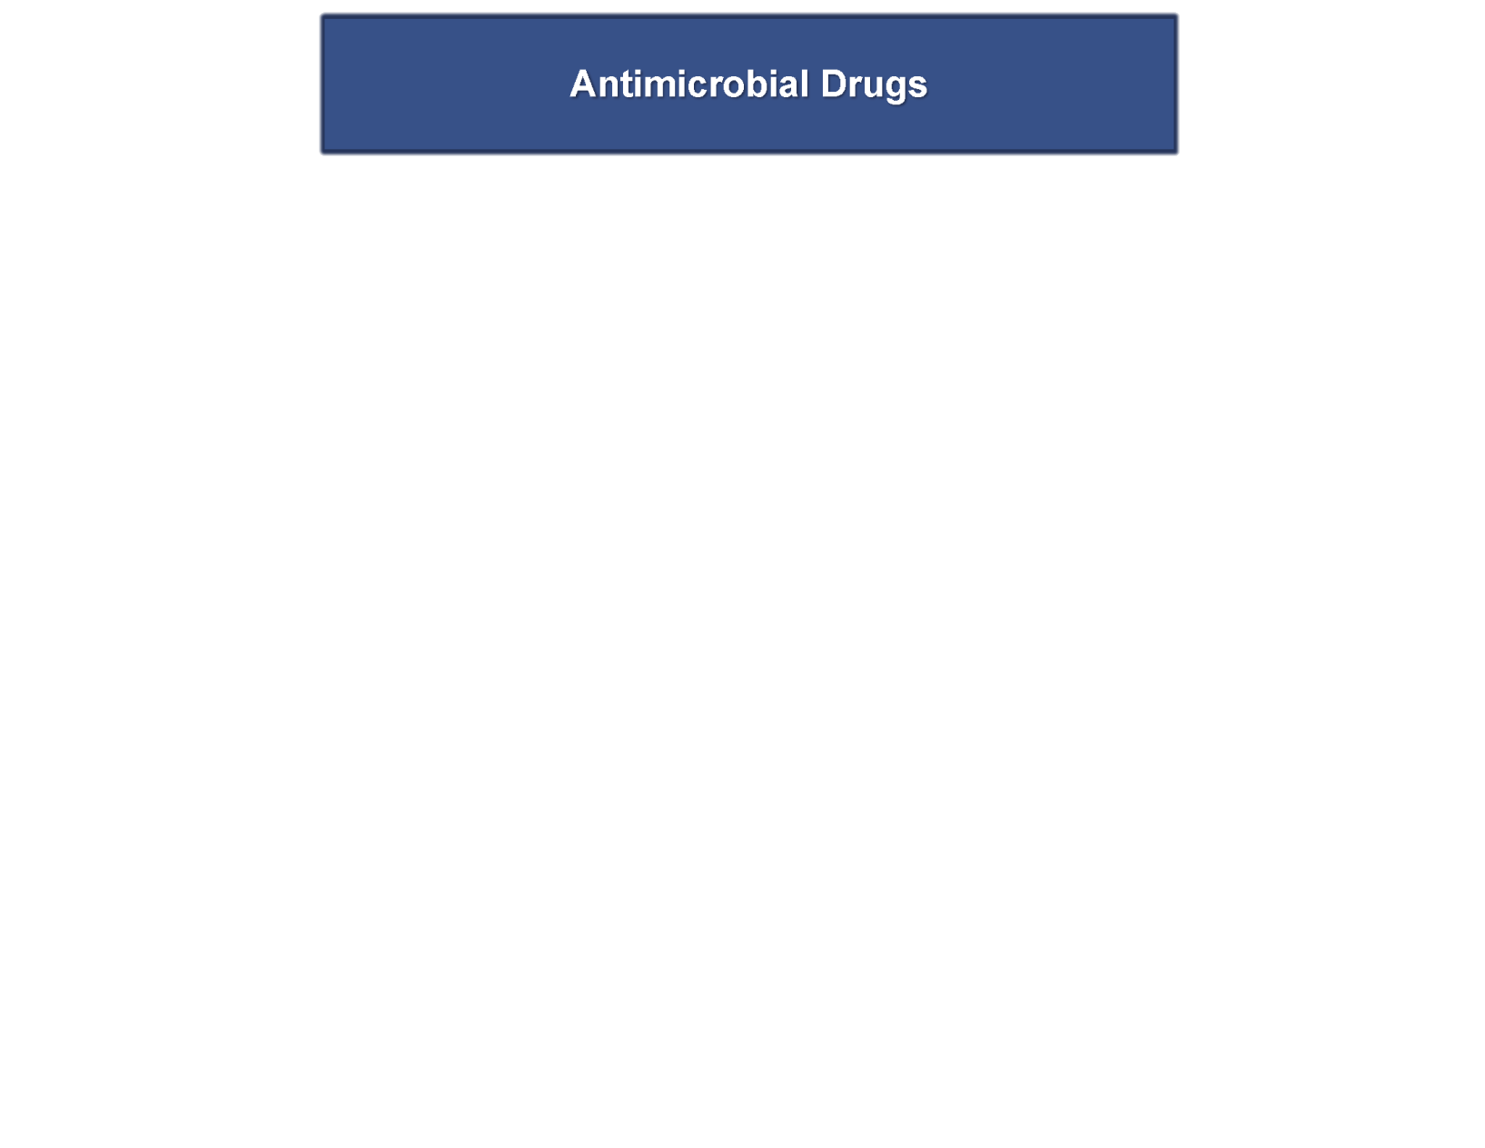
Need to use a livestock drug?
Notes:
You need to use a drug. Is it an antibiotic? If you are unsure, call your veterinarian.

Slide 14
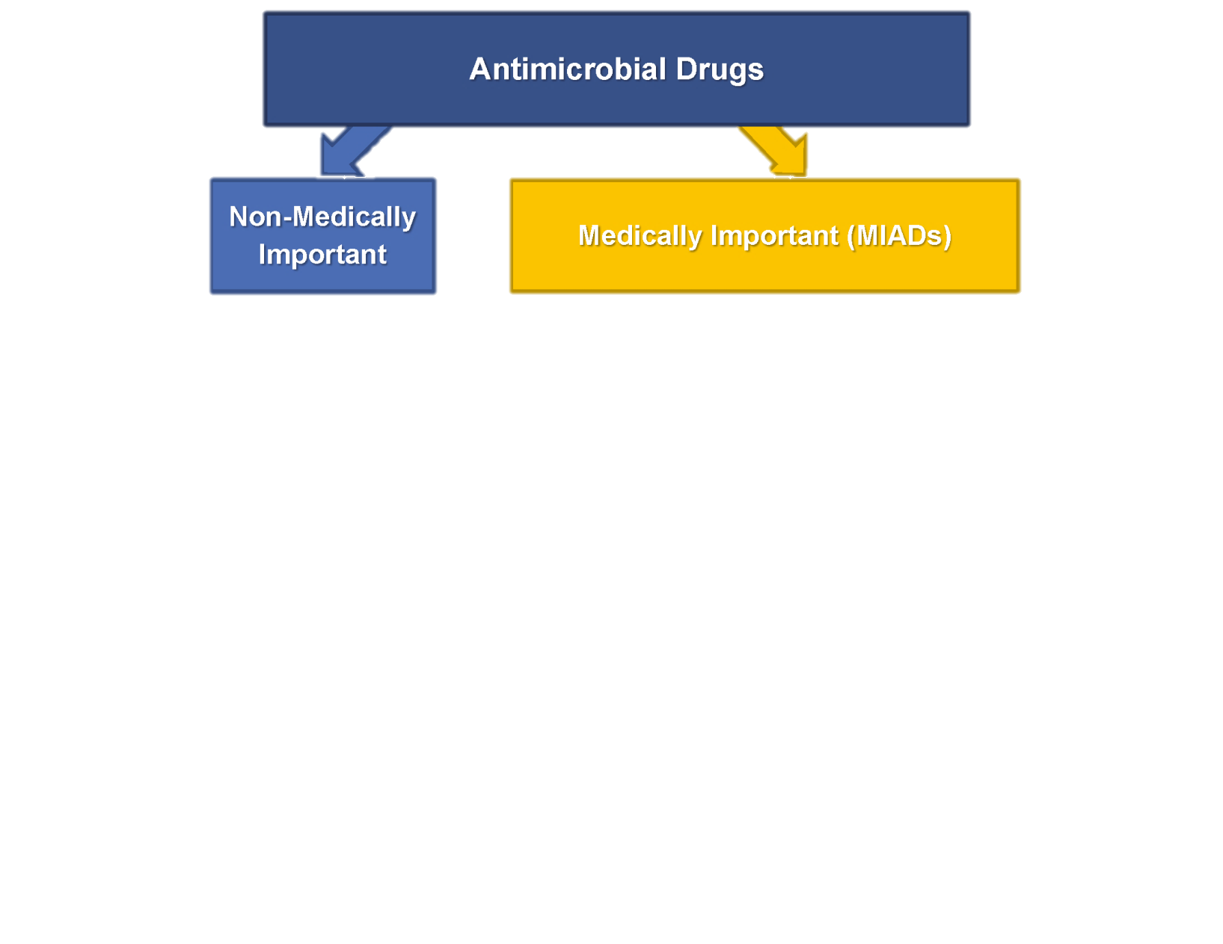
MIADs?
Notes:
Is the antibiotic you want to use a MIAD? Unsure, call your veterinarian.

Slide 15
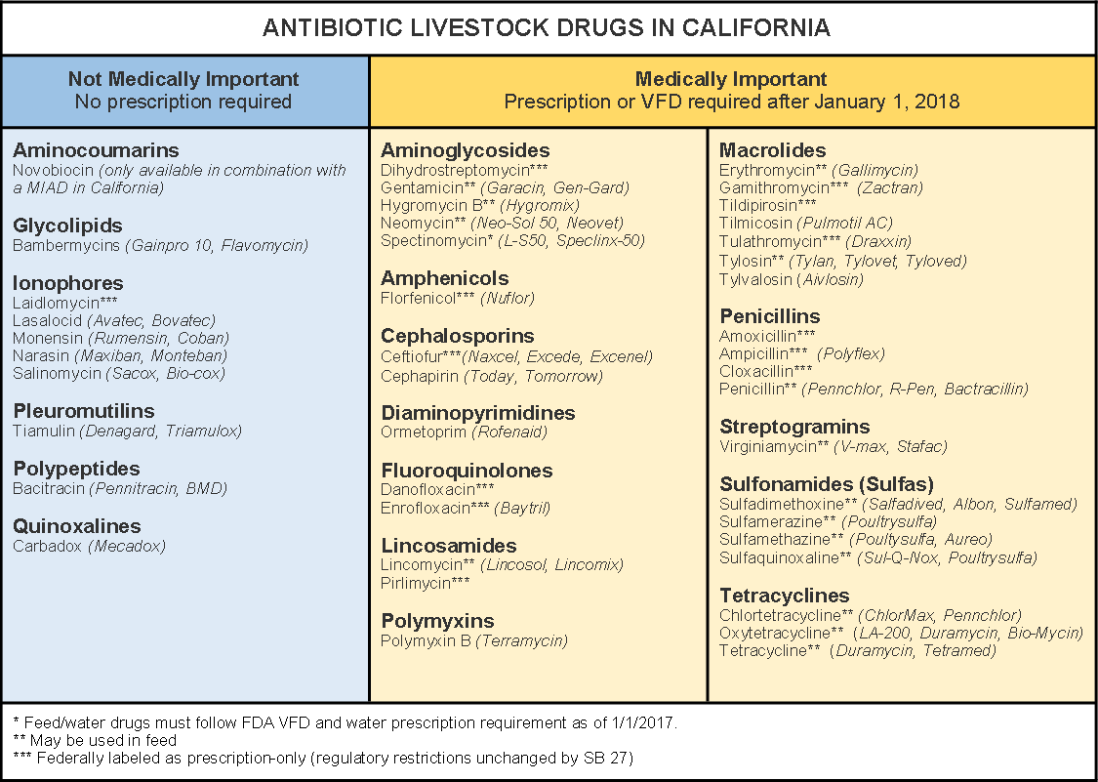
Medically Important Antibioitc Drugs
Notes:
This chart is available on the Drug_Chart handout on the website.

Slide 16
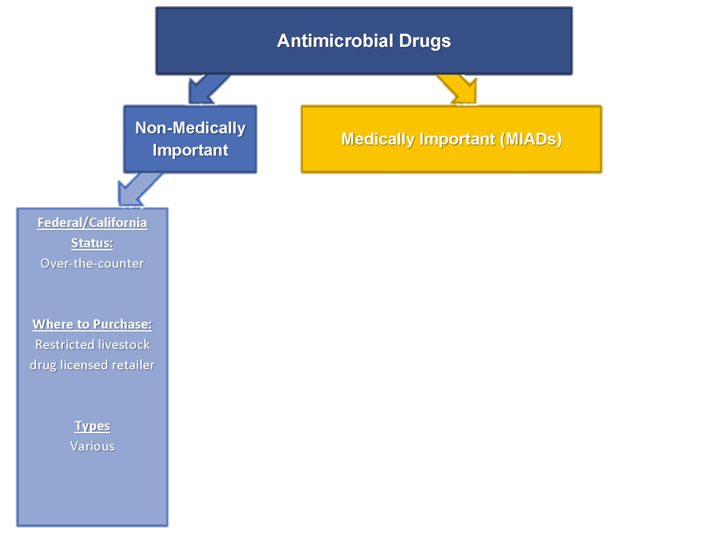
What’s the confusion?
Notes:
The bottom blue box refers to non-medically important antimicrobial drugs, which are available over-the-counter both federally and in California. This is not changing and no VCPR is required. The labeled directions must be followed.

Slide 17
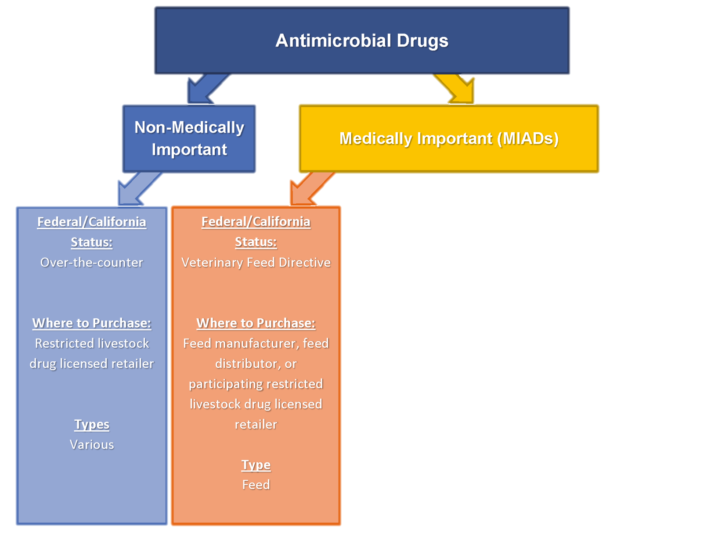
What’s the confusion?
Notes:
The second orange box refers to MIADs administered in livestock feed. This a Federal law (that applies to California as well). This is in place from January 1, 2017.

Slide 18
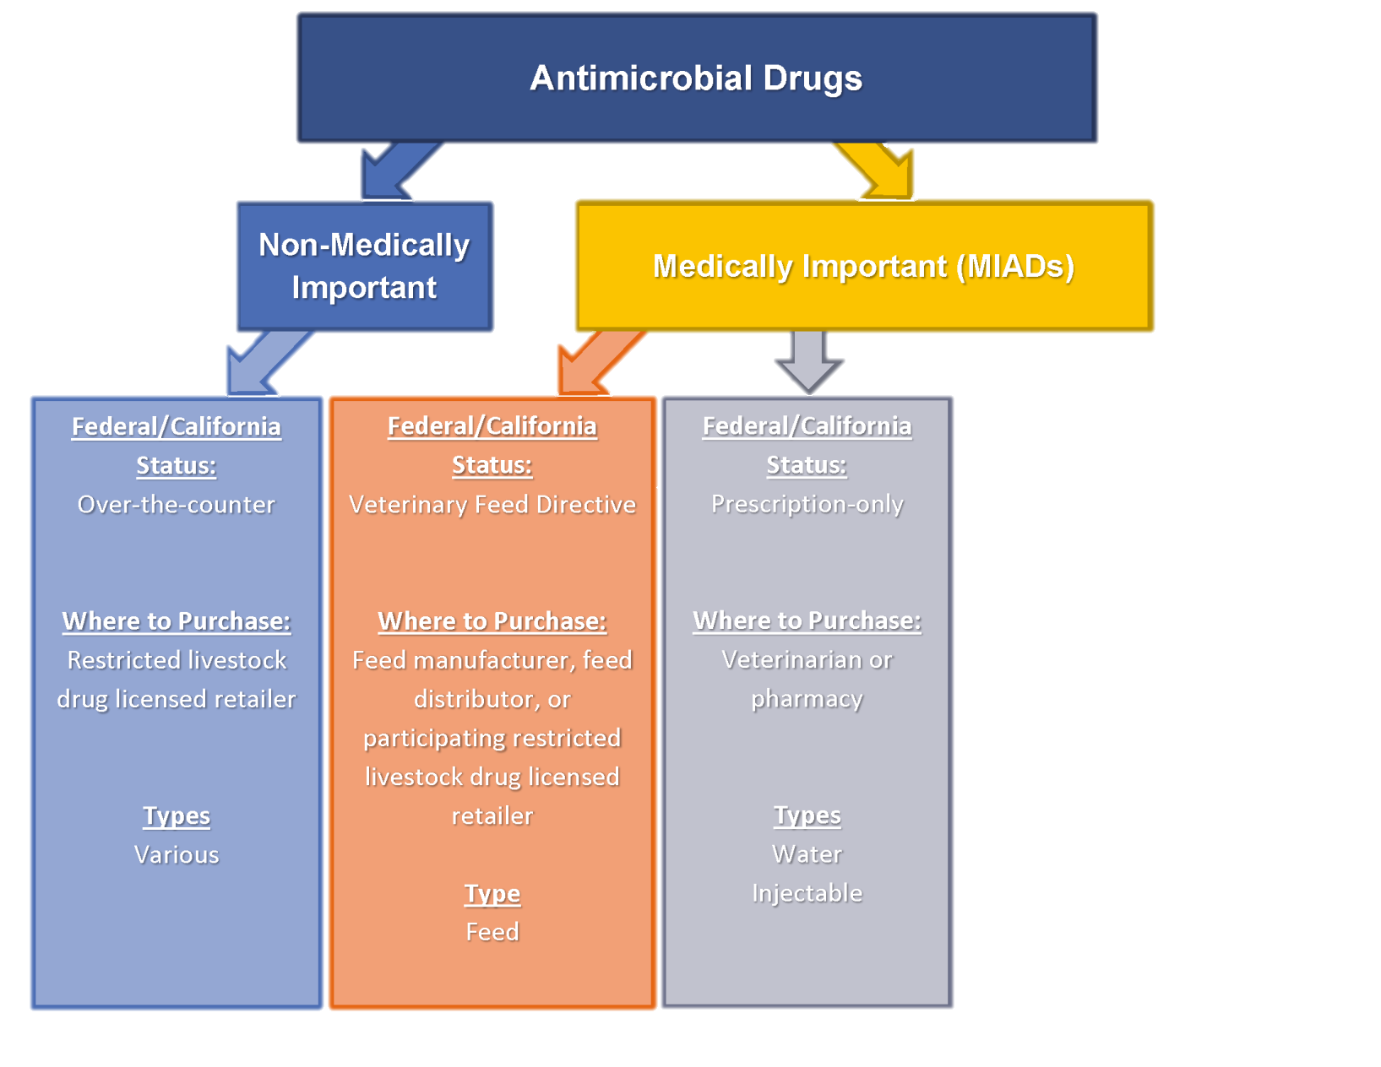
What’s the confusion?
Notes:
This third gray box illustrates that for MIADs under Federal legend, they cannot be sold anywhere but through a veterinarian or pharmacy. This is not changing.
(Examples include Nuflor, Draxxin, Naxcel or Excede)

Slide 19
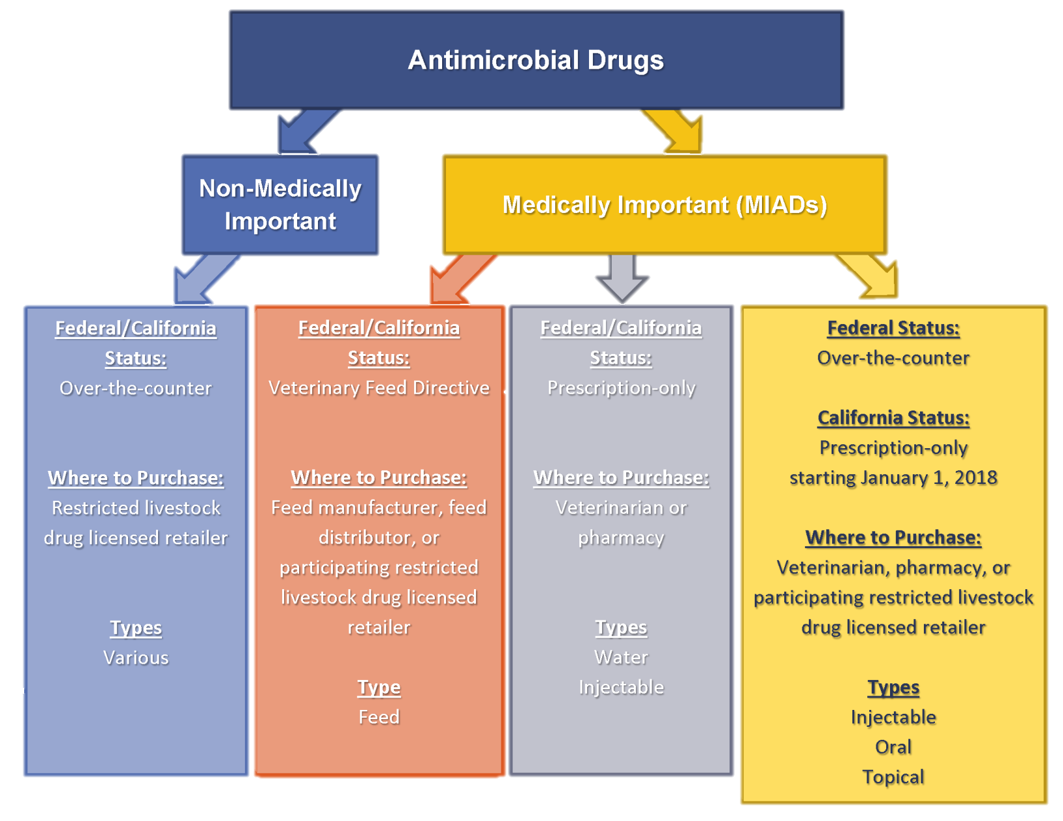
What’s the confusion?
Notes:
Yellow is MIAD that is changing status from Federal over-the-counter to California, to prescription-only with a valid VCPR as of January 1, 2018. With a prescription, a producer can buy either directly from a veterinarian, pharmacy, or from a participating CA licensed feed store.

Slide 20
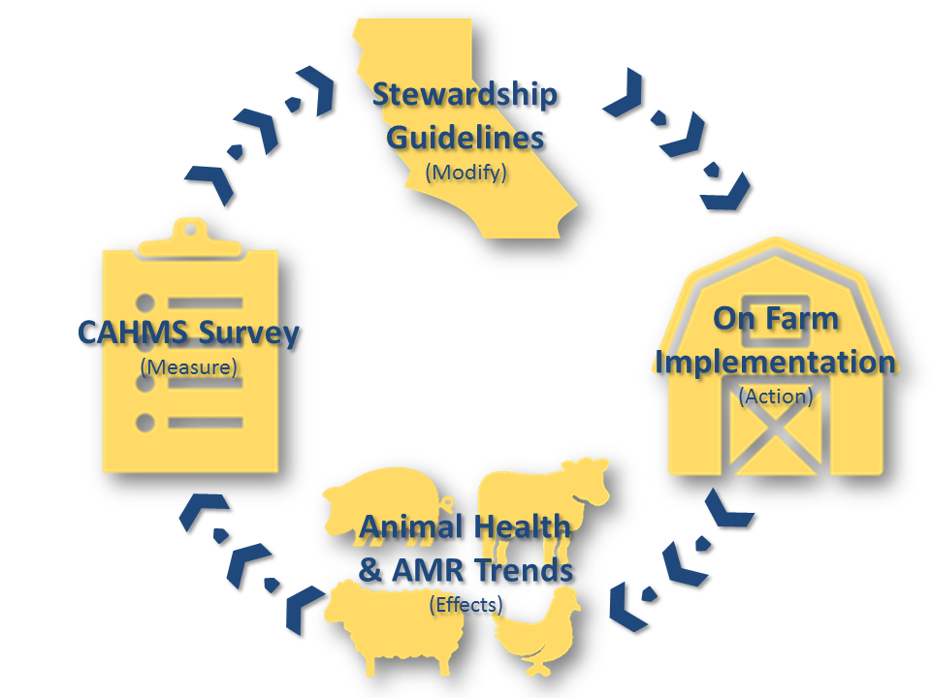
Antimicrobial Use & Stewardship
Stewardship
  Judicious Antimicrobial Use Principles
  Herd Health Guidelines and Best Management Practices
    Existing Quality Assurance programs
  Antibiotic Alternatives
    Scientifically proven to be effective and practical
California Animal Health
Monitoring System (CAHMS)
  Gather information on
    Sales & use of MIADs
    Livestock management practices
    (including animal health outcomes)
    Trends in antimicrobial resistance
  Confidentiality protected by law
Notes:
CDFA Program Focus Areas
Feedback Loop!
CAHMS- Confidentiality is protected by law, even from PRAs

Slide 21
Antimicrobial Use & Stewardship
Stewardship Committee to help Guide CDFA:
Robert Atwill UC CE Vet Med
Terry Lehenbauer UCD Vet School Tulare
Joan Dean Rowe UCD Vet School
Bennie Osburn UCD Vet School, Dean Emeritus
Jim Oltjen UC CE Animal Science
Grant Miller CVMA
Rob Rutherford Cal Poly Emeritus
Dave Daley CCA and Chico State
Tina Saitone UC CE Ag Econ
CDFA Veterinarians: Dennis Wilson, Rosie Busch, Marissa Silva
Notes:
CDFA Program Focus Areas
Feedback Loop!
CAHMS- Confidentiality is protected by law, even from PRAs

Slide 22
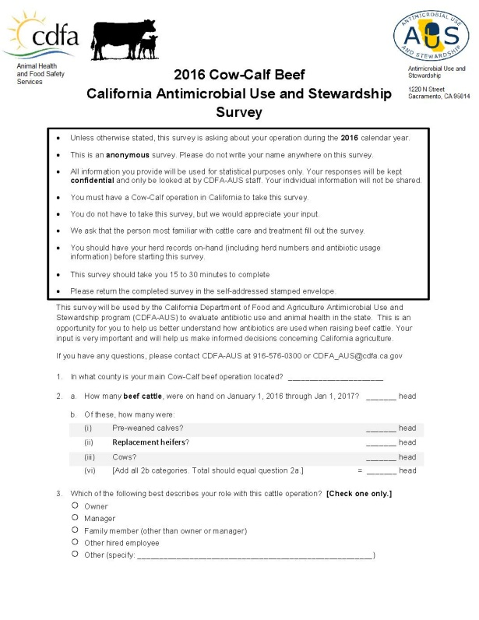
CAHMS Beef Survey
2016 Cow-Calf Beef California
Antimicrobial Use and Stewardship Survey
  Mailing out in Fall 2017
  Includes pre-paid return envelope
  Voluntary, anonymous survey
  All information held confidential,
  as mandated by law
Although voluntary, participation is crucial!
  Information direct from the source
  (no assumptions made for the industry)
  Helps the Antimicrobial Use & Stewardship program
  provide useful resources
    Better serve the California livestock industry
  Deliver tools for California producers to take an active and progressive role in the fight against antimicrobial resistance
Notes:
Reiterate if asked that the surveys will be collecting information on antimicrobial use, current animal management practices, veterinary relationships and access, and disease morbidity/mortality in order to better serve the industry. (It is the only antimicrobial resistance program that offers a stewardship component.)

Slide 23
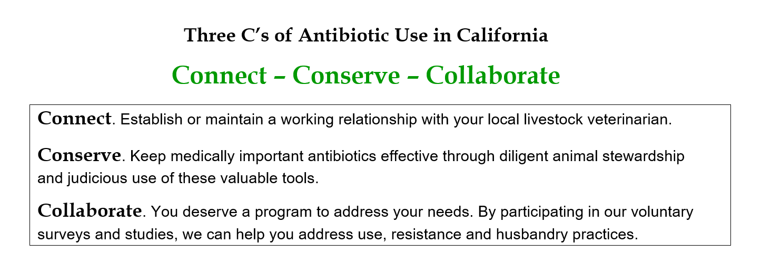
Three C’s of Antibiotic Use

Slide 24
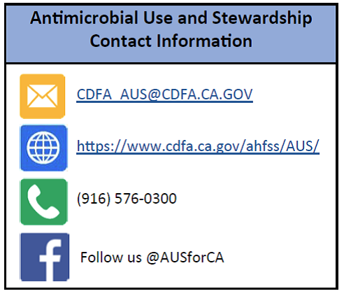
Additional Resources

Slide 26
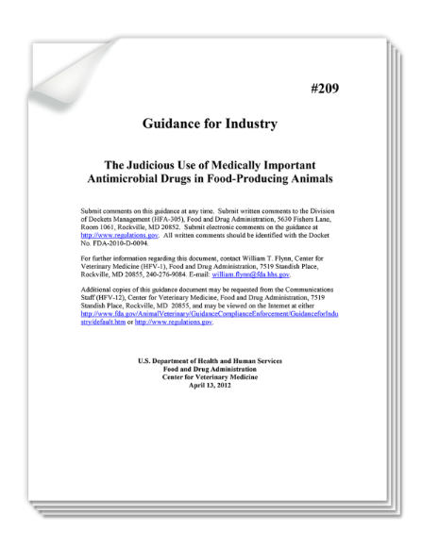
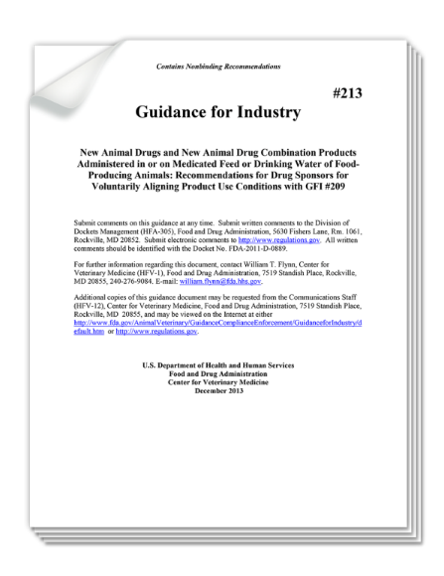
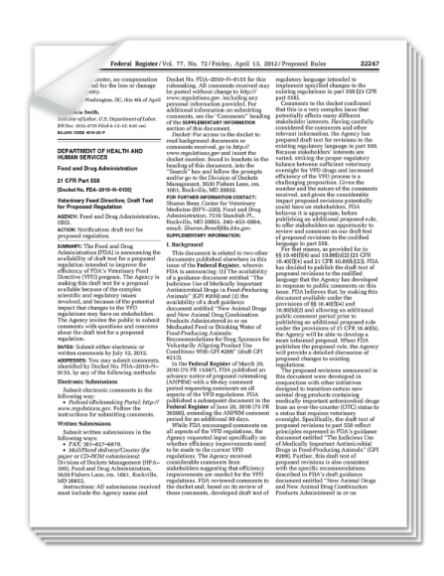
Access to Antibiotics
FDA issues 3 documents proposing to modify use of medically important antibiotics in food-producing animals
Guidance for Industry (GFI) #209
Guidance for Industry (GFI) #213
CFR 558

Slide 27
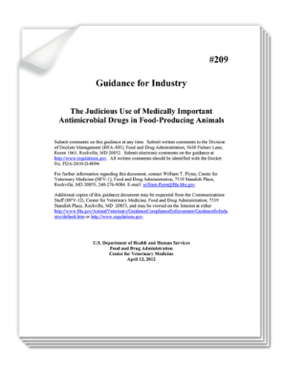
Guidance for Industry #209
The “what” component
Establishes “judicious use” principle
  Limits shared-class antibiotics to therapeutic purposes
Key: Use of medically important antimicrobial drugs in food-producing animals should be limited to:
Uses necessary to assure animal health
- Prevention
- Control
- Treatment
2. Uses that include veterinary oversight
- Feed: OTC to VFD
- Water: Rx (specified in GFI #213)
Performance uses (prohibited)
Notes:
GFI #209 provides 2 principles surrounding proposed modification in use:
Limited to use considered necessary for assuring animal health
Judicious = therapeutic uses (prevention, control and treatment)
Injudicious = performance uses
Therapeutic use needs to include veterinary oversight or consultation
Accompanied by marketing status change from OTC to VFD on feed use—from 2 to 43 and 20 (performance and therapy VFD)
Rx for water therapies
Foreshadowing on other products

Slide 28
Products Affected vs. Unaffected as Defined by FDA Guidance 152
Unaffected
Affected
Non-Medically Important
Products used exclusively in animals:
- Ionophores (Rumensin®)
- Polypeptides
- Carbadox
- Bambermycin
- Pleuromutilin
Medically Important
Products deemed “important for human medicine” & used by both animals & humans, such as:
- Penicillins
- Cephalosporins
- Quinolones
- Fluoroquinolones
- Tetracyclines
- Macrolides
- Sulfas
- Glycopeptides
- Others
Therapeutic uses — still allowed under veterinary supervision
      Treat animals diagnosed with an illness
      Control the spread of illness in a herd
      Prevent illness in healthy animals when exposure is likely
Production uses — Still allowed
Enhance growth or improve feed efficiency
Production uses — No longer allowed
Enhance growth or improve feed efficiency

Slide 29

Implications
Food producers aren’t losing all feed-grade antibiotics
The way they’re used will change
Key phrase is “medically important”
  Refers to drugs important for therapeutic use in humans

Slide 30
Veterinary Feed Directive (VFD)
Existing regulatory framework for veterinary oversight of feed-use drugs (21 CFR 558)
Designates VFDs as medicated feeds needing veterinary oversight
Limits use of such products to veterinary oversight
Requires a written statement (form) issued by a veterinarian
  Authorizes manufacture & use of feed containing a drug

Slide 31
Extra Label Use is NOT Permitted
  “Use of feed containing this veterinary feed directive (VFD) drug in a manner other than as directed on the labeling (extra label use) is not permitted”

Slide 32
California SB No. 27 (Chapter 758)
Livestock: use of antimicrobial drugs
Effective January 1, 2018
Prohibits the administration of medically important antimicrobial drugs to livestock unless ordered by a licensed veterinarian through a prescription or veterinary feed directive pursuant to a veterinarian-client-patient relationship, and would prohibit the administration of a medically important antimicrobial drug to livestock solely for purposes of promoting weight gain or improving feed efficiency.

Slide 33
CDFA Must…
Develop antimicrobial stewardship guidelines and best management practices on the proper use of medically important antimicrobial drugs
Gather information on medically important antimicrobial drug sales and usage, antimicrobial resistant bacteria, and livestock management practice data.

Slide 34
CDFA Phase I
(Antimicrobial and Herd Monitoring )
Veterinary Involvement in Animal Stewardship
1. Defined Criteria for VCPR
2. Development of Preventative Herd/ Flock Health Plan
3. Responsible Antibiotic Selection and Use
4. Analysis of Treatment Outcomes
B. Preventive Biosecurity (Prevent Introduction or Transmission)
1. HACCP Principles
2. Human Hygiene
3. Vehicular Hygiene (Farm-to-Farm Transmission)
4. Incoming Animal Quarantine
5. Farm Organization and Layout of Animal Groups

Slide 35
CDFA Phase 2
(Areas Addressed in BQA Programs)
Care and Husbandry Practices
1. Preventative Healthcare
2. Vaccination Protocols
3. Nutrition
4. Lameness
5. Anthelmintic Protocols
6. Behavior
7. Culling Management (Timely Marketing)
8. Necropsy and Follow-Up Diagnostics
B. Environmental Management
1. Stocking Rate (Suggested Group Sizes)
2. Facility Structure
3. Feed and Water Hygiene
4. Manure Management (aka Nutrient Management Plan)
5. Land Management

Slide 36
CDFA Phase 2
(Areas Addressed in BQA Programs)
C. Transportation/ Handling Guidelines
1. Reduction of Stress = Reduction of Illness
2. Flight Zone
3. Physical Body Language
4. Herd Behavior
5. Loading Density
6. Long Haul Protocols
7. Vehicle Sanitation Standards (for animal transport health)

