Slide 1
Volunteer Management System^{3.1}
New Volunteers
Notes:
Welcome to the Volunteer Management System! Volunteer Management System commonly referred to as VMS is an online system developed by UC Agriculture and Natural Resources to assist volunteers in keeping accurate records of volunteer activities. This presentation goes through the basics of VMS and how to access and use some of the features.

Slide 2
Learning Objectives
Explain what the Volunteer Management System is
How to access the Volunteer Management System
Know how to navigate the Volunteer Management System
Be able to edit volunteer profile
Identify volunteer opportunities and volunteer through the Volunteer Management System
Be able to record volunteer / continuing education hours and contacts in the Volunteer Management System
Reappointment
Notes:
This presentation goes through the basics of the Volunteer Management System and how to access and use some of the features.
(Read the learning objectives)

Slide 3
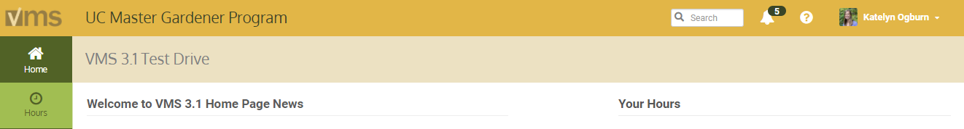
Volunteer Management System (VMS) is an online system developed by UC Agriculture and Natural Resources to assist volunteers in keeping accurate records of volunteer activities.
Notes:
The system was designed to be:
User‐friendly for volunteers
Modifiable by each county’s Volunteer Management System administrators, to provide a unique site
Vigorous enough to retain record tracking functions required by UC and the Statewide Master Gardener and Master Food Preserver Programs

Slide 4
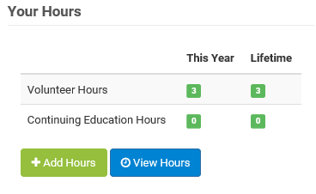
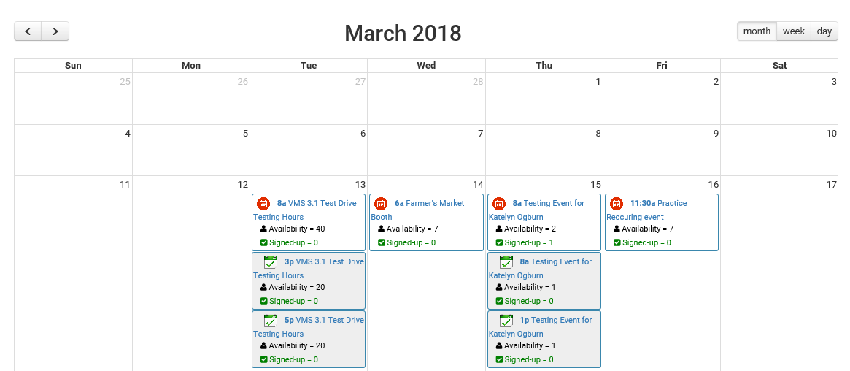
Volunteers and VMS
View calendars
Volunteer for events
Record volunteer / continuing education hours and contacts
Edit volunteer profile
Notes:
(Slide 1) VMS allows volunteers to create a profile, log volunteer and continuing education hours, and report contacts. The program also provides a place for communication and collaboration within each county program with options to create calendar events, share photos and documents.

Slide 5
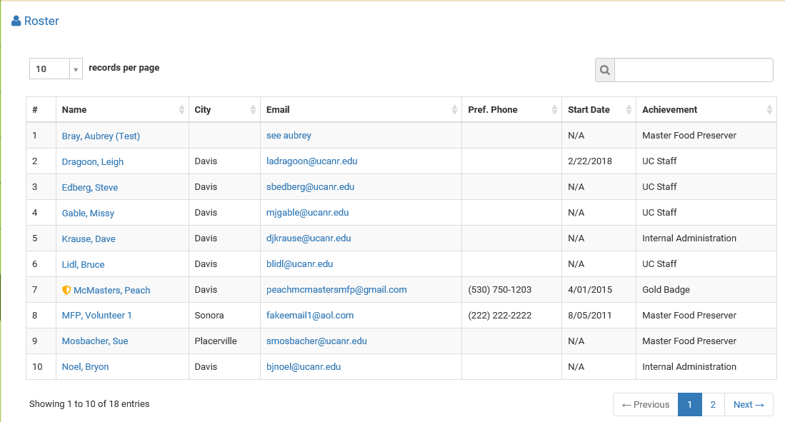
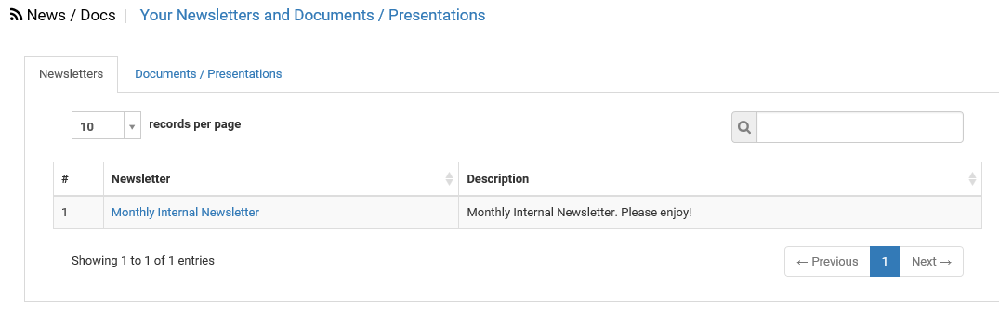
Volunteers and VMS
View Roster of members
Home page news
Access important links and documents
Completing Reappointment
(annually)
Notes:
(Slide 2 – same notes as previous slide with different bullet points) VMS allows volunteers to create a profile, log volunteer and continuing education hours, and report contacts. The program also provides a place for communication and collaboration within each county program with options to create calendar events, share photos and documents.

Slide 6
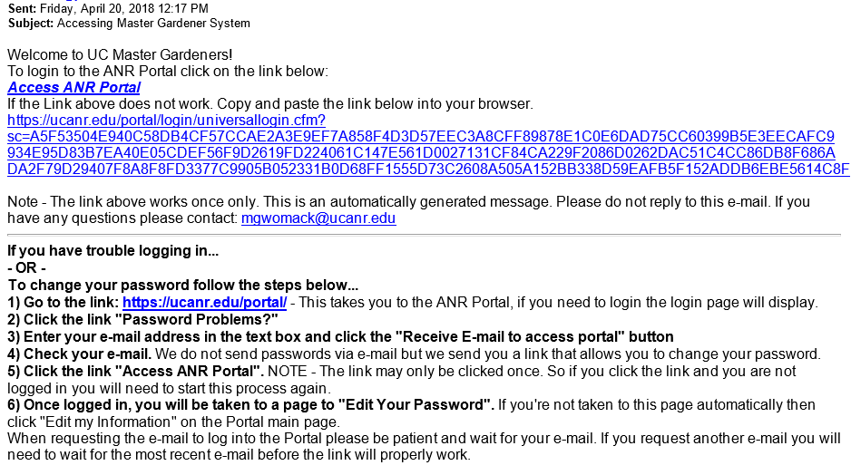
How do I get access to VMS?
Welcome email from VMS
Follow the directions
Notes:
You will receive a welcome email from VMS with instructions on how to access the system. Your first time logging in you will need to set a password. Passwords must be at least 7 characters in length with no spaces and contain a number or special character.
Read and follow the directions provided. If you have problems contact [insert your county contact information here].

Slide 7
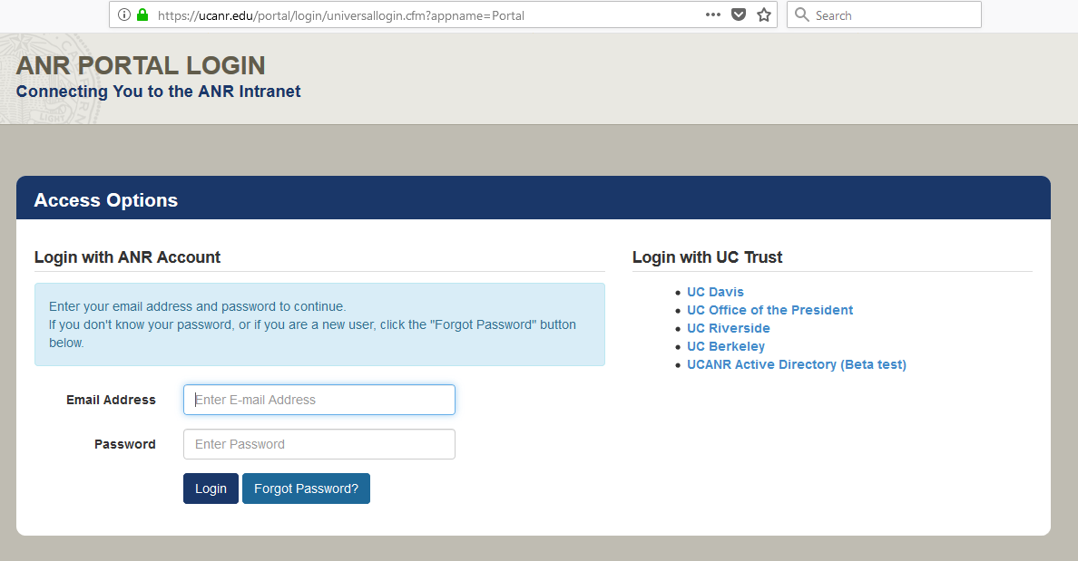
How do I access VMS?
Review your welcome email
Check your logon and create password
Users Guide
Tutorial Videos
Notes:
To enter VMS, open your browser of choice and navigate to the ANR Portal located at http://ucanr.org/portal.
The Portal allows you to come to one place to access the UC ANR (University of California Division of Agriculture and Natural Resources) websites, utilities, and systems in which you are involved.
Collaborative Tools, Site Builder, ANR Blogs, File Vault, Survey Tool, Repository, and VMS. The portal provides a simple yet secure way to get into important systems while only having to remember one username and password. All coordinators and UC Master Gardener/Food Preserver Volunteers have portal accounts.
After logging into the ANR Portal, select your county under Master Gardener/Food Preserver VMS 3.1

Slide 8
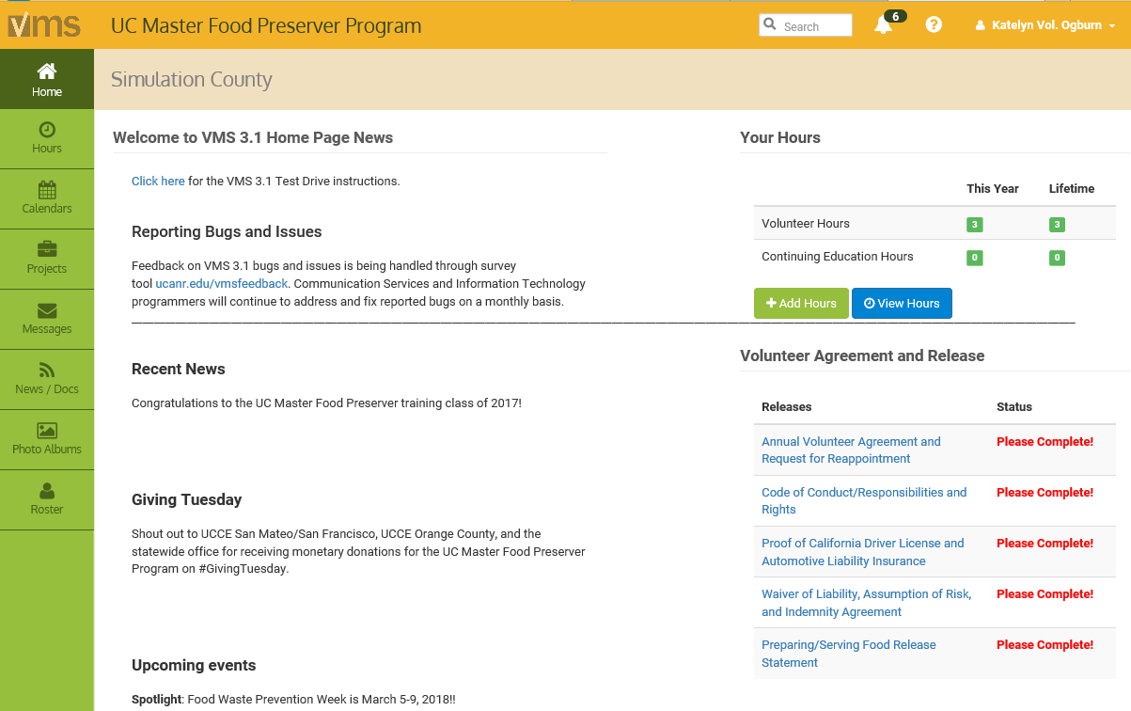
Once you have accessed the site…
COUNTY
NAME
Notes:
You are now in VMS, your name and county name will be displayed at the top of the page. This is your tool, no one else can log into it without having your logon and password.
Once logged in you can immediately start using VMS. These are screenshots of common screens you will see when using VMS.

Slide 9
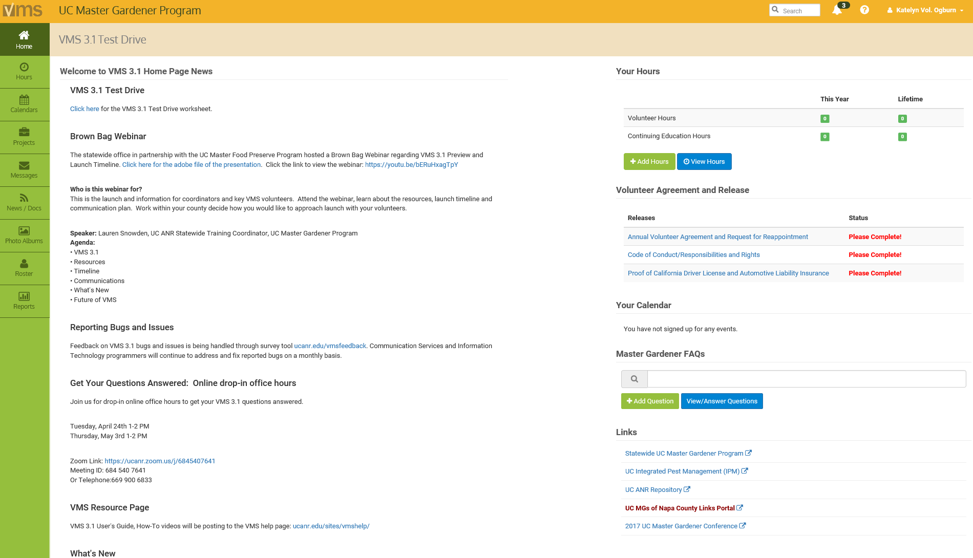
Navigation…
Notes:
Navigate through VMS by clicking on the left navigation bar. Within each of the sections there are different tabs that display information, lists and dates. Most have convenient search bars located near the top of the page to help narrow the lists if needed.
Home tab- returns user the Home Screen
Hours tab- enter and view volunteer hours, continuing education hours and report contacts.
Calendars tab- view, search, and volunteer for events through calendars
Projects tab- view / search and volunteer for projects
Messages tab- view incoming messages sent through VMS by VMS administrators
News / Docs tab- view, save, print and subscribe to newsletters; view, save, print documents and presentations
Photo Albums tab- create / edit photo albums, upload / view/ download photos
Roster tab- view list of county volunteers, including contact information
To navigate back to the start or home page click HOME on the left navigation bar. If you want to return all the way to the ANR Portal click on your name located in the upper right hand corner and select ANR Portal.
VMS help is one click away. Click the question mark located in the header and footer sections in VMS. There is a user’s guide with step by step written instructions with screen shots and several video tutorials covering the most often used features in VMS.
Be sure to Logout of VMS when you are done by clicking on your name located in the upper right hand corner of the screen and selecting Log Out. Finish logging out by selecting Logout of ANR Portal. It is not mandatory for you to log out but it is good computer practice to do so.
(Exercise: Live demo the system, walk them through)

Slide 10
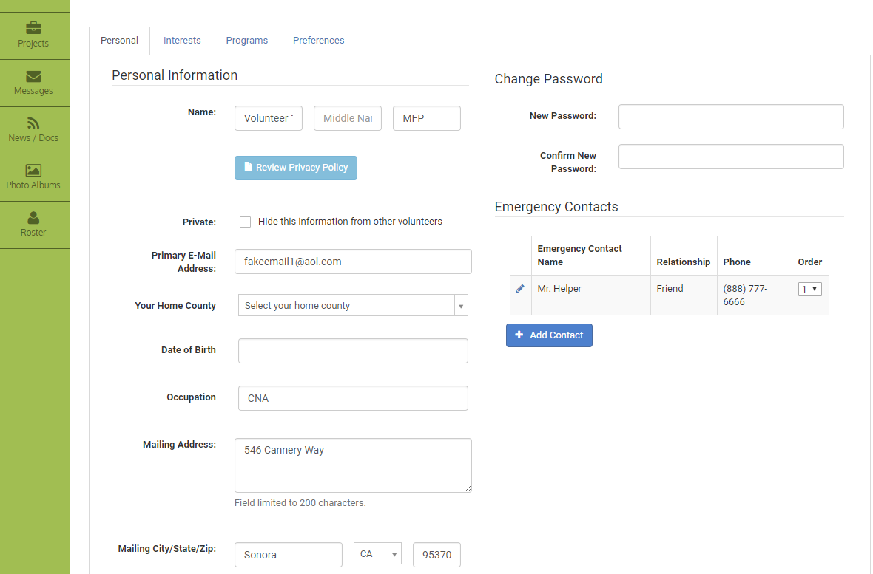
Editing your Profile...
Change your password
Update personal information
Add emergency contacts
Notes:
The first time you log in be sure to edit your profile and update it as often as needed.
This is where you will update your PASSWORD after you have logged on for the first time. You may also update your email address if needed. For your safety please add emergency contact information to your profile, this information is private and is only available to VMS administrators, not all the volunteers.
This is a secure site and is password protected so only volunteers in our county have access. However if you do not want your personal information seen even by other volunteers you can choose to make it unavailable through VMS.
If you make changes, click the blue Save button on the bottom of the page. If you do not do so your changes will not be saved.
Privacy Policy (can view this policy on VMS Member Profile Page): The personal information you provide on the roster/profile page of the volunteer management system (VMS) will not be made available in any public way. The policy of University of California is to protect individual privacy rights. However, it is necessary to maintain a roster including individual names, telephone numbers, email address and other personal contact data to effectively carry out Master Gardener / Master Food Preserver business. This information will be shared with other Master Gardener / Master Food Preserver volunteers in your county and is available to the Statewide Master Gardener / Master Food Preserver Program for official purposes only. This information will not be made public but if you want to keep this information hidden, please check the "Private" box. These data are not considered public records and they will not be released in any public setting without your express written authorization.
(Exercise: Live demo the system, walk them through editing)

Slide 11
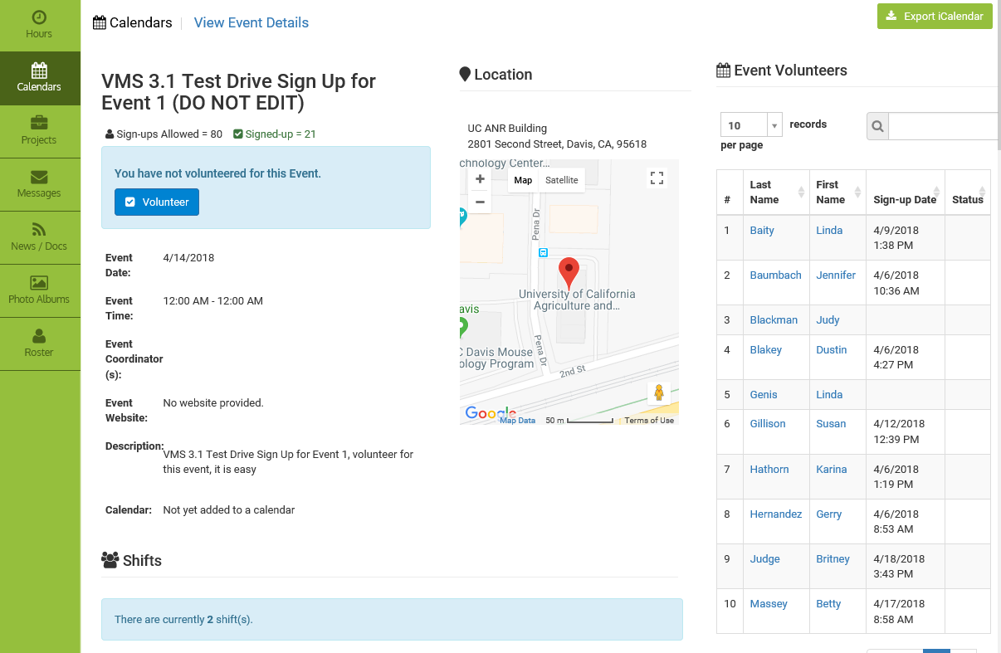
Volunteering through VMS
Notes:
The VMS Calendars includes scheduled events, activities and meetings specific to our county. Volunteering through VMS Calendars will assist you in keeping track of your volunteer activities as well as let event organizers know who is coming.
To view Calendars, click on the Calendars button in the left navigation bar.
The Calendar View tab displays the events in the current month. To see a list view of all upcoming events instead of the monthly view, click the ALL Events tab.
(CLICK) Click on an event on a particular day to reveal more information about that event. When you click on an event you will go to the specific event’s page. To volunteer for the event, click the blue Volunteer button.
(CLICK) When you sign up on for an event in VMS it will automatically add it to “Your Calendar.” You can view “Your Calendar” on the right hand side of the Home screen.
You can also download an iCalendar for your own personal electronic calendar.
If you decide later that you cannot volunteer for an event you’ve already signed up for, click on the event in the calendar, and click on the Unvolunteer button. This also removes the event from “Your Calendar” in VMS.
(Exercise: Live demo the system, walk them through volunteering, show “Your Calendar” and unvolunteering, show “Your Calendar”)

Slide 12
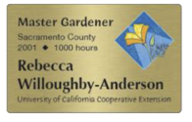
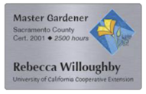
Why enter Volunteer Hours?
Provides essential information for:
First-year - to track if you've earned the required hours to become fully certified
Certified - to determine if you've earned enough hours to maintain active status
Required reporting for local and statewide reporting and funding agencies
Receive special recognition for achieving hour milestones
Notes:
Read/summarize slide

Slide 13

Why Enter Contacts and Demographics?
Contacts reported in VMS are an important piece of program evaluation and helps measure program effectiveness
Collection of this data is required by the federal government and reported on annually
Notes:
The Smith-Lever Act established Cooperative Extension services to inform the public about current developments in agriculture, home economics, public policy/government, leadership, 4-H, economic development, coastal issues, etc.
The UC Master Gardener /UC Master Food Preserver Program is connected to UC Cooperative Extension and should strive to serve an audience that is representative of the demographics located within our counties.
[Read slide]
The ‘Unknown’ category should not be used as a default, rather, it should only be used when truly necessary. Our responsibility is to report on our clientele and therefore program reach in the most accurate way possible within the limitations provided by the federal government.

Slide 14
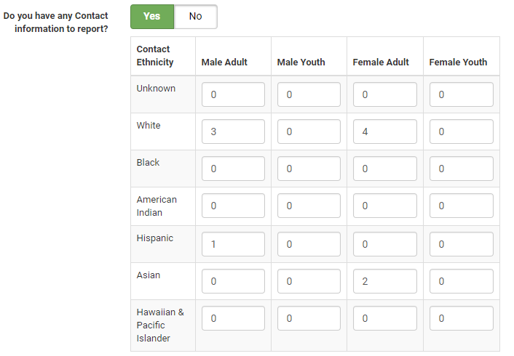
Why Enter Contacts and Demographics cont.?
Collection protocols are determined by the federal government
  Two genders
  Six ethnicities
  Both have an
  “unknown" category to be
  used when appropriate
  and necessary
Notes:
(continued from last slide) The Smith-Lever Act established Cooperative Extension services to inform the public about current developments in agriculture, home economics, public policy/government, leadership, 4-H, economic development, coastal issues, etc.
The UC Master Gardener /UC Master Food Preserver Program is connected to UC Cooperative Extension and should strive to serve an audience that is representative of the demographics located within our counties.
[Read slide]
The ‘Unknown’ category should not be used as a default, rather, it should only be used when truly necessary. Our responsibility is to report on our clientele and therefore program reach in the most accurate way possible within the limitations provided by the federal government.

Slide 15
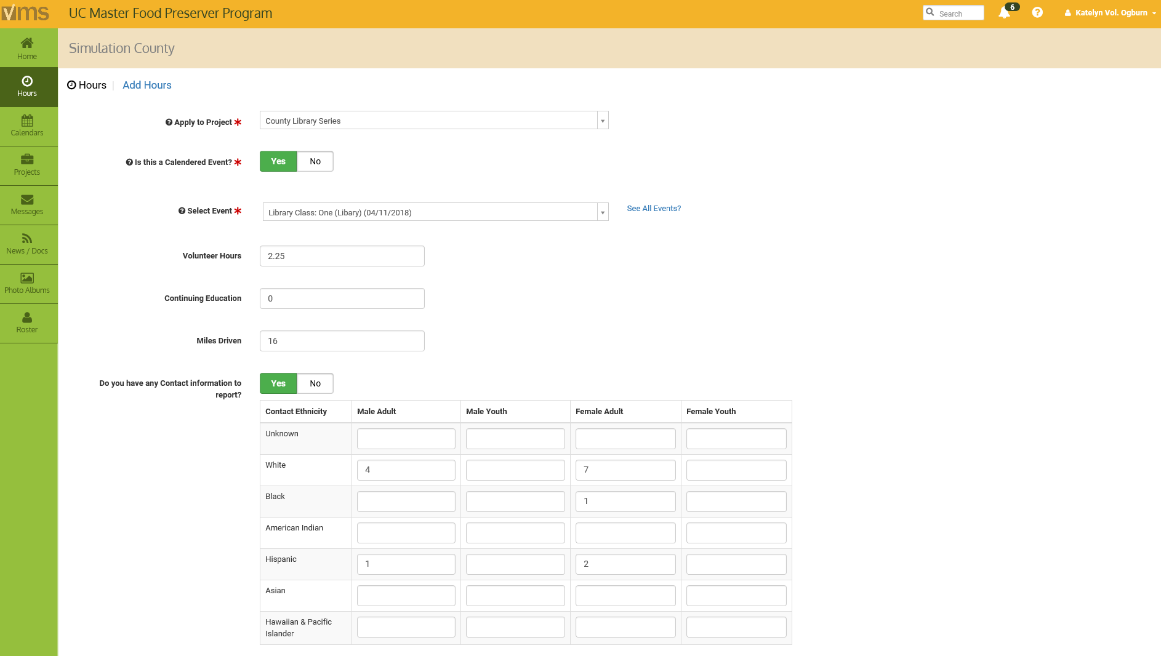
Entering Hours and Contacts
Notes:
To enter Hours, click on the Hours button in the left navigation bar. Select the green Add Hours button.
select the project the hours will be applied towards
Is this project a Calendared Event?
toggle the white Yes / No button
if Yes- Select the event from the drop down
if No- Enter the event name and event description
Enter applicable information:
Volunteer Hours
Continuing Education hours
Miles Driven, to and from the event (miles driven is optional)
Do you have any Contact information to report?
toggle the green Yes / No button
if Yes- Select yes and complete the form
if No- Select no
Enter any Comments / Notes
Select the blue ✓Save Hours button
Your hours are now entered!
(Exercise: Live demo the system, walk them through adding hours)

Slide 16
Entering Hours and Contacts cont.
Not all activities will have contacts, volunteer and continuing education hours
VMS rounds up or down to the nearest quarter hour
Miles driven is for your records
Do not double count contact reporting
Notes:
i.e.
If you have continuing education hours to enter you may not have demographics.
If you are putting together a talk you may have 1 hour of volunteer time and .50 hour of continuing education time.
If you volunteered at a Farmer’s Market and your table partner is going to enter the contacts you would only enter your Volunteer time with not contacts.
i.e.
Miles driven is not counted as volunteer time, this is for your record keeping purposes. If you are conducting UC business and driving discuss with (your coordinator name or Advisor) if you can claim volunteer hours.
i.e.
1.8 hours = 1.75 hours
i.e.
If two volunteers teach a workshop to twenty people only twenty contacts should be reported for that event by one volunteer, not both.

Slide 17
Reappointment
The minimum hours required to remain a certified volunteer are:
  25 hours - Volunteer
  12 hours - Continuing education
Note: First years are required to complete a minimum of 50 volunteer hours (no continuing education requirement) before the next reappointment cycle.
Notes:
Reappointment is the process by which all UCCE Master Gardeners and UCCE Master Food Preservers remain certified in their program. Annual reappointment begins on June 1 and is a requirement for all UCCE Master Gardeners and UCCE Master Food Preservers. The reappointment year runs on the state fiscal year July 1, 20## through June 30, 20##.
The minimum hours required to remain a certified volunteer are:
• 25 hours - Volunteer
• 12 hours - Continuing education
First years are required to complete a minimum of 50 volunteer hours (no continuing education requirement) before the next reappointment cycle.
VMS will prompt users to electronically complete the appropriate agreements, releases and waivers to successfully reappointment. Be sure to enter your hours into VMS throughout the year, this makes reappointment easier as people aren’t scrambling to remember what hours they have and haven’t entered.

Slide 18
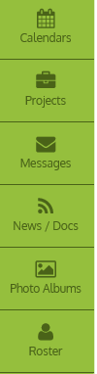
Other Features...
Projects
Messages
News / Docs
Photo Albums
Roster
Notes:
Projects- view details on active projects and volunteer. (Project Description, Project Location, Projection Information, Project Contact, Volunteer Details, Volunteers).
Messages- view messages sent through VMS
(Make sure what the status of this feature is in your county, full function is when anyone can send an email, limited function is when only Admins can send an email)
Newsletter/Documents- View newsletters or documents uploaded to VMS by your VMS administrators.
Photo Albums- Create photo albums and upload pictures to VMS for all volunteers to view and your preserve history.
Roster- See other MG’s contact information and interests. (Don’t want to share your information? Edit your profile to hide your information)

Slide 19
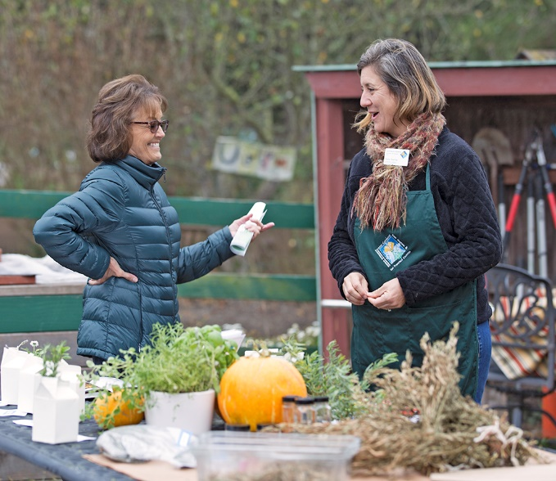
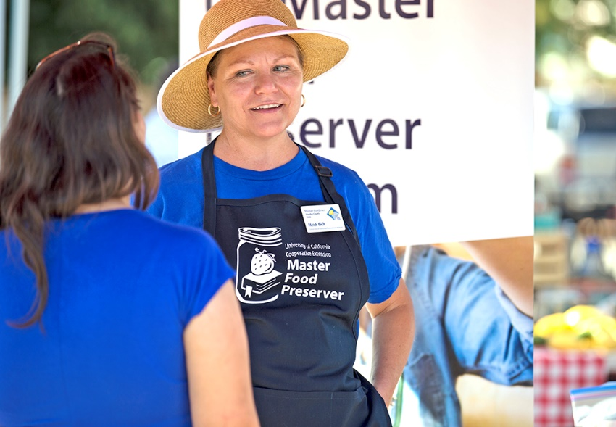
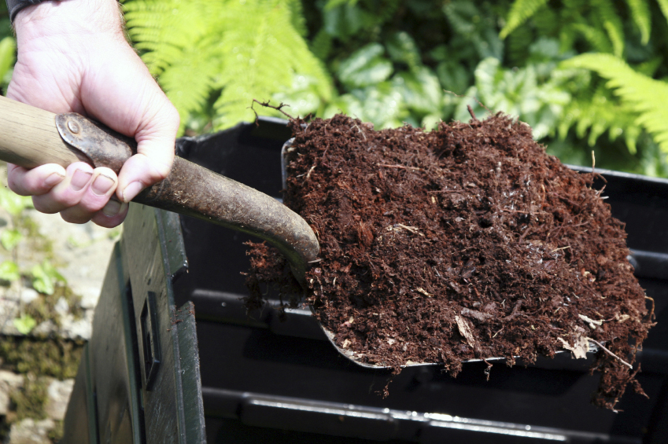
“To extend research based knowledge and information on home horticulture, pest management, and sustainable landscape practices to the residents of California and be guided by our core values and strategic initiatives."
- UC Master Gardener Program Mission Statement
"To teach research-based practices of safe home food preservation to the residents of California."
- UC Master Food Preserver Program Mission Statement
Notes:
There is a wide range of volunteer opportunities. Be sure to sign up for several different types of events and have fun!

Slide 20
Questions?
Contact [enter contact information here]
VMS Users Guide and Video Tutorials
http://ucanr.edu/sites/vmshelp/VMS_Users_Guide
Notes:
There’s a website, Users Guide, and How-To training videos to help you navigate VMS 3.1

