Slide 1
Volunteer Management System^{3.1}
New Administrators
Notes:
Presentation Description:
Welcome to the Volunteer Management System! Volunteer Management System commonly referred to as VMS is an online system developed by UC Agriculture and Natural Resources to assist volunteers in keeping accurate records of volunteer activities. This presentation goes through the basics for Admin level users of VMS and how to access and use some of the features.

Slide 2
Learning Objectives
Know what the Volunteer Management System is and Admin Access
Ability to access Admin Mode in the Volunteer Management System
Know how to navigate the Admin features in the Volunteer Management System
Manage Reappointment
Notes:
This presentation goes through the basic administrative functions of the Volunteer Management System and how to access and use some of the features. (Read the learning objectives)

Slide 3
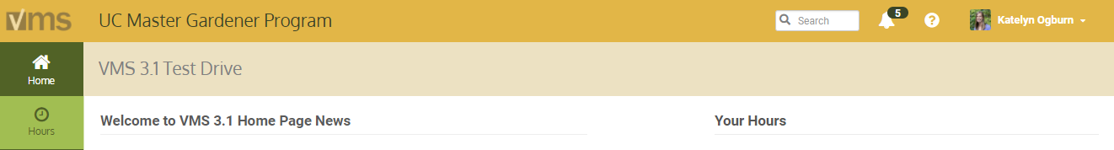
Volunteer Management System (VMS) is an online system developed by UC Agriculture and Natural Resources to assist volunteers in keeping accurate records of volunteer activities.
Notes:
The system was designed to be:
User‐friendly for volunteers
Modifiable by each county’s Volunteer Management System administrators, to provide a unique site
Vigorous enough to retain record tracking functions required by UC and the Statewide Master Gardener and Master Food Preserver Programs
(have) Extensive reporting capabilities

Slide 4
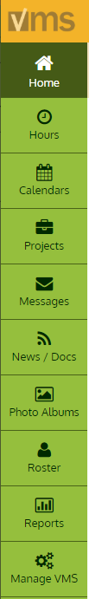

Administrators and VMS
View your roster of volunteers
Manage roster
Communicate with volunteers: VMS messages, home page news
Create and manage volunteer projects
Create and manage volunteer calendar events
Notes:
As a coordinator / administrator, VMS is the most helpful tool in your possession. You’ll use it daily to accomplish the following tasks (and more!)
View your roster of volunteers, including contact information, emergency contacts and interests
Manage roster by adding / removing / transferring / changing status of volunteers
Communicate with volunteers through VMS messages and home page news
Create and manage volunteer projects and volunteer calendar events

Slide 5
Administrators and VMS
View volunteer hour and continuing education reports
View volunteer contact reports
Upload documents, presentations (News/Docs)
Manage and deploy an internal newsletter (News/Docs)
Manage annual reappointment process, June - July (Manage VMS)
Notes:
(continued)
As a coordinator / administrator, VMS is the most helpful tool in your possession. You’ll use it daily to accomplish the following tasks (and more!)
Track and view volunteer / continuing education and contact reports
Upload documents, presentations, photos to share with group
Manage and deploy an internal newsletter
Manage annual reappointment process (occurs June-July every year)

Slide 6
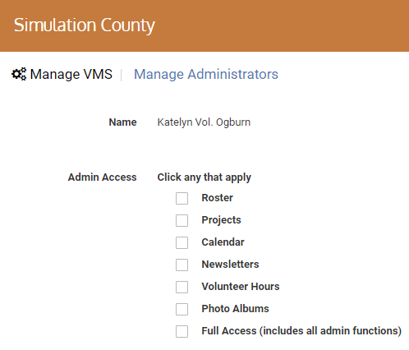
How do I get Admin Access?
Administrative access options:
Roster
Projects
Calendar
Newsletters
Volunteer Hours
Photo Albums
Full Access (includes all admin functions)
Notes:
The designated Owner of VMS has Full Access and the ability to grant administrative access to those volunteers and staff that require it. There are six different options for admin access, users may have one, several or all levels by being designated Full Access. If individual admin access is enabled the user will only have Admin Mode in those enabled areas, while Full Access includes all admin functions.

Slide 7
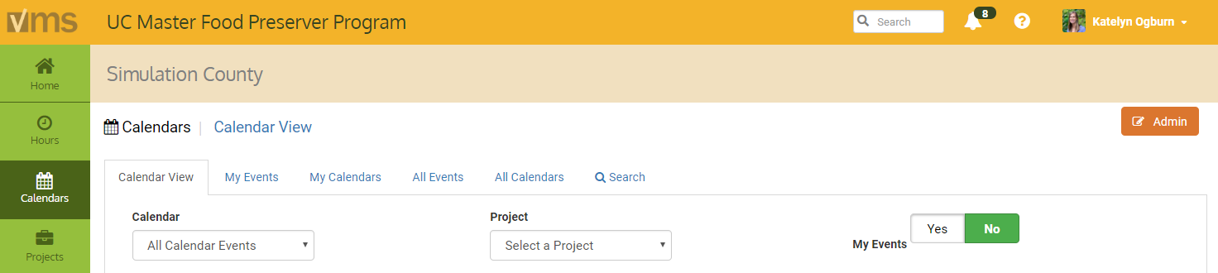
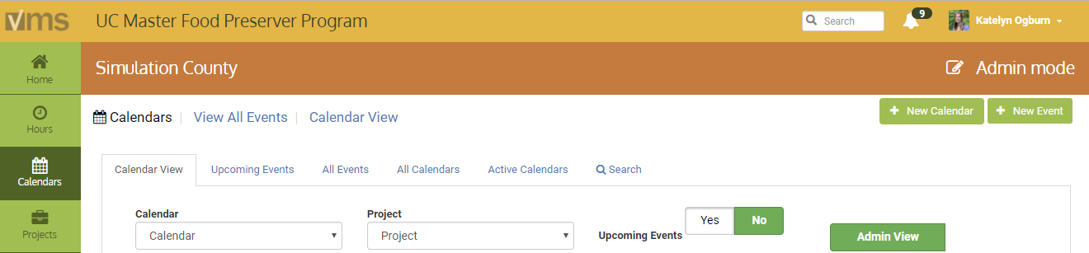
Accessing Admin Mode...
Notes:
Log into VMS, your name and county name will be displayed at the top of the page. This is your tool, no one else can log into it without having your logon and password.
The Admin button appears in tabs where Admin functions are Admin mode is accessed by clicking the orange Admin button. Once in Admin mode a orange bar will appear to designate the user is operating in Admin mode. To exit Admin mode click on any of the tabs from the toolbar on the left.

Slide 8
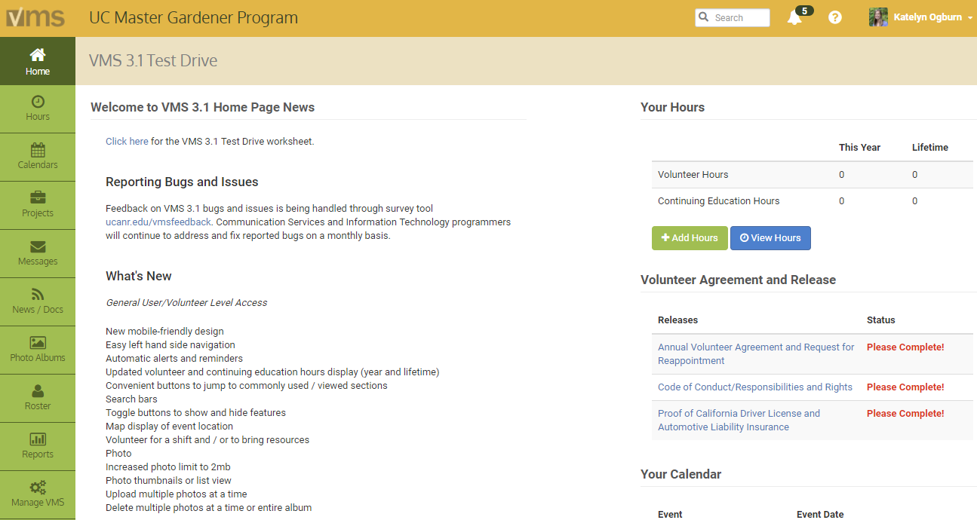
Navigation
Notes:
Navigate through VMS by clicking on the left navigation bar. Within each of the sections there are different tabs that display information, lists and dates. Most have convenient search bars located near the top of the page to help narrow the lists if needed.
The majority of features in VMS can be accessed through clicking the navigation bar running down the left side of the home screen. The Full Access administrator left navigation bar has the following features:
Home- returns user to the Home Screen
Hours- enter and view volunteer hours, continuing education hours and report contacts. Note: If you are an employee and a volunteer do not use your employee VMS account to keep track of volunteer hours. Only enter your volunteer hours in your volunteer account.
Calendars- view, search, and volunteer for events through calendars ADMIN MODE: Create / add / edit and archive calendars. Create / delete / edit events, shifts and resources
Projects- view and search projects. ADMIN MODE: create / add and edit projects.
Messages- view incoming messages sent through VMS. ADMIN MODE: Send message through VMS to volunteers using interest, project, group or email all volunteers. Message will appear in VMS messages and in the volunteers’ email inbox.
News / Docs- view, save, print and subscribe to newsletters; view, save, print documents and presentations. ADMIN MODE: Create / delete / archive document groups, add newsletters / documents, mange newsletter subscribers.
Photo Albums- create / edit photo albums, upload / view/ download photos
Roster- view list of county volunteers, including contact information ADMIN MODE: Add a new volunteer, send new volunteer email, create mailing labels, and create / export excel spreadsheet of volunteer roster.
Reports- does not appear as a volunteer option, admin function only ADMIN MODE: Run / view / save / export the following reports: Roster, Volunteer Hours, Contacts, Retention (duration), Programs Volunteer Commitment and Legacy reports (Retention, Category, Hours, Contact).
Manage VMS- does not appear as a volunteer option, admin function ADMIN MODE: the following sections will set up some basic information for your county VMS site.
Manage Administrators- keep track of who is managing what with the VMS admin management tool, add or remove administrators, change level of administrative rights
Home Page News- add news to the county’s VMS home page, or elect to use the ANR blog system to drive your news and keep track of older news
User Options- disable one of the options and the feature will not be available to volunteers
Links- create links for the home page to anywhere
Program Contact Info- manage your program’s address, phone and email
Manage Reappointments- manage, track, submit paper, reset terms, send list to Director, email unappointed volunteers and create excel report
Manage Interests- add, edit, or delete interests within your program
To navigate back to the start or home page click HOME on the left navigation bar. If you want to return all the way to the ANR Portal click on your name located in the upper right hand corner and select ANR Portal.
VMS help is one click away. Click the question mark located in the header and footer sections in VMS. There is a user’s guide with step by step written instructions with screen shots and several video tutorials covered the most often used features in VMS.
Be sure to Logout of VMS when you are done clicking on your name located in the upper right hand corner of the screen and select Log Out, and finish logging out by selecting Logout of ANR Portal. It is not mandatory for you to log out but it is good computer practice to do so.
(Exercise: Live demo the system, walk them through)

Slide 9
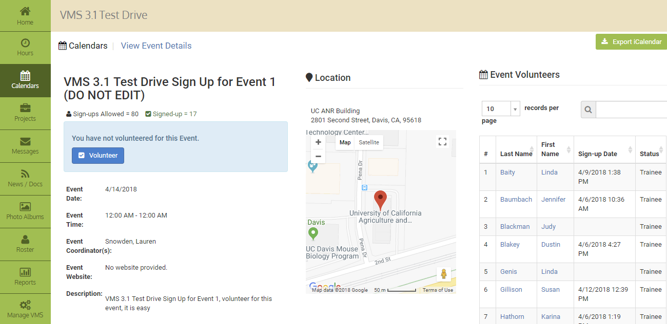
Creating Calendars, Events, Shifts
Notes:
Full Access and Calendar administrators are able to manage all calendar functions including: adding / archiving / deleting / making inactive / exporting calendars, adding / editing / deleting events, adding / deleting shifts and resources, adding /removing volunteers from events. VMS offers multiple ways to view calendars in Admin Mode and has extensive search capabilities.
(Exercise: Live demo the system, walk them through volunteering, show “Your Calendar” and unvolunteering, show “Your Calendar”)

Slide 10
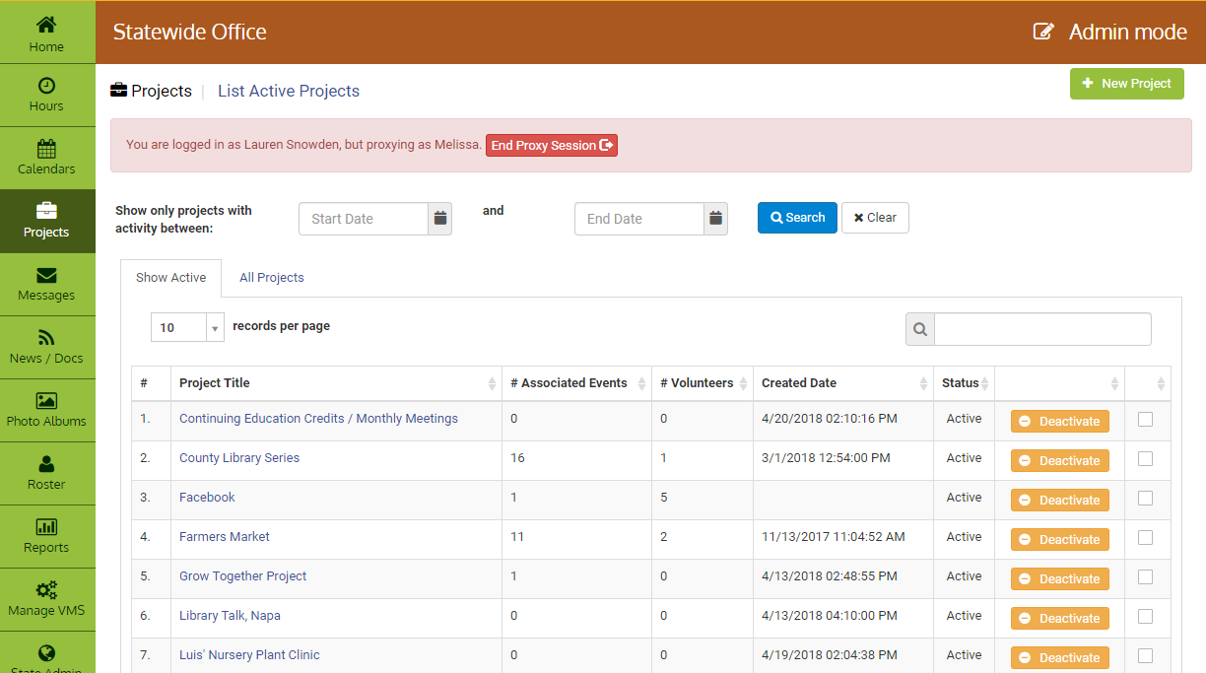
Projects
Notes:
VMS Project Categories
View Project List
Export Project List
Add New Project
Edit Project
Deactivate a Project
Reactivate a Project
Merge Projects
Enroll Volunteer(s) in a Project
Email Volunteer(s) Enrolled in a Project

Slide 11
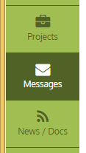
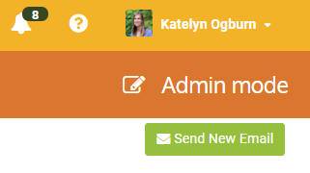
Messages
Customize send to list:
Name
Status
Achievement
Interests
Projects
Events
Notes:
The function to send messages through VMS by volunteers can be turned on and off by Full Access administrators of VMS at the county level. However, Full Access administrators can send messages through VMS regardless. Sending messages through VMS is helpful because the system uses the roster to help pick and choose what volunteers receives the email. Or just send it to everyone on your roster! The options allow for a very customizable distribution list.
For example:
If you just wanted to send all Active Status volunteers who are interested in rose pruning a message the Message Function helps you determine who those people are buy using the roster.
(Show example)

Slide 12
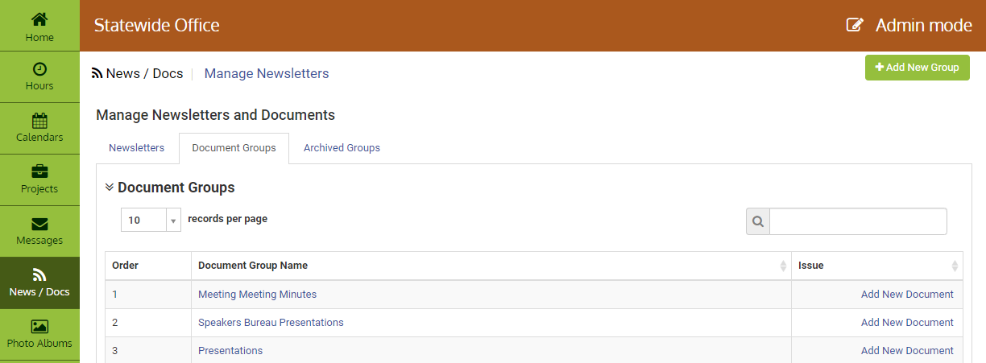
News/Docs
Notes:
Share documents and distribute internal newsletters through News / Docs. Save documents to VMS to share with volunteers such as: commonly used forms, minutes, agendas, job descriptions, presentations. VMS can serve as a place to store internal newsletters where volunteers can access them easily as well as subscribe to them so they receive newsletters automatically when a new issue is added or updated.
Full Access and Newsletters administrators have the ability to Add New Document Groups, Edit / Delete Document Group Information, Add Documents, as well as Add a Newsletter Issue, View or Manage Subscribers.

Slide 13
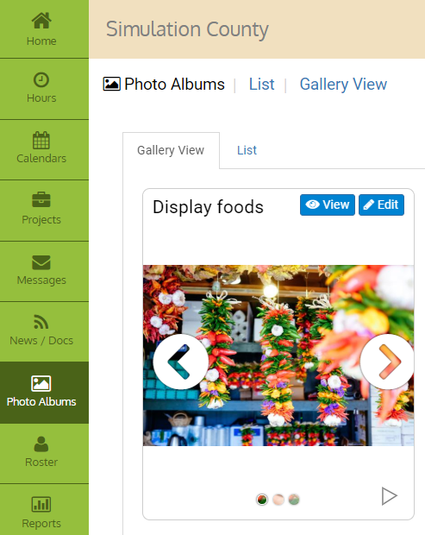
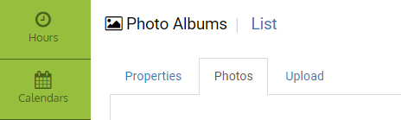
Photo Albums
View
Edit
Notes:
View and edit photos in Photo Albums. Use the slider arrows to click through the photos in an album or Select the blue View button.
To make changes, Select Edit and use the Properties, Photos, or Upload tabs. Uploads are done by 1) Dragging and dropping Files or 2) Browsing for Files.

Slide 14
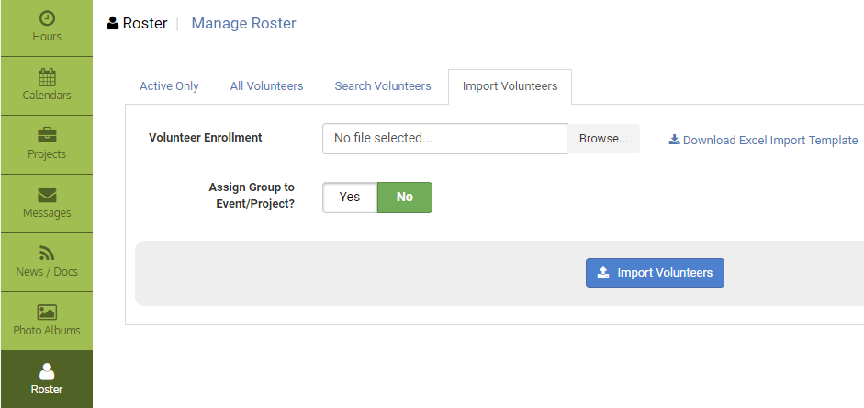
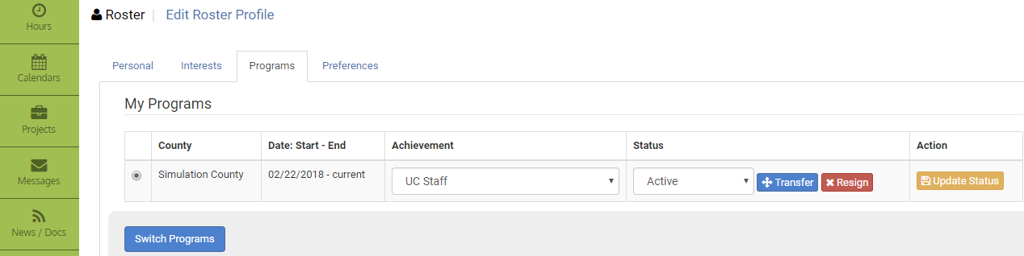
Roster
Notes:
The roster is where administrators can add new volunteers, reset passwords, change volunteer status (trainee, active, limited active, inactive / resigned), switch volunteer achievement levels (trainees, first year, Master Gardener / Food Preserver, gold badge, platinum badge, honorary) proxy in as a volunteer and create a mailing list.
One of the new features of the VMS roster is the ability to add a batch of new volunteers at once; it is called Import Volunteers. The import function utilizes an excel document uploaded to VMS, VMS will comb the list of new volunteers and won’t allow duplicate entry. Successfully imported new volunteers will have Trainee Achievement and Active Status in their profile as well as receive the new volunteer email. Step by step instructions on how to do this are in the Users Guide.
Another new feature of the VMS roster is the ability to Transfer a volunteer to another county. Volunteers seeking to transfer must still follow the steps outlined in the UCCE Master Gardener Program Administrative Handbook for Program Staff, Chapter 3 Volunteer Status, Section X. Transfer of Appointment from One California County to Another.
Do not make a transfer in VMS without the permission or approval of the county the volunteer is transferring to. Once a transfer is approved the volunteer may be transferred in VMS from the original county to the new county)

Slide 15
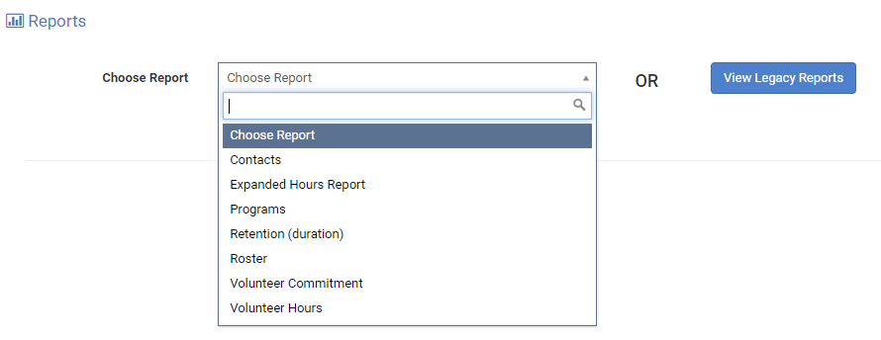
Reports
Full Access and Roster administrators can run / view /save / export a variety of set reports in VMS.
Notes:
The Choose Report function allows the user to customize reports in a variety of way and save the report for future searches. The Legacy Reports allows the user to look at complete reports of the roster in a variety of ways without entering search criteria.
A very useful VMS report is the Volunteer Commitment report, which says whether or not the volunteer met the reappointment requirements for a specific time period. Run this report for the reappointment time period (7/1/##- 6/30/##) to see who has met reappointment requirements and if not what hours they are in need of.
This report can be run at anytime and used to help keep track of those volunteers who may be in need of volunteer and continuing education opportunities.

Slide 16
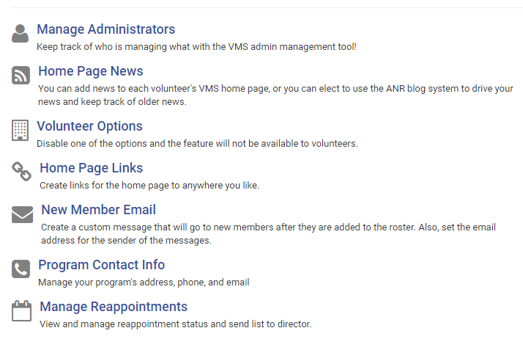
Manage VMS...
Notes:
Full Access Administrators access to Mange VMS
Manage VMS houses The following VMS functions can be found under the Manage VMS.
Manage Administrators- keep track of who is managing what with the VMS admin management tool, add or remove administrators, change level of administrative rights
Home Page News- add news to the county’s VMS home page, or elect to use the ANR blog system to drive your news
Volunteer Options- enable or disable features in VMS
Home Page Links- create links for the home page to anywhere
New Member Email - create a custom message that will go to new members added to the roster
Program Contact Info- manage your program’s address, phone and email that is displayed in the footer of VMS
Manage Reappointments- manage, track, submit paper, reset terms, send list to Director, email unappointed volunteers and create excel report
Manage Interests- add, edit, or delete interests within your program

Slide 17
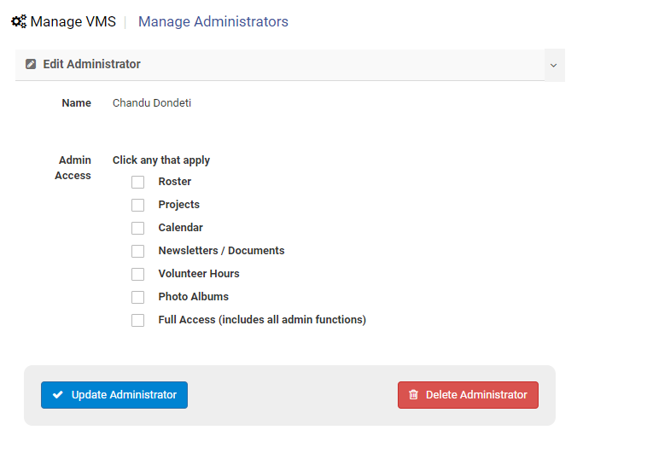
Manage Administrators
Notes:
Manage Administrators- keep track of who is managing what with the VMS admin management tool, add or remove administrators, change level of administrative rights
The designated Owner of VMS has Full Access and can Manage Administrators through the Manage VMS tab.
Roster
Projects
Calendar
Newsletter / Documents
Volunteer Hours
Photo Albums
Full Access (includes all admin functions)

Slide 18
Home Page News
Notes:
Home Page News- add news to the county’s VMS home page, or elect to use the ANR blog system to drive your news
Customize VMS’s home page and add timely program related news, updates, reappointment information, or upcoming events.

Slide 19
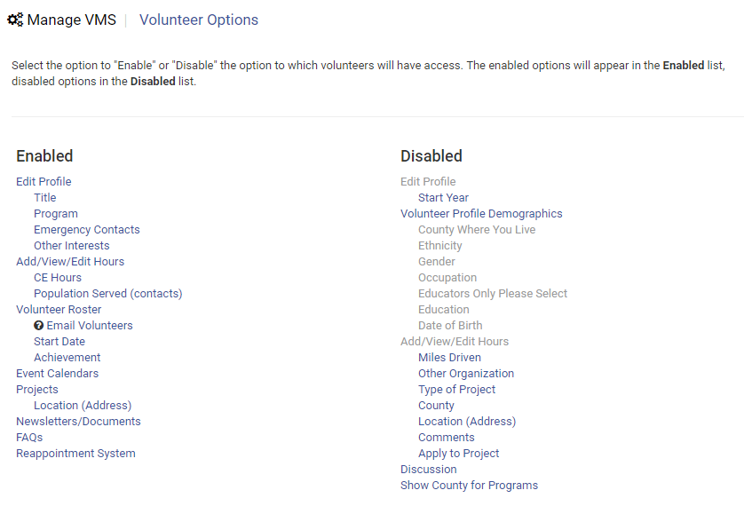
Volunteer Options
Notes:
Volunteer Options- enable or disable features in VMS
Volunteer Options customizes what is displayed in VMS and available to all volunteers

Slide 20
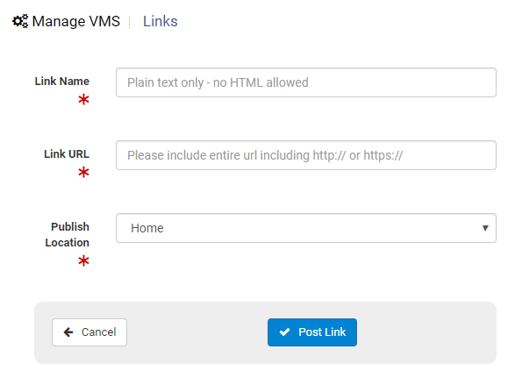
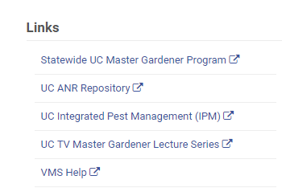
Home Page Links
Notes:
Home Page Links- create links for the home page to anywhere

Slide 21
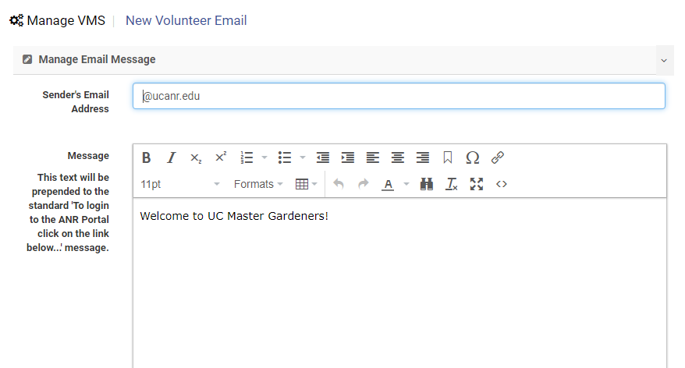
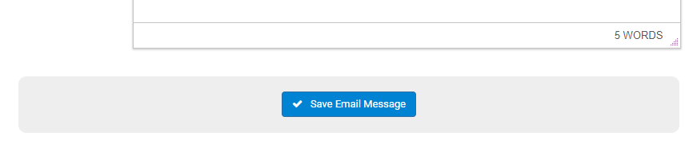
New Member Email
Notes:
New Member Email - create a custom message that will go to new members added to the roster
Create a custom message that is prepended to the standard ‘To login to the ANR Portal click on the link…’ message for new members after they are added to the roster.

Slide 22
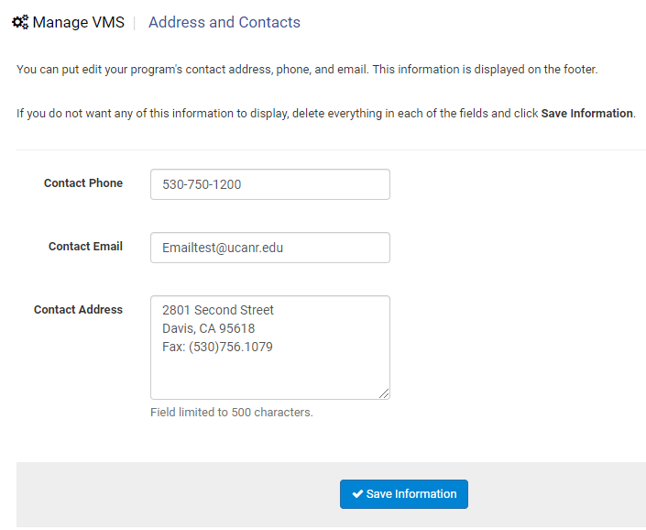
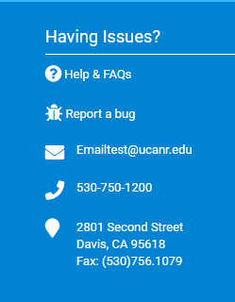
Program Contact Information
Notes:
Program Contact Info- manage your program’s address, phone and email that is displayed in the footer of VMS

Slide 23
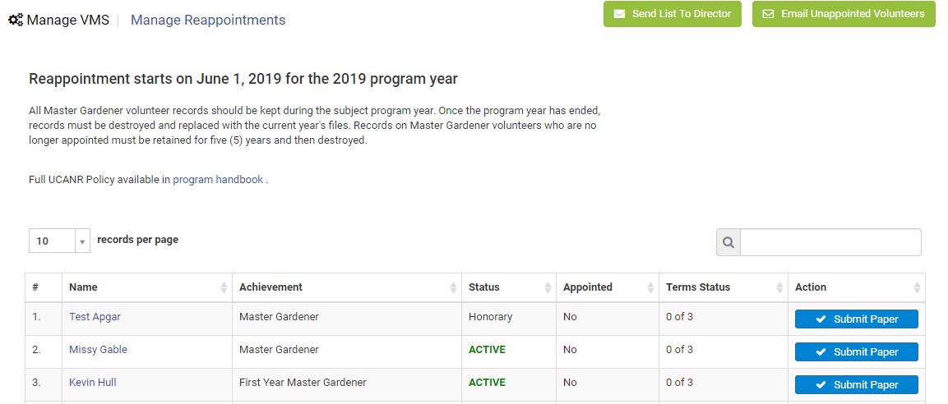
Manage Reappointment
Notes:
Manage Reappointments- manage, track, submit paper, reset terms, send list to Director, email unappointed volunteers and create excel report
Reappointment is turned on by the statewide office (June 1), at this time VMS prompts users to electronically complete the volunteer agreement and releases required to complete reappointment.
Administrators need Full Access rights to manage reappointment

Slide 24
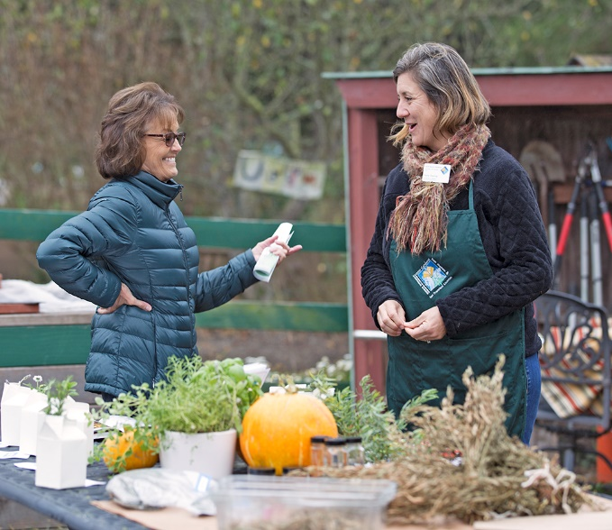
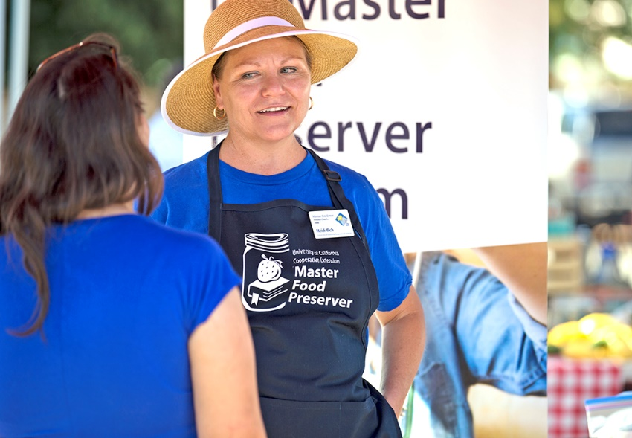
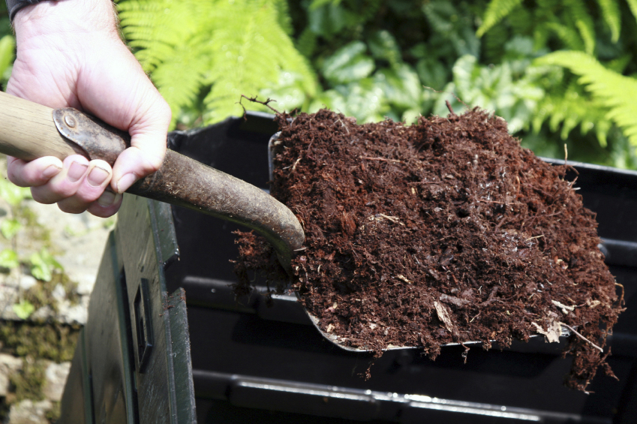
“To extend research based knowledge and information on home horticulture, pest management, and sustainable landscape practices to the residents of California and be guided by our core values and strategic initiatives."
- UC Master Gardener Program Mission Statement
"To teach research-based practices of safe home food preservation to the residents of California."
- UC Master Food Preserver Program Mission Statement
Notes:
There is a wide range of volunteer opportunities. Be sure to sign up for several different types of events and have fun!

Slide 25
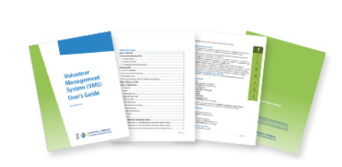
Questions?
Contact [enter your contact information here]
VMS Users Guide and Video Tutorials
http://ucanr.edu/sites/vmshelp/
Notes:
There’s a website, Users Guide, and How-To training videos to help you navigate VMS 3.1

