Slide 1

Instructions for use:
The evaluation process is an important component of telling our story and the impacts we are making in our counties and statewide. Collecting data from participants at events and workshops is critical to our ongoing success. Thank you for your help!
STEP 1: Collect participant name and email address via online registration or sign-in sheet for all public education events (sign-in template available in evaluation toolkit).
STEP 2: Copy slide #2, 3 or 4 from PPT and insert into your presentation as a final presentation slide. (Note: words and images can not be modified or changed because of government regulations. Speaker notes are included in PowerPoint slide).
STEP 3: Submit completed Contact Sheet (available in the evaluation toolkit). within one week of event, e-mail to Tamekia Wilkins, mgevaluation@ucanr.edu.

Slide 2


Help Us Better Serve You!
Our follow-up survey provides us the tools we need to grow and improve the quality of our program.
Notes:
Notes:
“So we can better serve our communities and improve the content and value of our program’s events and workshops, please be on the look-out for an email to access our online survey. The survey typically takes less than 10 minutes to complete. We are so grateful for your support of the UC Master Gardener Program”.

Slide 3

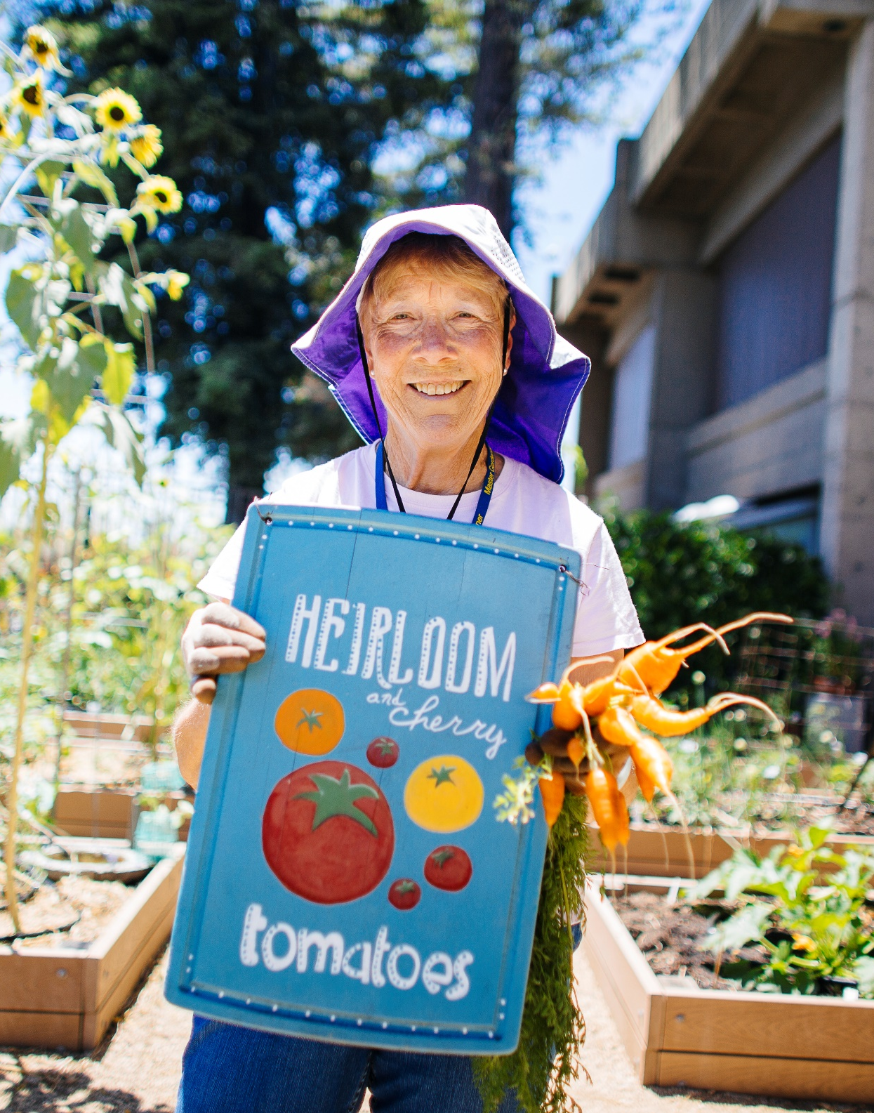

Help us Grow!
Our follow-up survey provides us the tools we need to grow and improve the quality of our program.
Notes:
Notes:
“So we can better serve our communities and improve the content and value of our program’s events and workshops, please be on the look-out for an email to access our online survey. The survey typically takes less than 10 minutes to complete. We are so grateful for your support of the UC Master Gardener Program”.

Slide 4
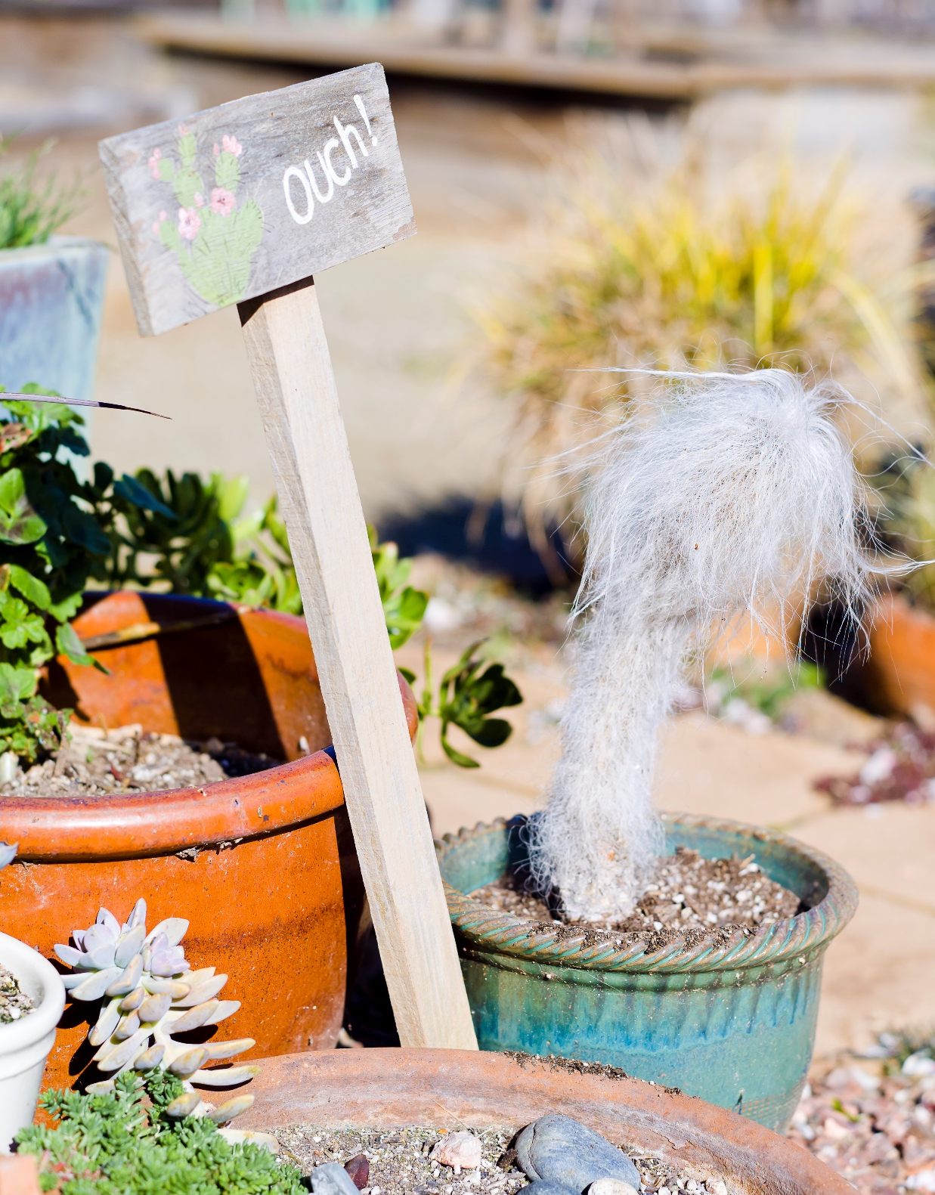
Don’t be
Prickly … Take Our Survey
Our follow-up survey provides us the tools we need to grow and improve the quality of our program.
Notes:
Notes:
“So we can better serve our communities and improve the content and value of our program’s events and workshops, please be on the look-out for an email to access our online survey. The survey typically takes less than 10 minutes to complete. We are so grateful for your support of the UC Master Gardener Program”.

