Slide 1
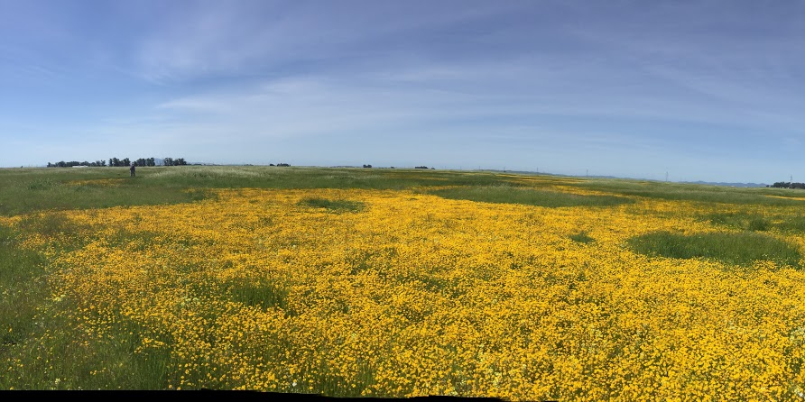
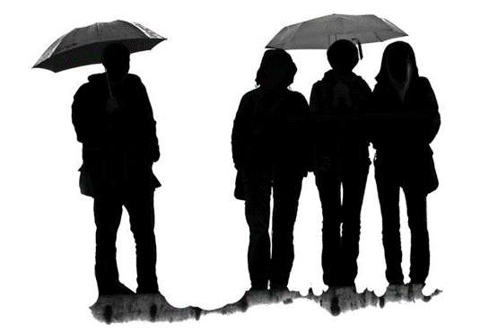

SI meeting: Specific actions to build the umbrella.
Unify
Communicate
UC ANR Strategic Initiatives
Create vision & Strategy
  Identify Initiative Themes & Grand Challenges
  Crystal Ball
  Operate Think tanks
  Id staffing needs
Build capacity
  Host meetings
  SI conference
  Support PT meetings
Manage Grants
Collate stories & highlights
  Knowledge stream
  Spotlight webinars
  SI brief (include PC?)
Develop materials (white papers, etc.)
  Thematic sites
  Trending
Foster debate
SI website
Water
(Quality, Quantity and Security)
Healthy Families
and Communities
Pests
(Endemic and Invasive Pests and Diseases)
Sustainable
Food Systems
Advocate
Represent UC ANR/SI
Engage stakeholders and government
Raise awareness
Representatives on Program Council
Sustainable
Natural Ecosystems

Slide 2
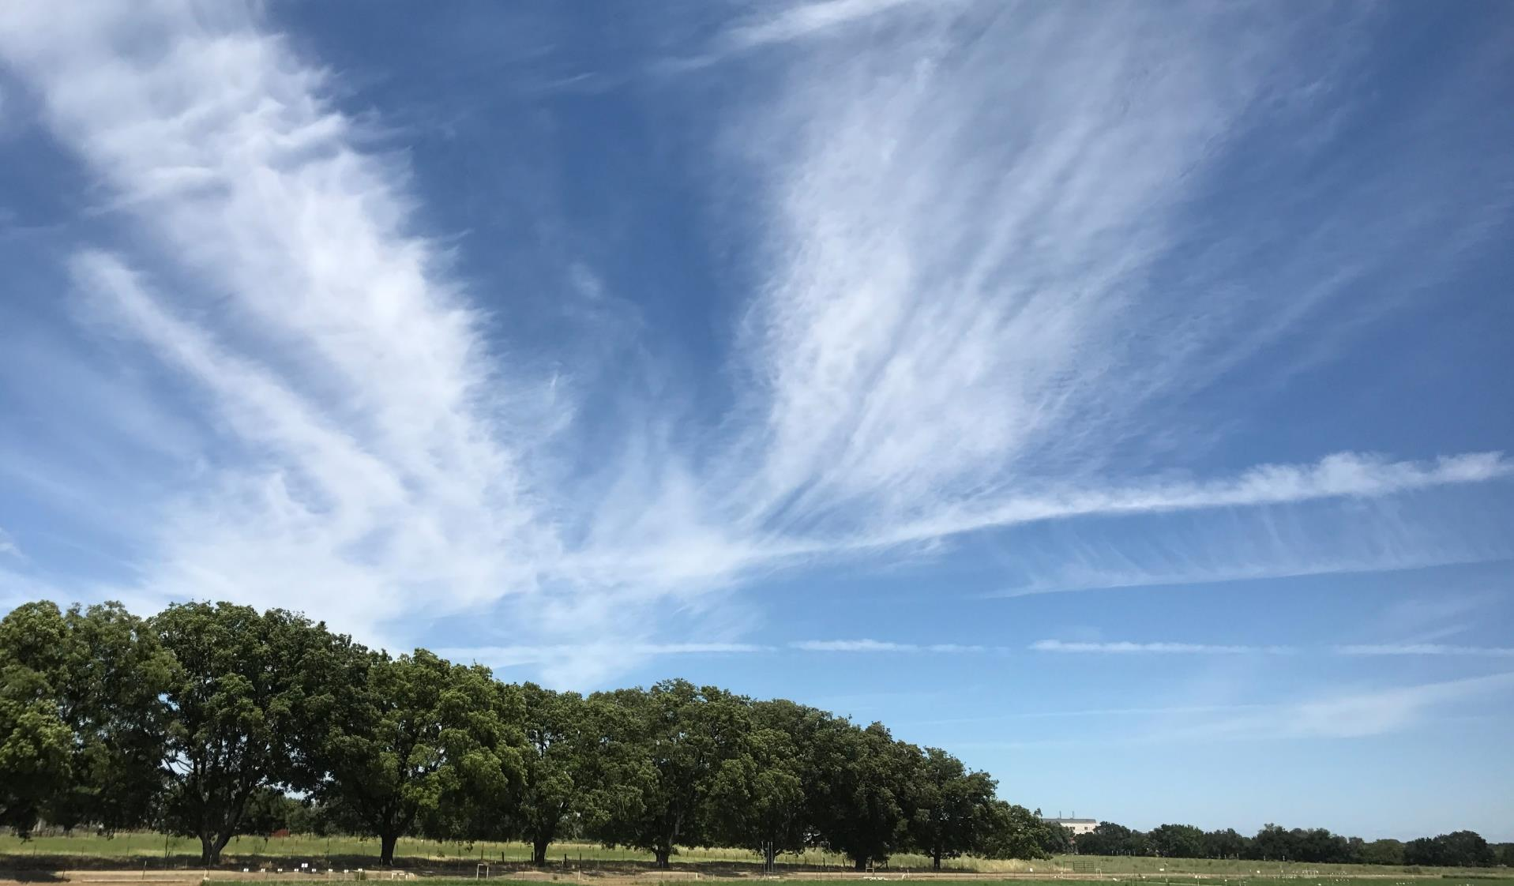
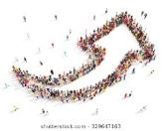
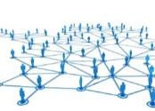

The UC ANR Jigsaw – Connecting for impact
Program Council
Programmatic Policy &
Directions
The Team
Partners
Campus
County-based personnel
(including State Wide Programs)
Davis (2nd St)
Oakland
Strategic Initiatives
(Panels)
Unify
Communicate
Advocate
Program Teams
Network
Share
Learn
Work Groups
Plan & Implement
(Communities of Practice)

Slide 3

Debrief
Unifying
  Crystal ball
  Focal areas and Grand challenges
  (Compass - understanding each other)
  Fire Summit (California Safe)
Communication
  Thematic sites: Fire ; Healthy Soil, …?
  Knowledge stream
  Spotlight
  Trending
  PT reports
  SI Brief (ANR employee newsletter)
  SI website
Advocating
  UC ANR Blogs – PVS activated Example
  Telling our story - What's happening across UC ANR
How build connections - Grow UCA?

Slide 4
Program Team | Status/Questions
Cross cutting
Climate Change
Research-to-Policy
HFC
California Communities | (Food Access - Covered here)
Food Literacy and Healthy Lifestyles
Positive Youth Development
Youth Science Literacy in Nutrition, Agriculture & Natural Resources
EIPD
Pest Management
SFS
Diversified Farming And Food Systems | Name changed
Agronomic Crops | (SFS also EIPD, Water)
Dairy Production & Food Safety
 | Combine as Animal protein?
Meat Production & Food Safety
Pomology | (SFS also EIPD, Water)
Vegetable Crops | (SFS also EIPD, Water)
Viticulture | (SFS also EIPD, Water)
Program Team | Status
SNE
Environmental Horticulture
Forest & Rangeland Systems | How best represent livestock, forestry, rangeland and wildlife?
 | Fire - Add as a PT theme (Crosscutting?)
Water
Water Resources | Represent Ag, urban and Environmental flows
 | How best represent drinking water & resources?
Inactive PTs | Status
Consumer Food Safety | Covered elsewhere
Air Quality | Inactive
Wildlife & Fish | Keeping
*Egg Production & Food Safety | Inactive (combine as animal protein?)

