Slide 1

Adding Video to
Your Extension Program
David Lewis, David Lile, Mark Bell, Petr Kosina, JoLynn Miller, Dustin Blakey, Linda Forbes, and Lauren Snowden
March 02, 2020

Slide 2


Why bother with video?
There are different Video types: e.g.,
Product Review
Educational Videos (e.g., DIY)
Vlogs
Gaming
Sport
Where do Educational videos fall in terms of views? #10? # 5? #20?
#2

Slide 3

Let’s not miss the boat
We have plenty of good information
Let’s turn that information into viewable action that people
want,
can find, and
can learn from.

Slide 4

UC ANR and Videos
Let’s “own YouTube”
When does video make sense
Audience considerations
Storyboards and scripts
Production checklist
Distribution and marketing
Training and production resources
“Don't worry about failures, worry about the chances you miss when you don't even try.”
― Jack Canfield, Chicken Soup for the Soul

Slide 5
When is video the right format for extension?
Why not blogpost, social media, blast email, newsletter, article?
We read faster than we speak!
Video is the medium to show motion!
Video is good for
Showing people & places
Demonstrating techniques
Showing action
Video is not good for
Long explanations
Facts and figures
Static situations
(even static speakers)
Notes:
We are NOT talking about:
Documentary videos (describing events)
Institutional videos (promoting a project or an organization)
We read faster than we speak => what can be easily explained in text, using image or graph, will most possibly not get any better if presented as video.

Slide 6
Advantages | Disadvantages
Excellent format for presenting “how to” instructions, sequential processes, and complex concepts where the visual part facilitates learning | Much harder to edit/correct/update compared to textual information
Better than written text to increase audience’s motivation. | Specific skills, equipment and software needed for video production
Proven longer retention of information received in verbal and visual way (sensory experience) | Environmental and external factors can make the video production complicated
Video is an attractive content to share on social media and blogs | Development takes more time.
 | (Video dictates the speed of information receiving)

Slide 7
Examples of use of video in ag extension:
  raising awareness (e.g. new pests)
  training on agricultural technology and innovations
  stimulating demand for support (e.g. fighting bad diet habits)
  farmer-to-farmer extension
  tool for documenting and monitoring and evaluation (M&E).
Viewers expect more than a “talking head”
  Prerequisite for a successful video is eye-catching, interesting visual material
Video is just a medium for your message
  So, what’s your message?

Slide 8
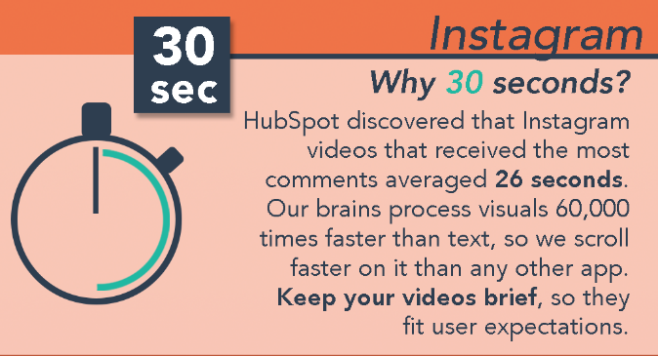
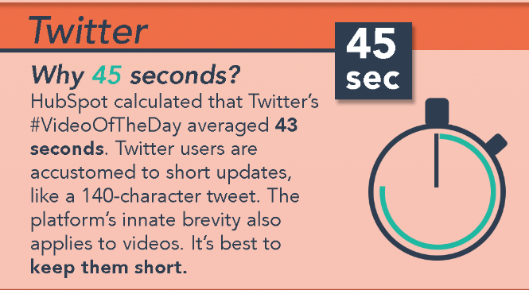
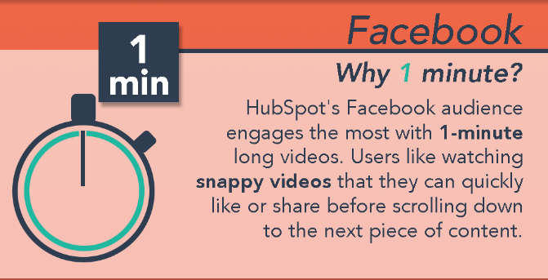
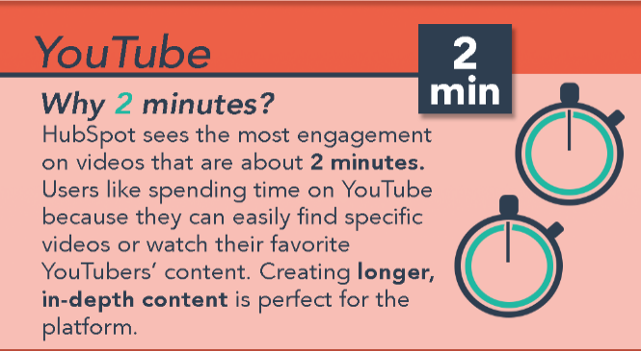

The video should be between 30 sec and 3 min
https://blog.hubspot.com/marketing/how-long-should-videos-be-on-instagram-twitter-facebook-youtube

Slide 9
Before the camera rolls, serious work goes into thinking about the audience, the story,
and the distribution of video.
Notes:
Define & refine your ideas: Why do you want to make this video?
Why not a flyer, brochure, blog post, infographics or other form?
Reason for making video is to show, illustrate, demonstrate; not just tell.
Takeaway - skill, concept, principle you want to teach/present

Slide 10
Target Audience
-Because it’s on YouTube, my audience is EVERYONE? NO, we still must have a target audience.
-Who is your audience for other extension programs?
-Demographics, socio-economics, geography, behavior patters, etc.
-Could you expand your audience using video?
-Be sure to announce who your audience is in the description or at the beginning of the video.

Slide 11
Learning Objectives
-Bring awareness to your program
-Learn a specific skill
-Invitation to an event
-Call to action (donate, visit your website, etc.)
Once you’ve decided on a learning objective, THEN you can build the video.

Slide 12
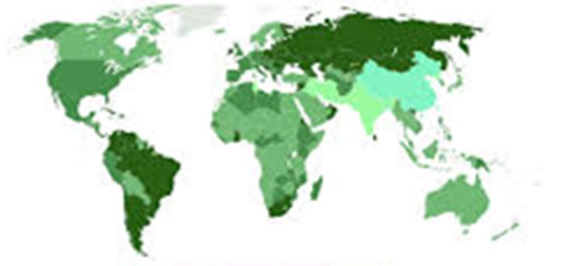
Culturally Relevant Programming

Slide 13

What is Culture?
The shared experiences of people, including their languages, values, customs and worldviews.
Fields, N. (2019). Increasing Cultural Awareness and Equity in Your Extension Programs. https://campus.extension.org/

Slide 14

What is Culturally Relevant Programming?
Uses the “cultural knowledge, prior experiences, frames of reference, and performance styles of ethnically diverse students to make learning encounters more relevant to and effective for them”
Gay, G. (2000). Culturally Responsive Teaching : Theory, Research, and Practice (Multicultural Education Series, No. 8). New York: Teachers College Press.

Slide 15
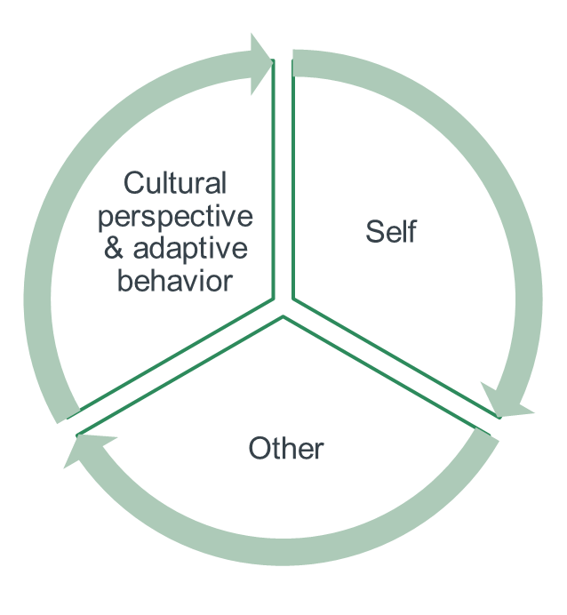
Ideas to consider…..
-Understand and identify your cultural identity
-Examine your assumptions about teaching diverse populations
-Learn about the cultural identities, practices, history, and norms of your target audience
-Identify & include diverse voices of history, theories, & experiences in your curriculum & teaching materials.
-Incorporate multicultural information, resources, and materials

Slide 16
Script and storyboard
Disclaimer:
Parts of content adapted from
Lee LeFever founder of Common Craft and the author of The Art of Explanation – Making Your Ideas, Products and Services Easy to Understand.
What is a storyboard and why do you need one? (https://www.vyond.com/resources/what-is-a-storyboard-and-why-do-you-need-one/)
Notes:
https://www.vyond.com/resources/making-an-explainer-video-writing-a-script/

Slide 17

Script - how to start?
Create a list of the essential information
What your audience need to understand and why?
What key points (or steps) can you communicate that will serve that need?
What do you want your audience to do once they understand?
  start writing
writing down an explanation helps you understand it better

Slide 18

Framework for your script
Build context
Tell story
Make connections
Describe the steps and why they matter
Call to action
  Visit website, download an app, share the video, or?

Slide 19

Script do’s and don’ts
Introduce appropriately your character(s)
For 3 minutes video, limit your script to 400-500 words
Read it aloud
Limit the use of abbreviations
Use video to show not just to tell
Script is easy to share and get feedback!
One important decision to make:
Will you record audio and video simultaneously or do a voice over?

Slide 20
Script – Identification of parasitized alfalfa caterpillars
I’m Rachael Long, farm advisor with UC Cooperative Extension in Yolo county. In this video I’ll show you how to recognize caterpillars that have been parasitized by tiny wasps. Alfalfa caterpillars, western yellowstriped armyworms, and beet armyworms are key pests of alfalfa. Although these pests can cause significant economic damage to alfalfa, it’s not always necessary to use pesticides to get rid of them. There are naturally occurring parasites and predators in the field that can help reduce caterpillar numbers so that you can avoid unnecessary pesticide use. Regular monitoring of your field for the presence of alfalfa caterpillars and armyworms is essential for making good management decisions. To record the data about caterpillars collected in your sweep net, use the Monitoring form which can be downloaded from the UC IPM website. …..

Slide 21
Storyboard
Blueprint, a graphic representation of how your video will unfold, shot by shot [a comic book version of your script]
Divides your story into chunks/scenes, but also helps to keep it coherent
Guides what shots (and props or tools and other visuals*) you’ll need to create (and how to create them) => excellent plan for production
Guides video editing – forces you to think about details ahead of time (e.g. scene transitions, zoom, text placement, etc.)
Helps to share and explain your vision for your video with others (=> getting better feedback)
It is an extra step in planning but saves time in revisions later!
*Visuals - photos, slides, screencasts, schemes, animations, other video clips, etc.
Notes:
Storyboarding was allegedly developed by Walt Disney studios in early 1930’s

Slide 22
Video: __________________________________
Shot/screen #
Shot/screen #
Shot/screen #
Action:
Dialogue:
FX:
Action:
Dialogue:
FX:
Action:
Dialogue:
FX:
Notes:
Each square is different shot or screen
Many different templates available on internet - https://www.sampletemplates.com/business-templates/free-storyboard-templates.html
https://www.printablepaper.net/category/storyboard
Also PowerPoint can be used or specialized software for storyboarding

Slide 23
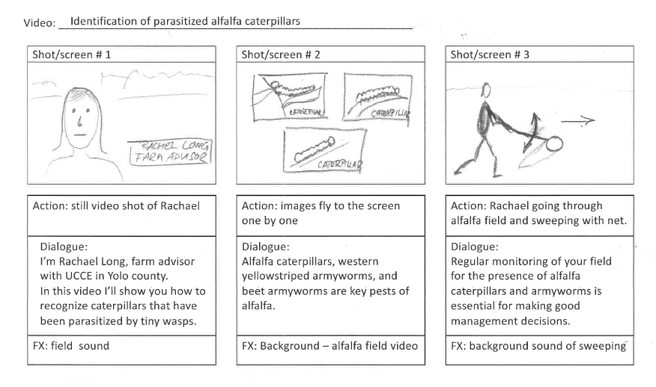

Slide 24
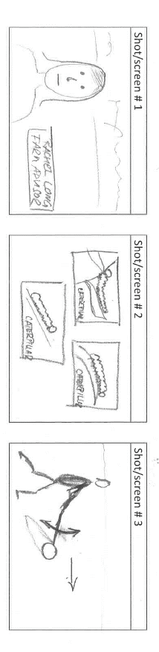
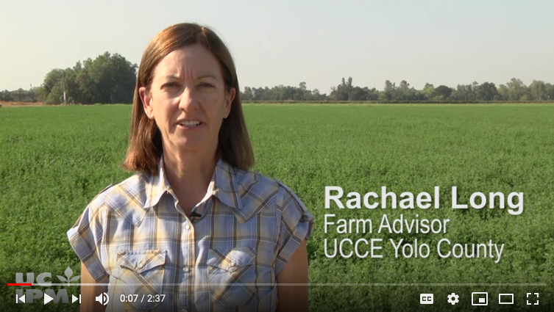
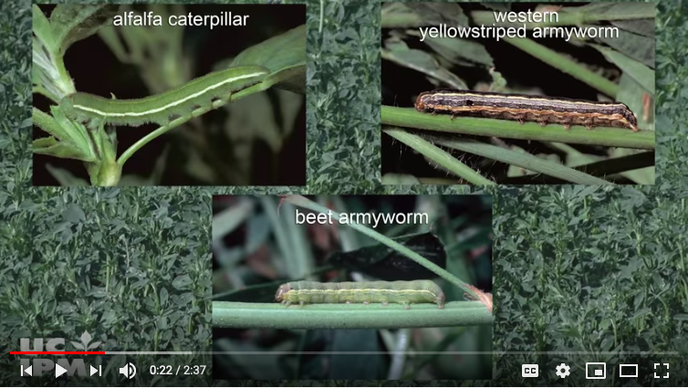
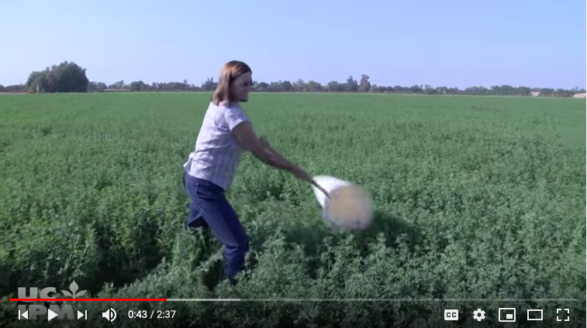

Slide 25
 | Footage/photo/slide | Narration
1 | Waist up shot of Rachel Long standing in alfalfa field | I’m Rachael Long, farm advisor with UC Cooperative Extension in Yolo county. In this video I’ll show you how to recognize caterpillars that have been parasitized by tiny wasps.
2 | Three still images of the three different caterpillars fly in one by one, ending side by side | Alfalfa caterpillars, western yellowstriped armyworms, and beet armyworms are key pests of alfalfa.
3 | Rachael going through alfalfa field and sweeping with net. | Regular monitoring of your field for the presence of alfalfa caterpillars and armyworms is essential for making good management decisions.
4 | Detail shot of emptying sweep net content on a tray. Swing the camera from tray with worms to monitoring form lying next to the tray. | To record the data about caterpillars collected in your sweep net, use the Monitoring form which can be downloaded from the UC IPM website.

Slide 26
Script writing and storyboarding is an iterative process
Write/draw
Get feedback
Review and edit
Production
Notes:
Chages during production are much more time consuming = expensive

Slide 27

Storyboard best practices
Show, don’t tell.
Be cinematic. Do people, places and things move or stand still? Does the camera move?
Make sure it’s logical and coherent.
Include all relevant details. Break up your script into smaller chunks and make note of important information:
  What is the setting or background for the scene?
  Is there a character on screen? If so, what action is the character performing?
  What props are in the scene?
  Will any text appear on screen? What is the size, color, and position of the text?
  Keep in mind your objective for making this video!

Slide 28
Useful terminology
Close-up shot: A close range of distance between the camera and the subject.
Long shot: A long range of distance between the camera and the subject, often providing a broader range of the setting.
Reaction shot: A shot of someone looking off screen, revealing their reaction to a character within a scene.
High camera angle: A camera angle that looks down on its subject, making it look small, weak or unimportant.
Level camera angle: A camera angle that is even with the subject; it may be used as a neutral shot.
Low camera angle: A camera angle that looks up at its subject; it makes the subject seem important and powerful.
Point-of-view shot (POV): A shot that is understood to be seen from the point of view of a character within a scene.
Pan: A steady, sweeping movement from one point in a scene to another
Tilt: Using a camera on tripod, the camera moves up or down to follow the action.
Zoom: Use of the camera lens to move closely towards the subject.
Dissolve: A transition between two shots, where one shot fades away and simultaneously another shot fades in.
Fade: A transition from a shot to black where the image gradually becomes darker – a ‘Fade out’; or from black where the image gradually becomes brighter – a ‘Fade In’.
Jump cut: A rapid, jerky transition from one fame to the next, either disrupting the flow of time or movement within a scene or making an abrupt transition from one scene to another.

Slide 29
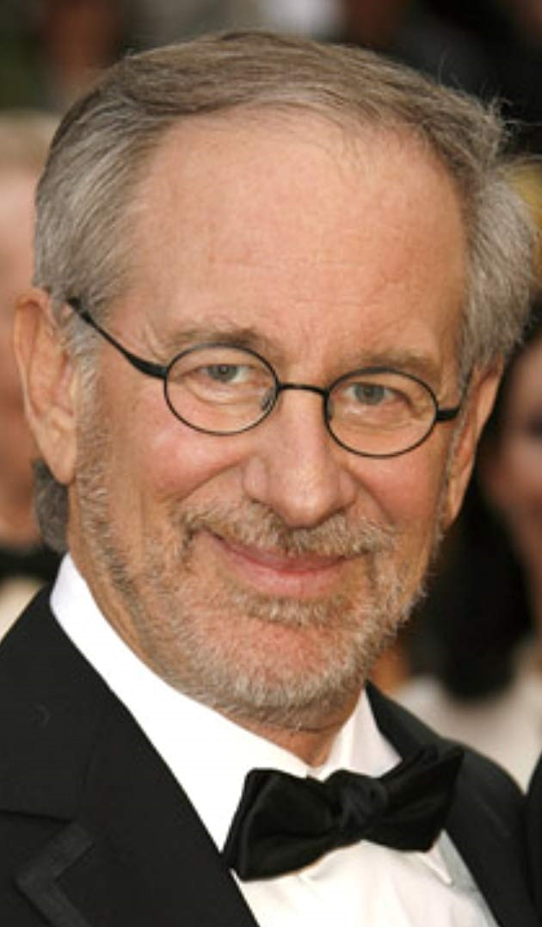

ANR Video Production Checklist
“Adding Video to Your Extension Toolbox” Webinar
March 2, 2020

Slide 30

A Checklist??

Slide 31
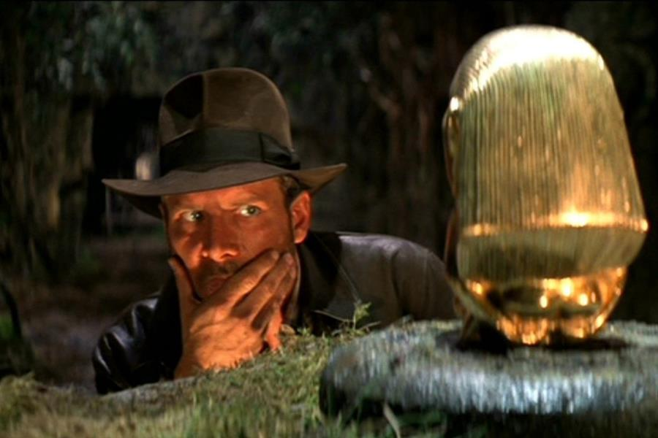
Decision Points
Pre-production
Content Management
Editing
Encoding
Uploading / Posting

Slide 32
Learning & Development Toolbox
ucanr.edu/videotools
(This link will be shown again so get your pencil ready.)

Slide 33
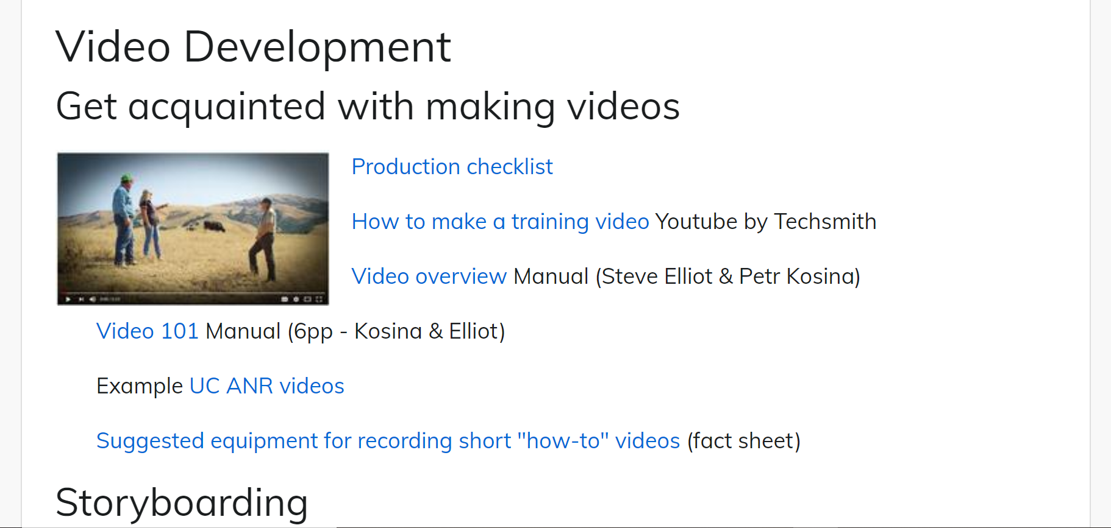
Learning & Development Video Tools
Look here!

Slide 34
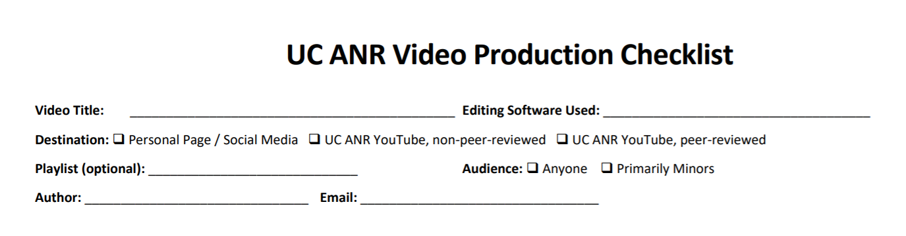
Top Part…

Slide 35
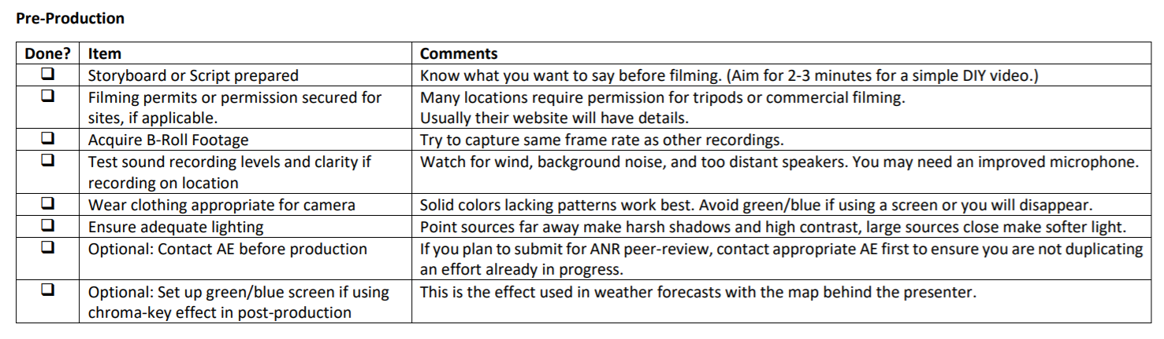
Pre-Production…
An ounce of prevention is worth a pound of cure.

Slide 36
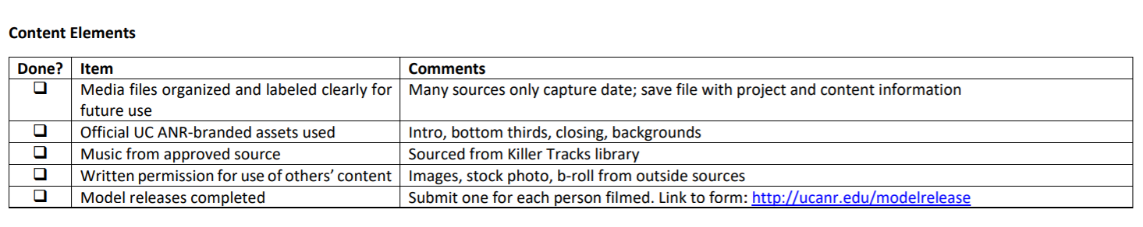
Content Elements…
Make sure content follows guidelines.

Slide 37
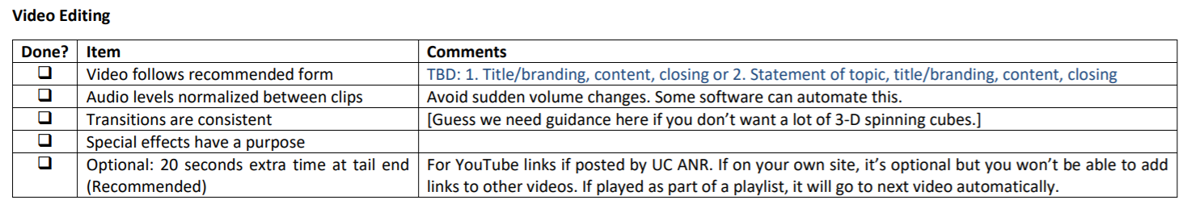
Editing…
Things to watch for during edit.

Slide 38
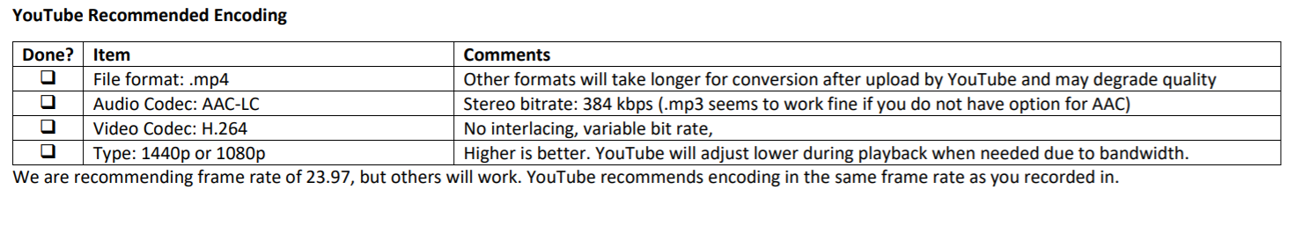
Encoding…
How to save a file for uploading.
This is different than saving the project in your editor.

Slide 39
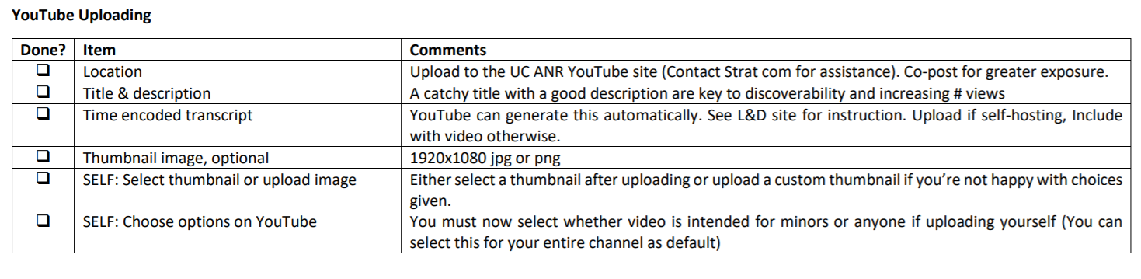
YouTube Uploading … Subject to Change
Decide where it’s going and what it’s called.
This is the final finishing touches.

Slide 40

Stuff to Keep in Mind:
Checklist is a working draft – Feedback is welcome
More ANR asset options are being developed
Check in at the start of each project for latest versions!

Slide 41
To Get The Checklist Go To L&D Video Page:
ucanr.edu/videotools
Submit form with peer-review, or for ANR Channel uploading.
Personal uploading? Recommend using form, but no submission needed.

Slide 42
Branding, posting and distributing your videos

Slide 43
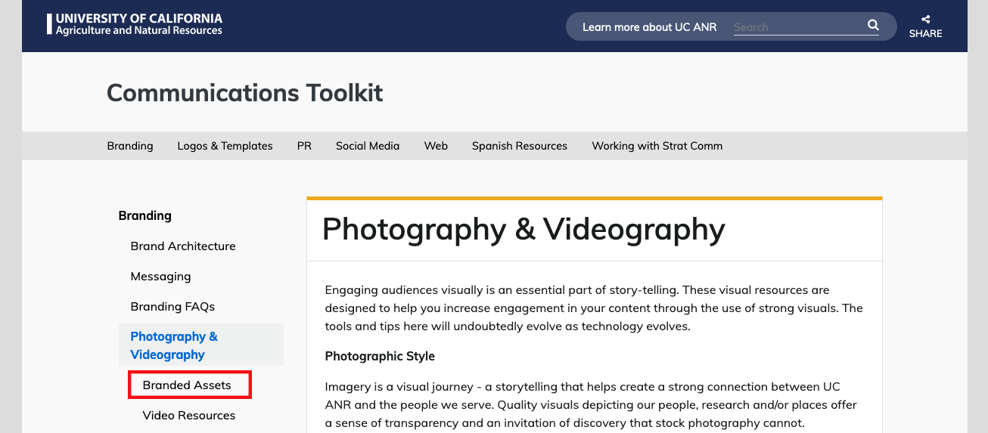

Slide 44
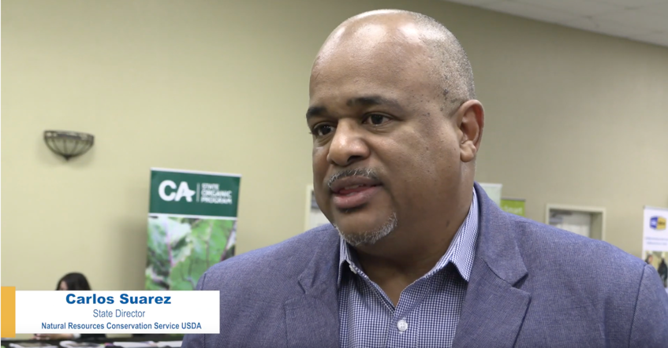
Available Assets
Branded “intro” and “outro” options
White and blue backgrounds 1920x1080
Lower third format

Slide 45
Posting Best Practices
Conduct keyword research
Write a keyword-rich description
Optimize YouTube tags using relevant keywords
Transcribe your videos
Categorize your videos
Use cards and end screens if appropriate
Upload a custom thumbnail image for your video’s search result link
See detailed guidance on the Learning & Development site

Slide 46
Distribution Best Practices
Share and embed videos
    -Website
    -Relevant landing pages
    -Emails and email signatures
    -Blogs
    -Social media
Comment, engage, interact with the YouTube community
Share your video link with contentpipeline@ucanr.edu
Discuss promotion strategy with Strategic Communications
See detailed guidance on the Learning & Development site

Slide 47
Training and Production Resources
ucanr.edu/videotools
  Production Checklist
  Video 101 Manual
  Equipment list
  Best video recording practices video
  Editing with branded intro and outro
Shooting Videos with Your Iphone – Ricardo Vela, Webinar April 8, 11:30-12:00

Slide 48
Training and Production Resources
Getting Your Extension Program on YouTube – Clinics for do-it-yourself video production
  Weds. & Thurs. April 15-16, 2020 Hopland REC
  Tues. & Weds. April 21-22, 2020 South Coast REC
  Application:
    Opens March 2, 2020, look for email with online application survey
    Closes March 20, 2020
    Notification March 27, 2020
  Application homework
    Submit a brief (1-2 page project proposal)
    Participate or watch this webinar
      Golden Ticket Password for the application
        “ANR’s how-to videos”

