Slide 1
New Pcard Reconciliation Process Training
ANR Pcard Holders
Presented by ANR Business Operations Center, Janene Iorga
Thursday, August 12

Slide 2
Today’s Agenda
Why the process is changing and when
Benefits
How to process Pcard expenses in Aggie Travel
Appendix
  Delegates create/edit report
  Workflow & Ad-hoc Routing for approvals
  Best Practices
  Concur App
  Resources

Slide 3
Why the process is changing
ANR contracts with UC Davis Procurement Services
When: August 27, 2021
To improve and expedite the reconciliation process
    •Streamlined expense types
    •Easier interface
    •Mobile app functionality
Consolidate p-card and travel card reconciliation processes
  in a single system
Aggie Enterprise is coming…

Slide 4
Benefits
Multiple card transactions can be reconciled at one time on one single report (bi-weekly, weekly)
No need to complete Pcard Detail Form – info imports to system
Concur App – take photo of receipt (paper or email) – upload to system automatically
No lost receipts
Saves time and easier to track
Expenses can be reflected in ledgers faster

Slide 5
Processing Pcard Expenses in AggieTravel

Slide 6
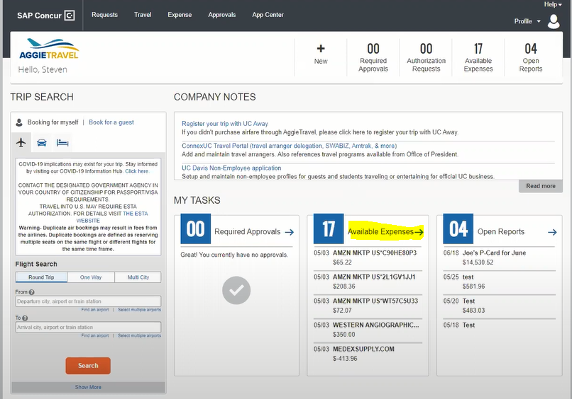
How to process Pcard expenses in AggieTravel
Pcard expenses will upload directly into AT

Slide 7
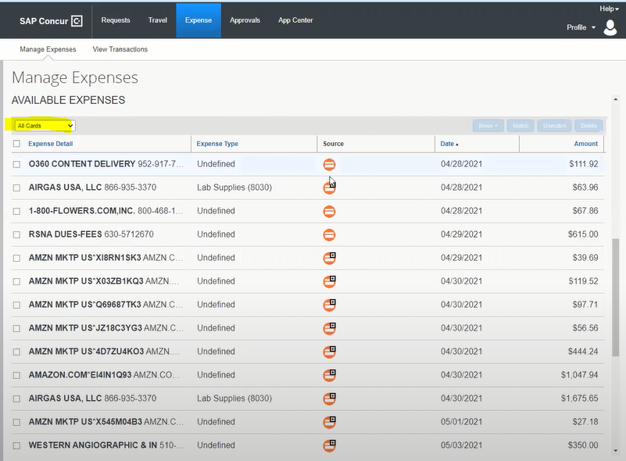
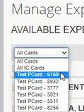
How to process Pcard expenses in AT - continued
Select Card on the scroll down under Available expenses
Orange – Pcard expense
Green – Travel Corporate card expense

Slide 8
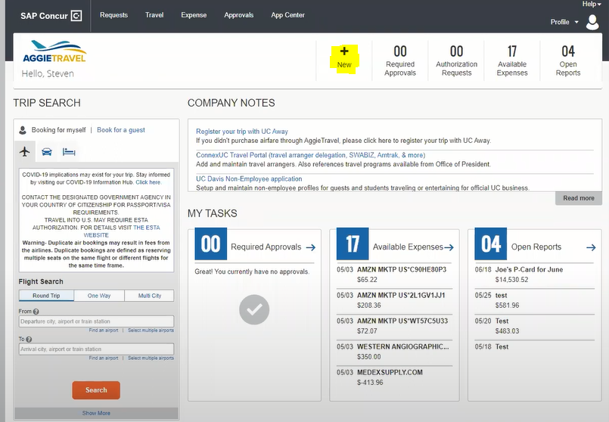
How to process Pcard expenses in AT - continued
Create Report

Slide 9
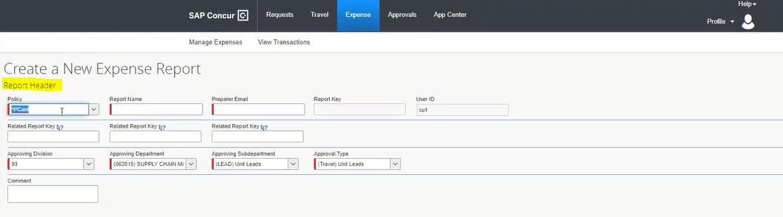
How to process Pcard expenses in AT - continued
Create Report
Select Pcard (Policy drop down defaults to Travel Card)

Slide 10
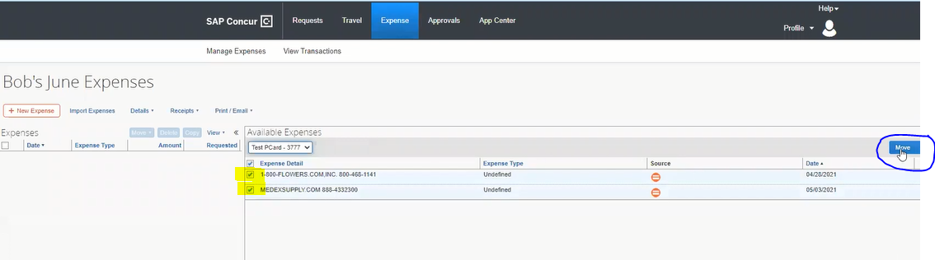
How to process Pcard expenses in AT - continued
Move selected expenses to report
Click on Move to transfer selected expenses to current report
Select expenses

Slide 11
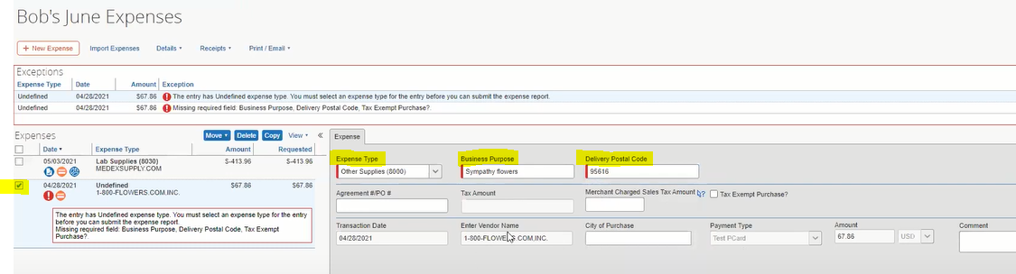

Completing expense details
Click here if same account is being used for all the transactions
Important: Enter Delivery Postal Code – Determines the tax rate
Select Expense to complete the Expense fields, allocate expenses and attach receipts
Select expense type from drop down menu
Detail Business Purpose includes what, why (benefit), program or project. Field has 64 characters (Use Comment section as needed)
Notes:
Postal Code – If purchased on site, use the store’s zip code; If purchase on line, use the delivery address zip code

Slide 12
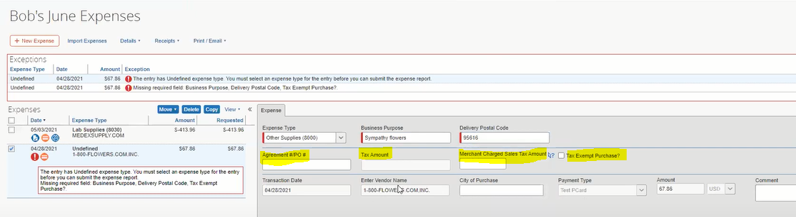
Completing expense details
If sales tax was not prepopulated but charged, enter amount here.
Select box if purchase is sales tax exempt in CA: non-tangible items
If purchase had an approved Purchase Agreement or Purchase Order – enter number here
If transaction charged sales tax it will prepopulate this field

Slide 13
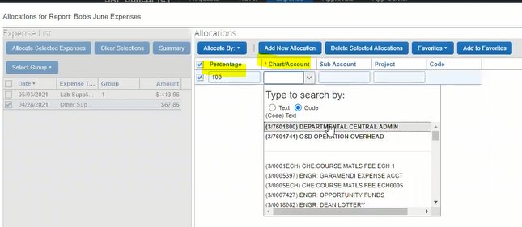
Completing expense details
Always attach receipts for individual expenses (from available receipts in your Concur dashboard or from your computer)
Once completed, save, allocate expense to an account and attach receipts.
Percentage – allocate 100% or split
Chart/Account – L/349PDSL
*Use back slash “/” (not dash)

Slide 14
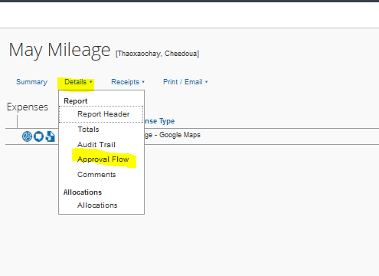
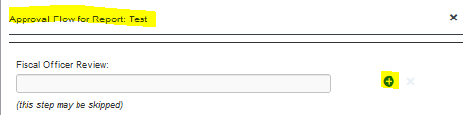
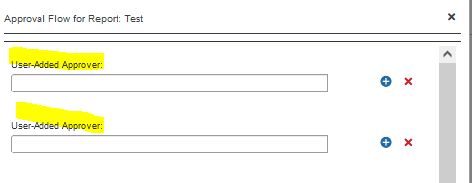

Adhoc Report Routing to Unit Director or Designated Unit Approver
2
1
3
From main page of expense report, select Details, and Approval Flow
This screen will be your initial viewing screen, click on the plus sign
Add your adhoc approver(s)
Save Workflow
4

Slide 15
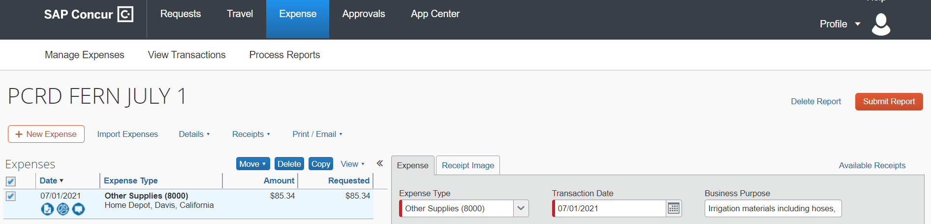
Submit Pcard expense report
Checklist:
All expenses selected from available expenses
Select expense type
Complete Business Purpose and Tax information
Allocate account
Attach Receipt
Add Adhoc routing
7. If Delegate creates report, select Orange button “Notify Employee”
8. Pcard holder Submits report.

Slide 16
Appendix
Creating Delegates
Adhoc Routing
Best Practices
Concur App
Resources

Slide 17
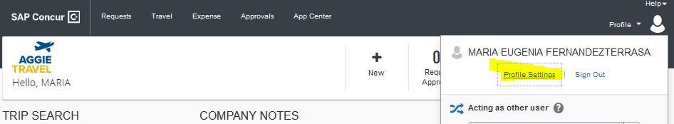
How to set up Expense Delegates
Pcard holder can set up as expense delegates to create expense reports for a Pcard holders
1. On the main page of your Aggie Travel Dashboard, select Profile, and select Profile Settings

Slide 18
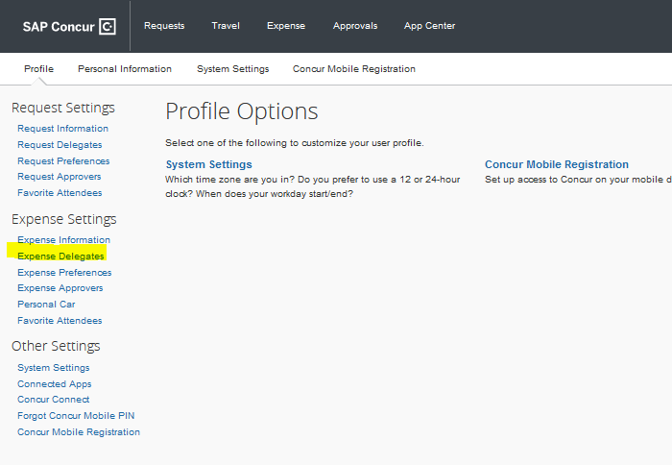
How to set up Expense Delegates continued
2. Select Expense Delegates

Slide 19
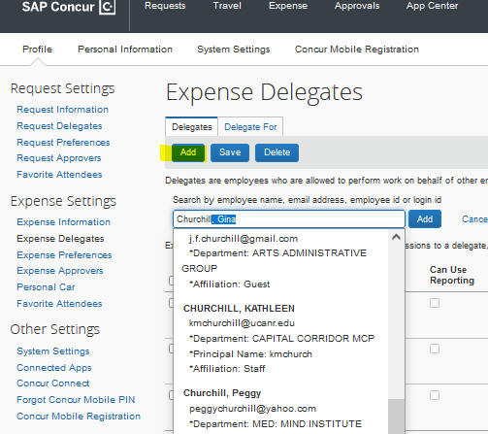

How to set up Expense Delegates continued
3. Select Add and start writing the name of your delegate until it populates
4. Select boxes for “Can Prepare”, “Can View Receipts”, “Receive Emails” and “Receives Approval Emails”
5. Click Save Button to save new added delegate,

Slide 20
Adhoc Routing Required
Pcard expense reports automatically route to Fiscal Officer as default
Unit Director approval required before Fiscal Officer
Adhoc approvals need to be entered on each report

Slide 21
Workflow Options: SWP - Admin Units - RECs
1
Card Holder creates expense Report in AggieTravel
Adhoc to an approver as needed e.g. Director
BOC/FISCAL OFFICER reviews and approves
Expenses post to ledgers next day
2
Card Holder prepares Pcard cover sheet
Delegate to BOC staff to create expense Report in AggieTravel
Card Holder reviews and submits report in AggieTravel
Adhoc to an approver as needed e.g. Director
BOC/FISCAL OFFICER
Reviews and approves
Expenses post to ledgers next day
Notes:
RECs reach out to your Business Manager to discuss how your location will be managing this new process

Slide 22
Best Practices
Reconcile transactions at least biweekly, or as frequently as necessary. Each Pcard holder must submit their expense reports and is ultimately responsible for managing their charges.
Attach receipts and backup to each line individually, not at the Header section
Assign delegates to prepare cardholder reports. A Pcard holder can have multiple delegates.
A delegate can either prepare or approve a report, but not both.
Utilize the Concur app for remote capture of receipts and backup

Slide 23
Pcard requirements that have not changed
The deadlines and importance of completing the reconciliation process in a timely manner do not change
  Within 30 days of the transaction posting
  After 60 days, it becomes taxable income
  Pcard privileges can be revoked for non-compliance
Follow allowable uses for the Procurement Card and existing policies
Annual Pcard Training is required
FIS 418 shows unreconciled expenses

Slide 24
Remember…
Adhoc reports to Director before submitting
  Each unit can determine the adhoc routing scenario to use
  Expenses charged to an award always need to be approved by PI

Slide 25
Tips for Approvers
Review:
  Allowable expenses
  Detailed Business Purpose per each expense transaction
  Correct account used on each expense
  Appropriate receipts and documentation are attached
  Adhoc to any additional approver as needed

Slide 26
Concur App

Slide 27
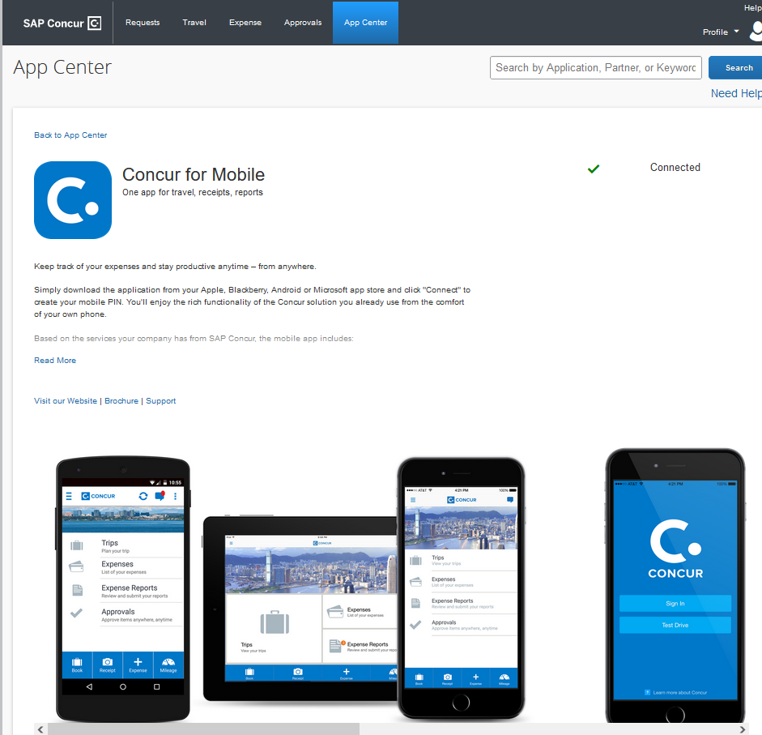
Concur App
Download the SAP Concur mobile app from your device's app store. You can also get a link to download the app from your AggieTravel profile under the Concur Mobile Registration link

Slide 28
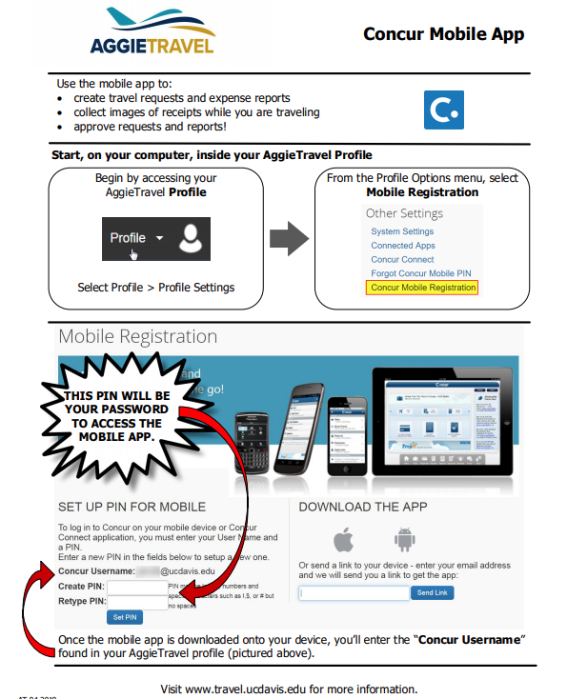
Concur App
https://supplychain.ucdavis.edu/sites/g/files/dgvnsk2181/files/inline-files/Mobile%20Application-v.4-19.pdf
Link for instructions to set up your mobile access in your Aggie Travel profile using a computer before you can login to the app.

Slide 29
RESOURCES

Slide 30
Links to websites:
UCD – New Process Pcard Reconciliation
https://supplychain.ucdavis.edu/pay-purchase/p-card/reconciliation-in-aggietravel
Allowable and Unallowable Expenses
https://supplychain.ucdavis.edu/pay-purchase/p-card/using-card#allowable
Adhoc Routing
https://supplychain.ucdavis.edu/travel-entertainment/aggietravel/expense-reports/ad-hoc-routing
Sales Tax and Use Tax
https://financeandbusiness.ucdavis.edu/systems/kuali/docs/purchasing/pcdo/use-tax

Slide 31
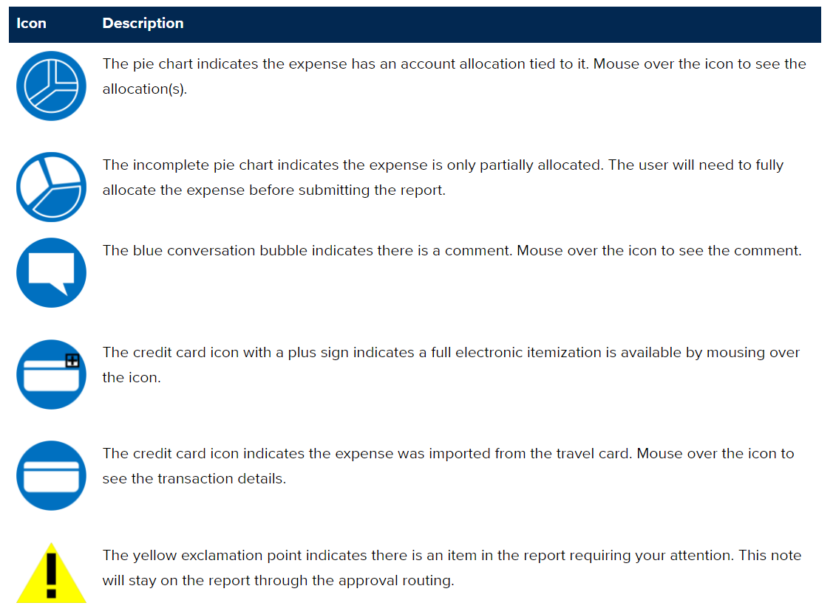
Aggie Travel Icons
https://supplychain.ucdavis.edu/travel-entertainment/aggietravel/help/icons

Slide 32
Questions? Contact your BPT Team:
Team 1: boc-uccepartner1@ucanr.edu
Team 2: boc-uccepartner2@ucanr.edu
Team 3: boc-uccepartner3@ucanr.edu
Team 4: boc-uccepartner4@ucanr.edu
Team 5: boc-partner5@ucanr.edu
THANK YOU!

