Slide 1
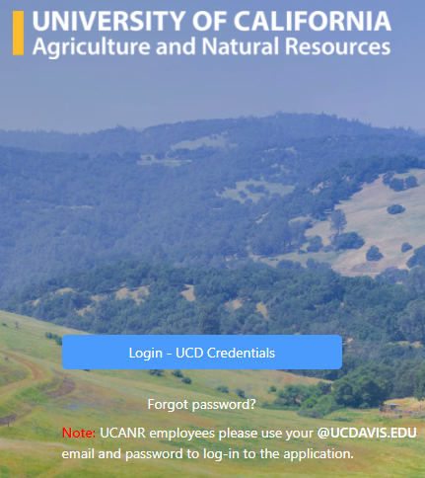
Workflow Automation Application Training
Presented by ANR Business Operations Center Janene Iorga & Maru Fernandez
Thursday, August 12

Slide 2
Today’s Agenda
Workflow Automation Application Details
Implementation
Dashboard
Unauthorized Purchase Form
Check Request Form
Funding Change Request Form

Slide 3
Workflow Automation Application Details - BOC
Purpose: to provide an easier, automated process to route the following forms:
Unauthorized Purchases - Confirming Orders
Check Requests
UC Path Funding Change Request
No policy or other changes intended – automated routing of the same information and existing approvals

Slide 4
Automated Workflow Forms - BOC
Implementation steps:
Three initial forms were piloted
Engaged in focused user testing: BOC staff and clients
BOC forms are now “Live”
One month “grace” period
Expect modifications and forms/process to evolve

Slide 5
Automated Workflow Forms - BOC
Implementation Support
Adhoc trainings for Units upon request
“Office hours” by zoom to support implementation
Central email for support: support@ou.ad3.ucdavis.edu
Notes:
We are offering Adhoc trainings to Units that want more instruction
Offices hours have been setup and I will discuss these later in the presentation
Support email if you have not received the “Invitation” to the WFA platform ~ example invite

Slide 6
Automated Workflow Forms – Other Units
Office of Contracts and Grants
  Form 800
  Advance Account Request
Risk and Safety Services
  Alcohol Permit
  Certificate of Insurance
Notes:
More units will be launching their respective forms ~ Currently Contracts/Grants & Risk & Safety have launched forms.

Slide 7
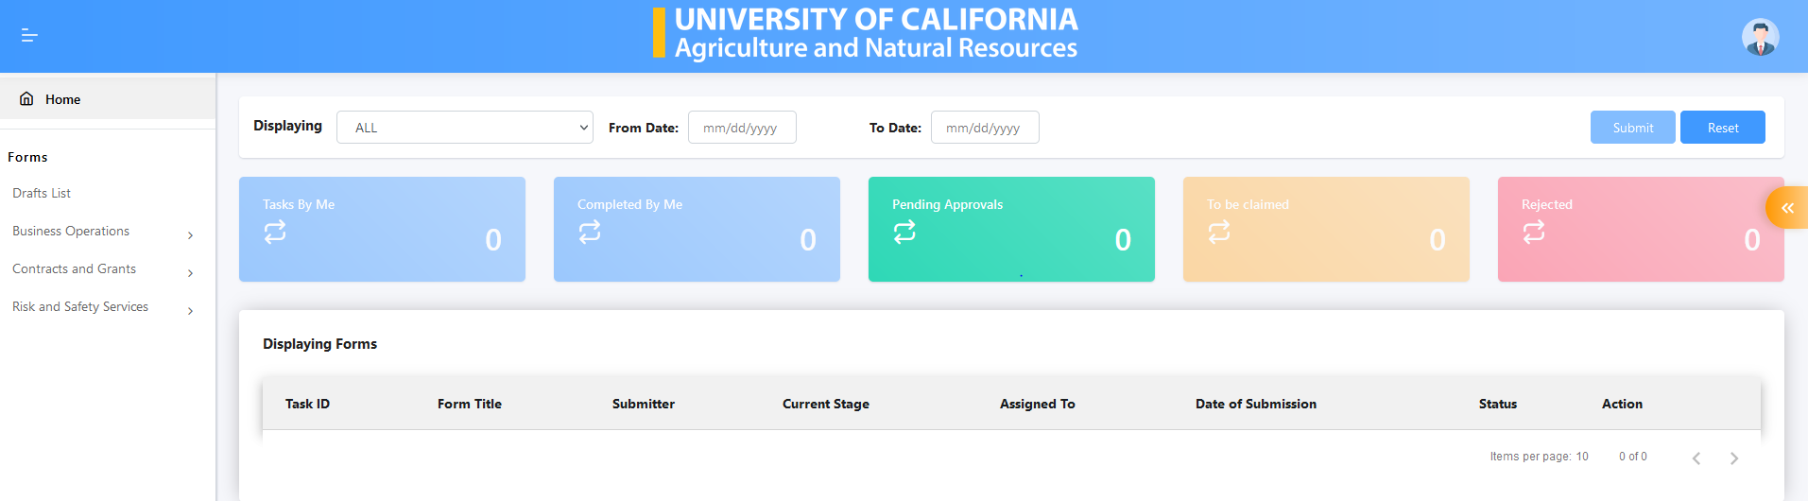
WFA Dashboard
Notes:
Must use “House” to return to menu ~ The Unit (blue) will not take you back to the menu

Slide 8
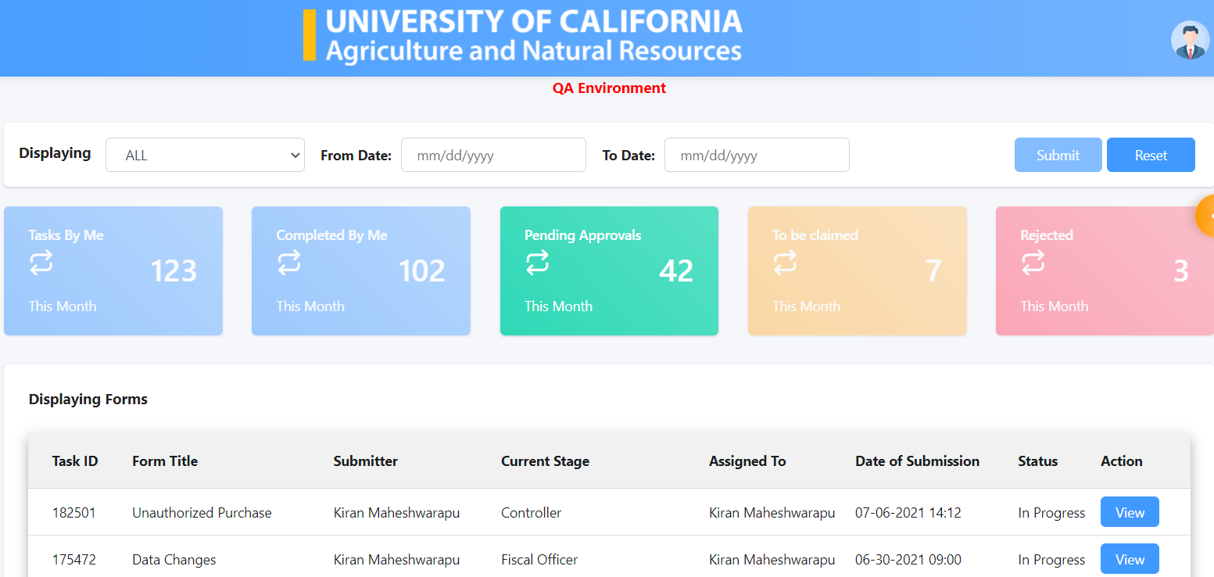
Navigate the Dashboard
Tasks by Me: displays forms submitted by you as well as drafts

Slide 9
Navigate the Dashboard
Completed by Me: displays forms that you’ve already approved

Slide 10
Navigate the Dashboard
Pending Approvals: displays forms that are waiting your approval

Slide 11
Navigate the Dashboard
To be Claimed: is applicable to forms that are programmed to route to groups

Slide 12
Navigate the Dashboard
Rejected: displays forms where changes / additional information may be required and the form be resubmitted.

Slide 13
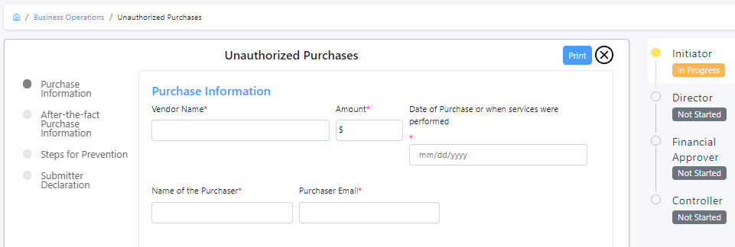
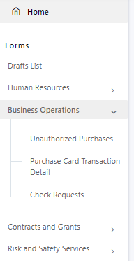
Unauthorized Purchases
(Confirming Order)
Go to the Dashboard → Forms (from the left side of the screen)→ Select Department → Displays all forms under the department

Slide 14
Unauthorized Purchases Form
Purpose
  Purchase that did not follow UC Davis and UC ANR policy
  Out of pocket purchases higher than $499
  Unauthorized service without an approved UC business contract/purchase agreement
  Unauthorized purchase without an approved UC purchase order
  Emergency Purchase
Another staff member can submit the form for the purchaser

Slide 15
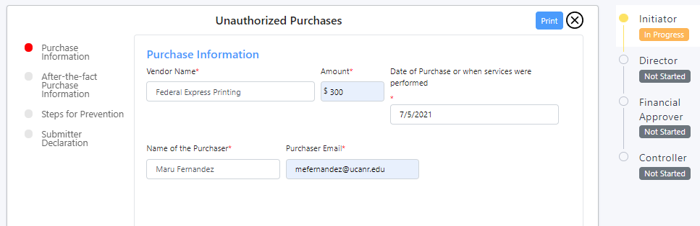
Unauthorized Purchases Form – Page 1
Form Pages
Form Routing
Notes:
Do live DEMO here

Slide 16
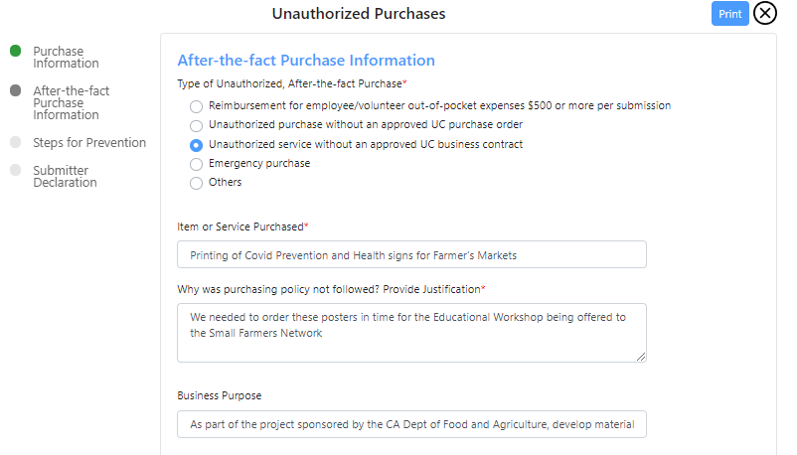
Unauthorized Purchases Form – Page 2
Select which item best describes your unauthorized purchase
Describe items or services purchased
Provide complete and detailed justification

Slide 17
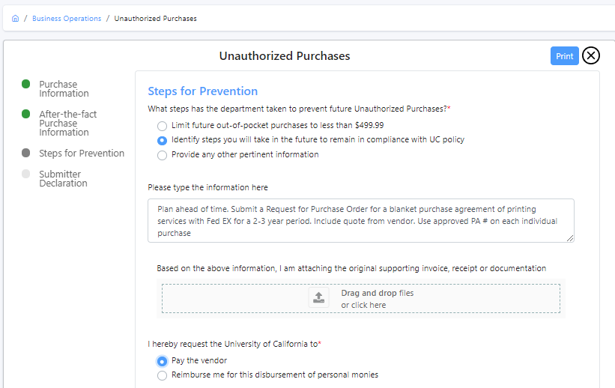
Unauthorized Purchases Form – Page 3
Describe what steps will be taken to prevent this unauthorized purchase in the future
Always upload backup: receipts/invoice

Slide 18
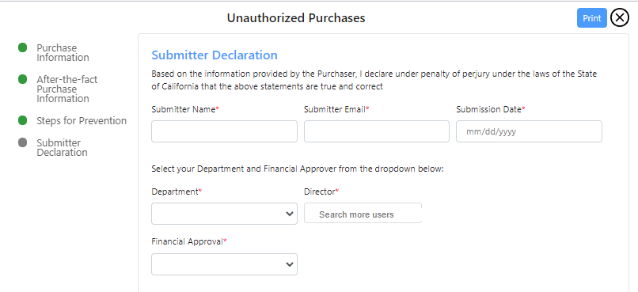
Unauthorized Purchases Form – Page 4
Enter Purchaser’s Department and Director for review and approval
Final Approval
ANR Controller
Select from options
UCCE – Su-Lin Shum
SWP – Joni Rippee
RECs – Heather Kawakami

Slide 19
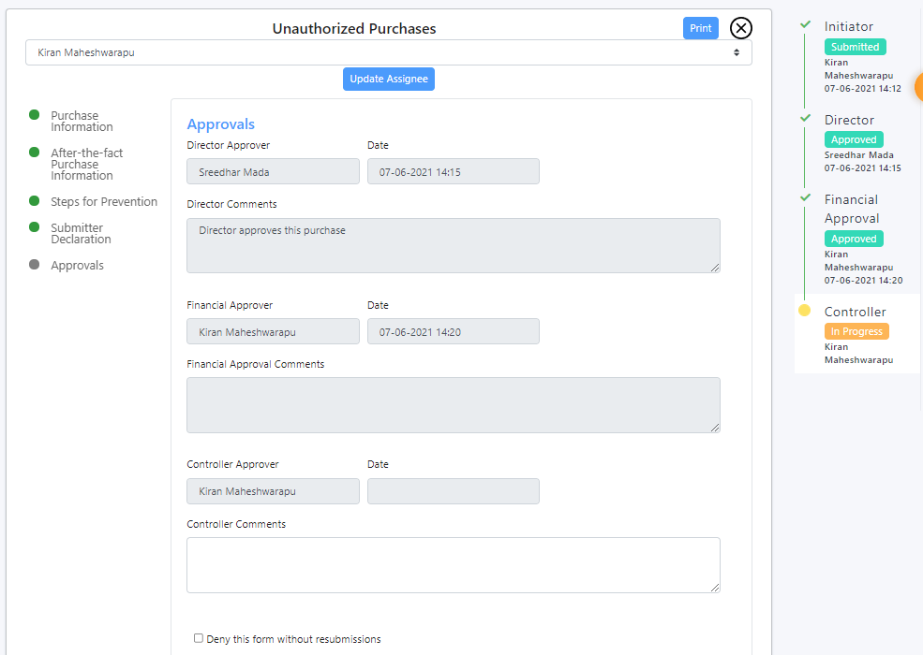
Unauthorized Purchases Form - Approvals
Time stamp Approvals
Controller has not approved yet.

Slide 20
Unauthorized Purchases Form
Check the dashboard to know status of form
Once fully approved, save as a pdf and include with the rest of the purchasing documentation
Final Approver is ANR’s Controller

Slide 21
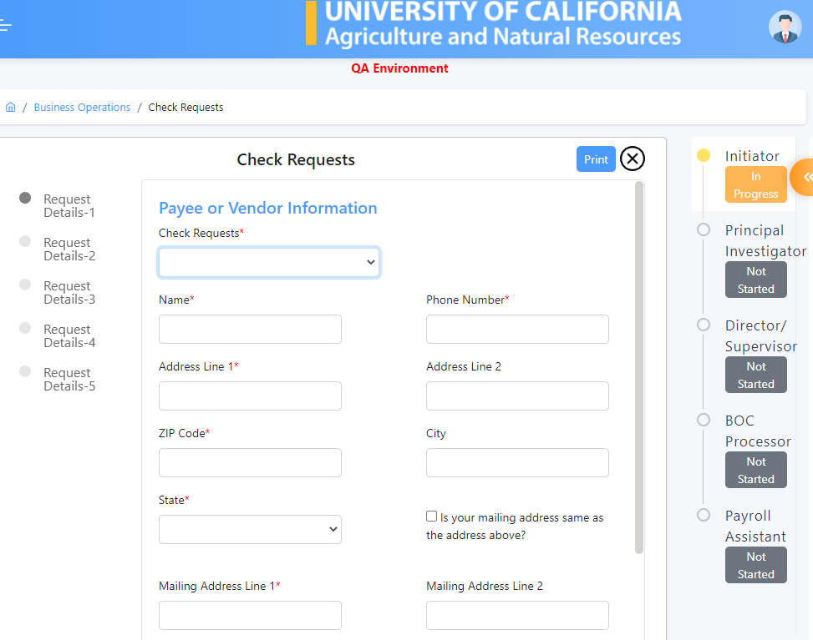
Check Request Form
Go to the Dashboard → Forms (from the left side of the screen)→ Select Department → Displays all forms under the department
Funding Change Request

Slide 22
Check Request Form – Page 1
Select Check Request Purpose:
  Reimbursements or Other (Utilities, Disposal, Communications, Metered Mail)
  Honorariums for non-employees
  Fellowship/Scholarship (includes Stipends)
  Entertainment Vendor Requests (includes Facility Use Agreements FUA)
All fields with red asterisk (*) are mandatory
Submitter Name is auto populated
Identify your approver – the person that used to sign the paper form. Usually the County Director for UCCE or Director for SWP or Director for REC.
If sponsored project – Enter the name of the Principal Investigator
Vendor Email Field Missing – Please add on Page 2 “Special Instructions” field
Notes:
Verify REC ~ I think each site Director currently approves
Currently in this version of the Check Request form there is no vendor email field, please add the vendor email under the “Special Instructions” field on page 2

Slide 23
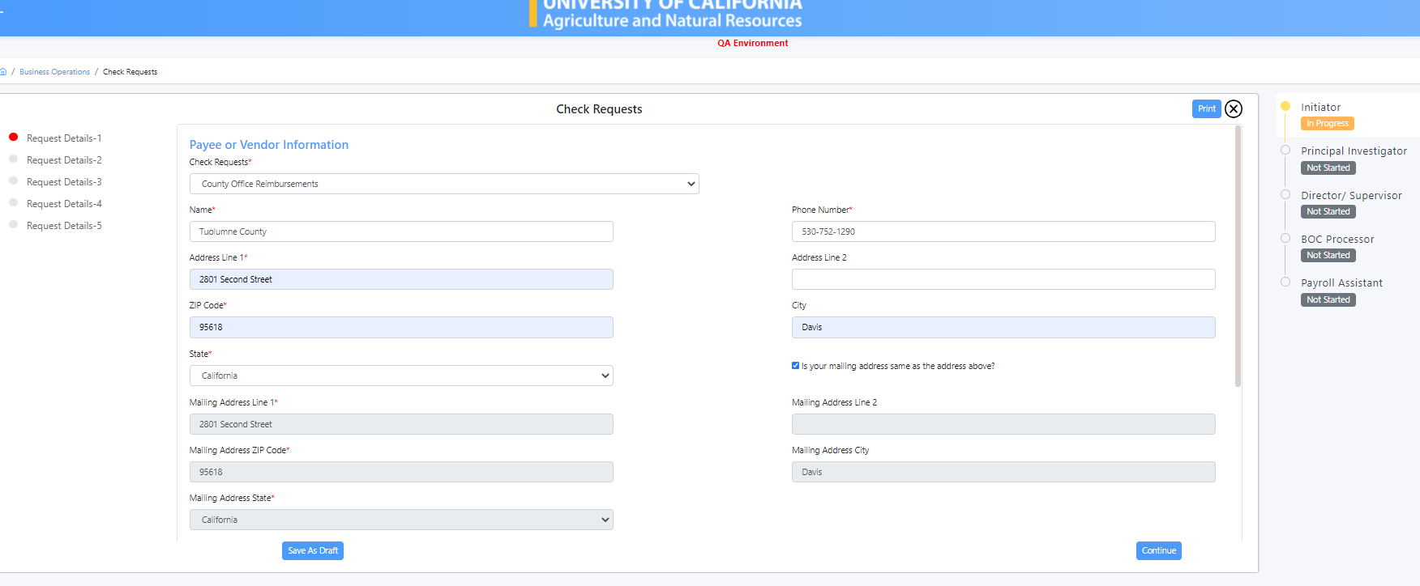
Check Request Form - Page 1
Form Routing
Form Pages

Slide 24
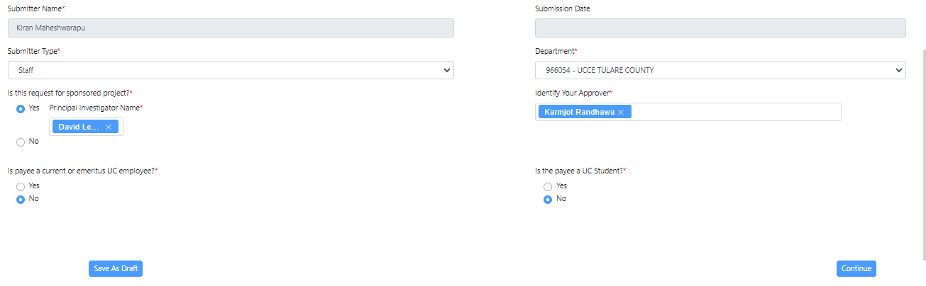
Check Request Form-Page 1
Pre-populated
If account to be used is an award, indicate Yes and enter the name of the PI.
These fields will usually be NO. Are applicable for Honorarium use

Slide 25
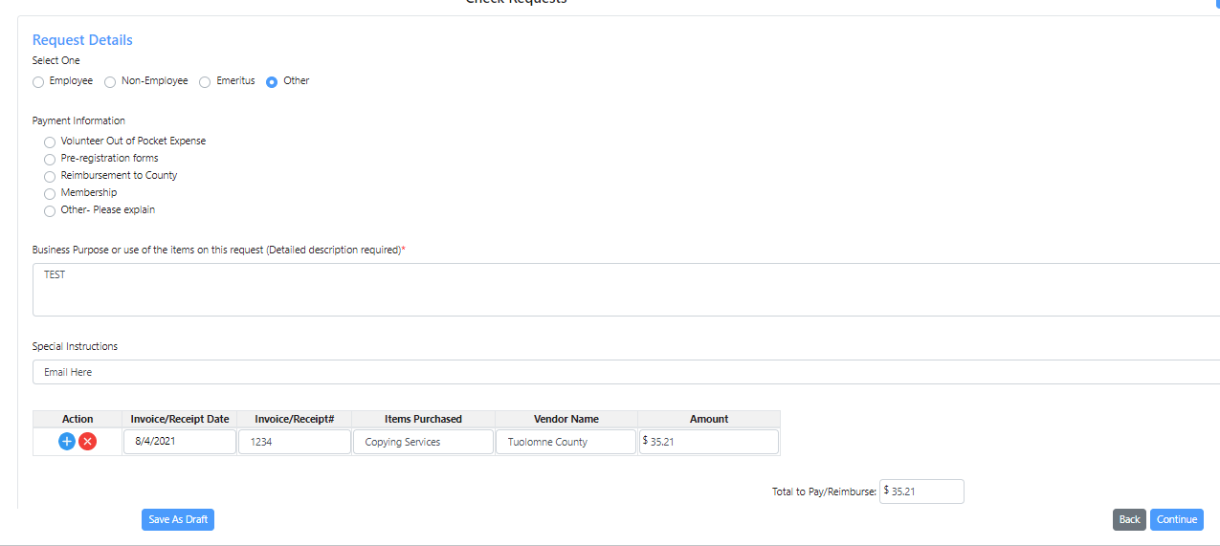
Check Request Form - Page 2
Use “Other” except for Honorarium or Fellowship/Scholarship
Select what best describes the type of payment.
Enter detailed purpose - if Honorarium, enter all event/lecture information here
Enter vendor email here or any additional information as needed
Auto calculates expense lines
Use (+) to add expense lines
Use (x) to delete expense lines

Slide 26
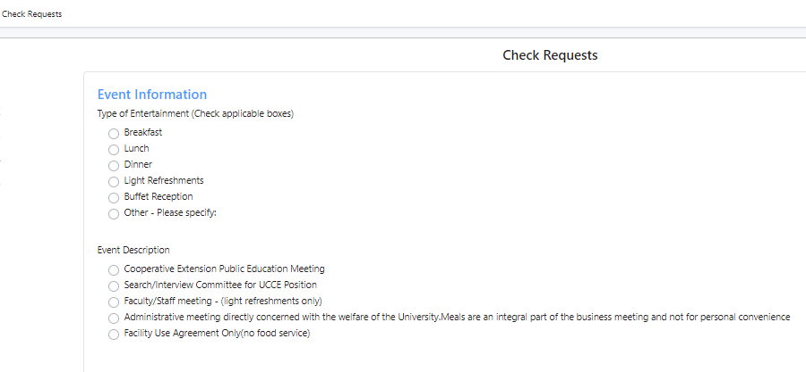
Check Request Form – Page 3
This page is used for Entertainment Vendor Check Requests. Leave blank if not applicable

Slide 27
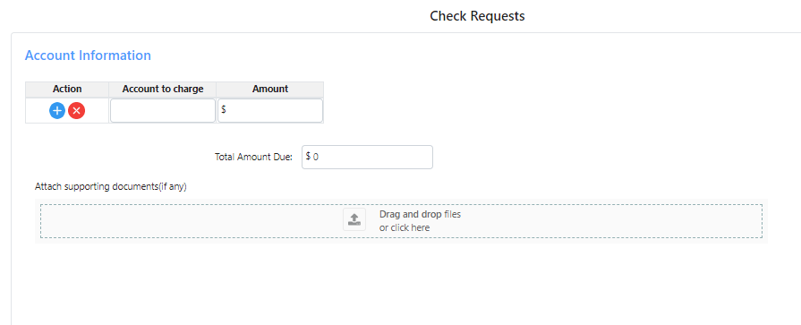
Check Request Form – Page 4
Enter account(s) to charge. Use (+) to add accounts.
Use (x) to delete accounts.
Total amount = Sum of all account lines
Always attach invoice and/or backup documentation.
Notes:
Next form reiteration the documentation upload will be mandatory

Slide 28
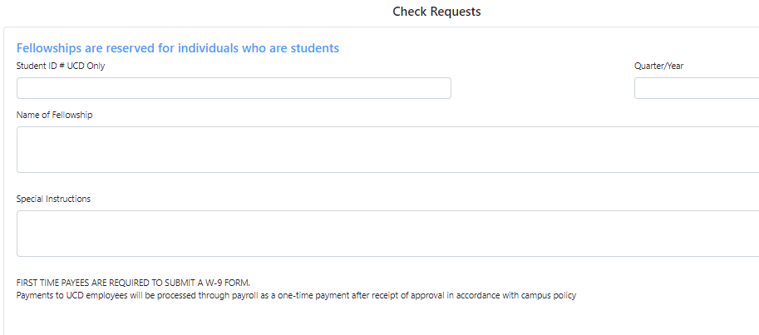
Check Request Form – Page 5
This page is used for Scholarships/Fellowships and Stipends. Please provide all pertinent information.

Slide 29
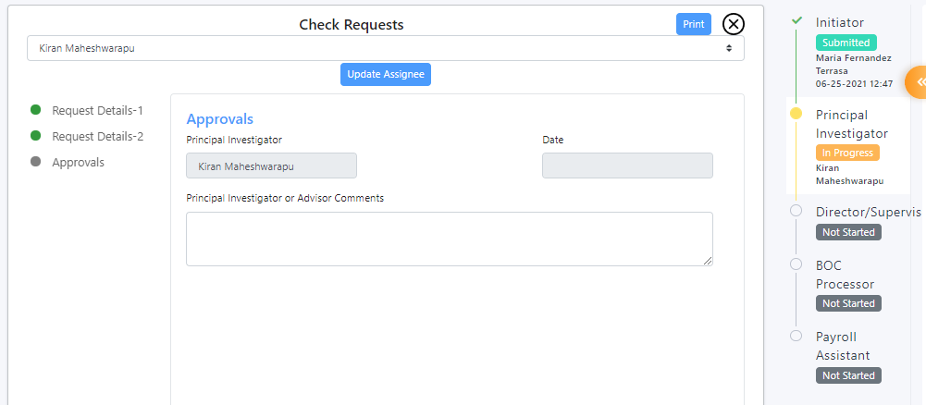

Certify/Approve Check Request Form
PI approval page in the case an award account is being used.

Slide 30
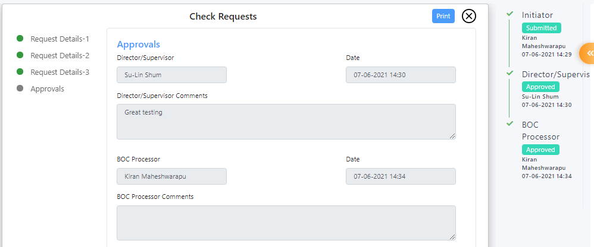
Certify/Approve Check Request Form – Final Approvals
Time stamp Approvals
Director Approval and comments
BOC Processor approval means Check request was submitted in KFS, Doc# will appear in the comments.

Slide 31
Check Request Form
Ends at the BOC Processor (Teams 1 to 5) to process in KFS
Ends with Payroll Assistant if Honorarium for an employee or fellowship for a student.
Once form is submitted by initiator, no changes/edits can be made by the initiator.
Approvers can make changes and write notes when they approve/reject.
Go to dashboard to check status of form, to read notes and/or comments from approvers.
BOC processor will include KFS Doc # in the notes – this will be your confirmation that the check request is completed.
Print to pdf as needed.

Slide 32
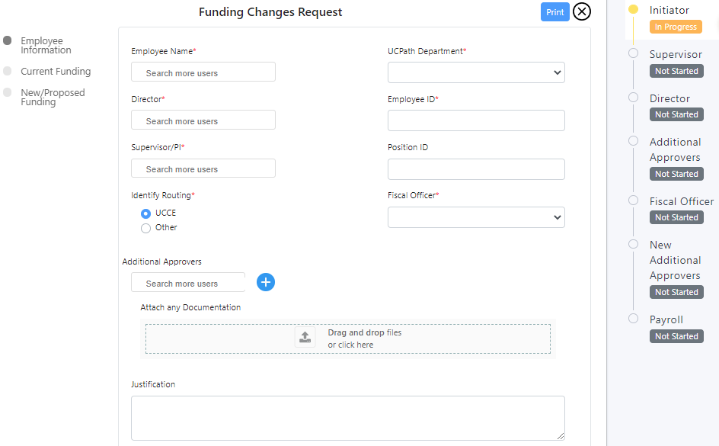
Funding Change
Request

Slide 33
Funding Change Request
Same process as the paper form: current and future funding
Include Employee ID and Position ID
Additional Approvers:
  Statewide Office Approval
  PI Approval
  Another Fiscal Officer
Justification – not a required field. As needed.
Attachments – not required.

Slide 34
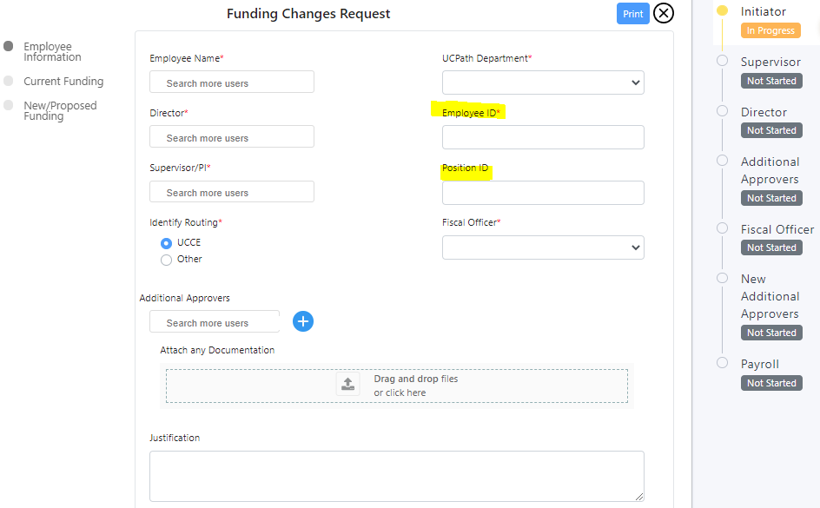
Funding Change Request – Page 1
Fiscal Officer:
UCCEs select your Team’s FO
Additional Fiscal Officers will be added depending on the accounts used
Other PIs, Statewide Program Director, other FOs
Form Routing

Slide 35
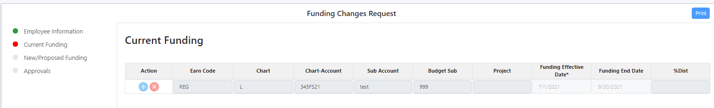
Funding Change Request – Page 2
02
Earn Code – REG
CHART – L
Budget Sub – 00 (SB06)
Budget Sub – 01 (SUBS)
Budget Sub – 02 (SUBG)
Project – Project code
Funding Effective Date
Funding End Date
% Distribution

Slide 36
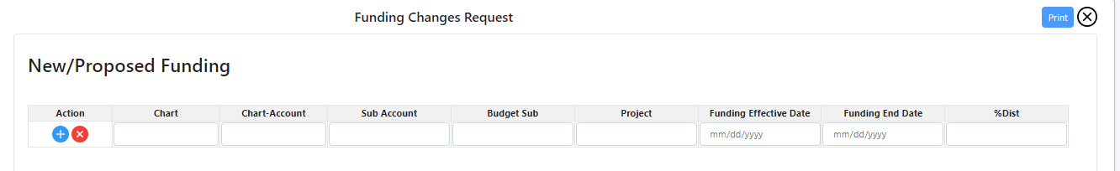
Funding Change Request – Page 3
Earn code – no longer required
Funding Effective Date – Do not use a past date prior to the current Pay period
Funding End Date – Leave blank if the funding account does not change (i.e. EFNEP, County Support account, Central Budget Account)

Slide 37
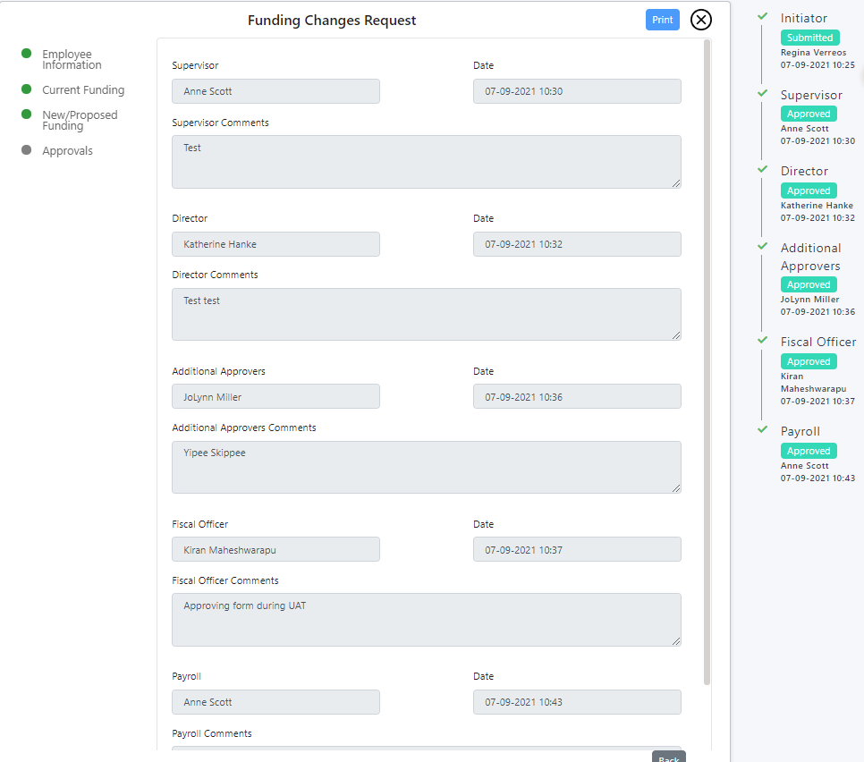

Funding Change Request - Approvals
Ends with Payroll – confirmation of task completed

Slide 38
RESOURCES

Slide 39
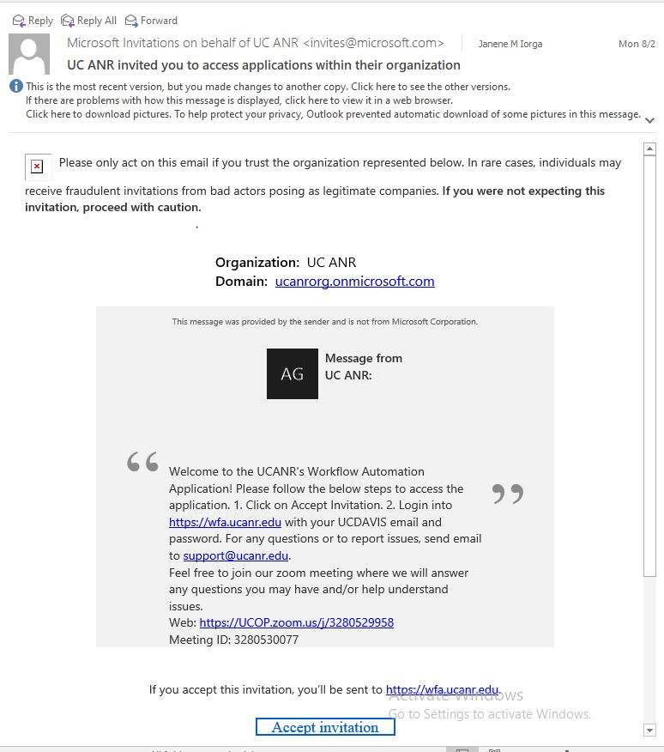
WFA Invitation Email
Notes:
This is the invitation email ~ Please check you spam/junk email folder to make sure it isn’t there.
Send request for invitation to support email

Slide 40
ZOOM OFFICE HOURS
August 13
1:00pm to 3:00pm
August 16 to August 20
8:30am to 10:30am
Join Zoom Meeting – OFFICE HOURS
https://ucanr.zoom.us/j/98919189617?pwd=TVZKZWtmcXl2Z29XcjVFTDZQNmFOQT09
Meeting ID: 989 1918 9617
Passcode: 179192
One tap mobile
+16699006833,,98919189617# US (San Jose)
+13462487799,,98919189617# US (Houston)

Slide 41
Links to websites:
Workflow Automation Application: https://wfa.ucanr.edu/
Risk and Services Forms Quick Guide: https://ucanr.edu/sites/risk/files/355669.pdf
Contracts and Grants Quick Guides:
  Advance Account Request: https://ucanr.edu/sites/anrstaff/files/355661.pdf
  Form 800: https://ucanr.edu/sites/anrstaff/files/355662.pdf
BOC Quick Guides and Presentation Slides:
  County Directors/Office Managers Collaborative Tools Group
  Business Managers Collaborative Tools Group
  BOC website

Slide 42
Questions? Contact your BPT Team:
Team 1: boc-uccepartner1@ucanr.edu
Team 2: boc-uccepartner2@ucanr.edu
Team 3: boc-uccepartner3@ucanr.edu
Team 4: boc-uccepartner4@ucanr.edu
Team 5: boc-partner5@ucanr.edu
THANK YOU!

